Slide 1
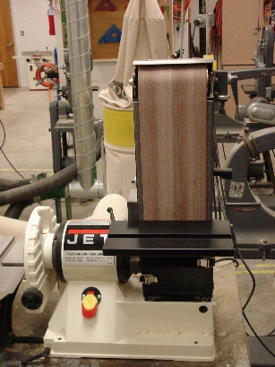
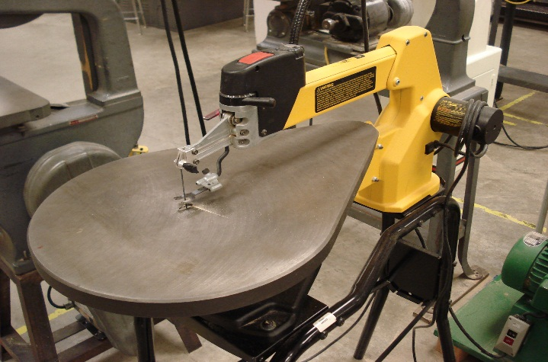
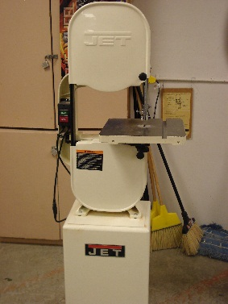
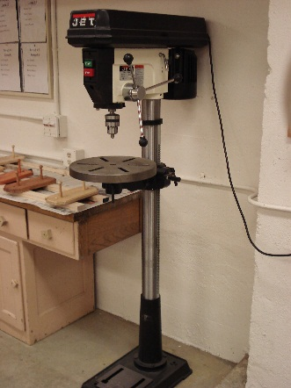
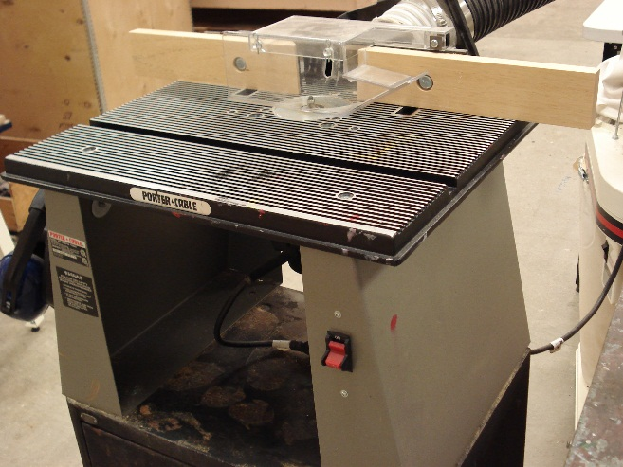
General Safety Rules
Power Tools

Slide 2
Industrial Technology General Safety Rules
Safety Glasses must be worn at all times.
Long hair must be pulled back when working with power tools.
Long sleeves must be rolled up when working with power tools.
The minimum distance your hands or fingers can be to any piece of equipment is 3 inches.
Loose clothing or jewelry can’t be worn when using any power tools.
Open toed shoes are not allowed in the shop when working on a project.
The first thing you should do if something goes wrong on one of the machines you are using is Shut it off.
1 person should be in the safety zone at a time.
The general speed you use a machine is Slowly.

