Slide 1
Chapter 17.2
Heating the Atmosphere

Slide 2
Heat vs. Temperature
1. Heat
Total amount of energy possessed by molecules.
Flow of thermal energy from a hot object to a cold object by conduction convection or radiation.
Measured in calories or Joules
2. Temperature
Average kinetic energy (energy of motion) of particles
Measured in degrees Fahrenheit, Celsius, or Kelvin
heat vs temperature

Slide 3
Two ways to change Air Temperature
1. Increase heat
2. Reduce volume

Slide 4
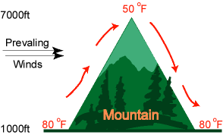
Adiabatic Temperature Change
Temperature decreasing as altitude increases due to a decrease in pressure
When the pressure applied on a parcel of air is reduced, the air in the parcel is allowed to expand; as the volume increases, the temperature falls as its internal energy decreases.
Adiabatic cooling occurs in the Earth's atmosphere with orographic lifting

Slide 7
Energy Transfer as Heat
1. Conduction
Transfer of heat through matter by molecular activity

Slide 8
Energy Transfer as Heat
1. Conduction continued
Some materials conduct heat more efficiently than others.
Materials that do NOT conduct heat as well could be considered insulators (a barrier between rapid conduction and the surrounding environment).

Slide 9
Energy Transfer as Heat
2. Convection
Transfer of heat by mass movement or circulation within a substance that acts like a fluid.

Slide 10
Energy Transfer as Heat
3. Radiation
Heat traveling outward in all directions.
All object emit radiant energy
Hotter object emit more radiant energy
Hotter bodies emit shorter wavelengths
Objects that are good absorbers are good emitters

Slide 11
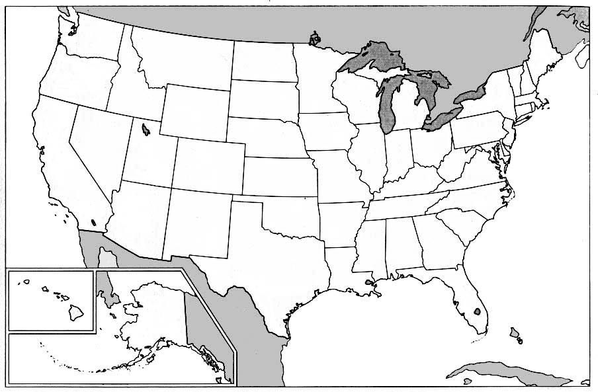
Eureka, CA
Lafayette, IN

Slide 12
Chapter 17.3
Temperature Controls

Slide 13
Heating Land vs Water 5-FACTORS
Specific Heat – how a substance responds to the input/output of heat.
Heat required to raise the temperature of 1 gram of a substance 1 degree Celsius (C).
Examples:
Pure water has a specific heat value of 1.0.
ie: 1 calorie of heat applied to 1 gram of pure water will raise the temperature of that water 1 degree C.
Dry sand = .19
Concrete = .2
If dirt has a specific heat of .25 we would say that dirt heats up four times faster than water.

Slide 14
Heating Land vs Water 5-FACTORS
2. Land is Opaque – Not able to be seen through.
Light won't shine through very much dirt.
Solar radiation is concentrated on the surface thus heating it quicker.
Air closest to the surface is heated by the process of conduction because the air molecules are close enough to be considered in “contact” with the surface.

Slide 15
Heating Land vs Water 5-FACTORS
3. Water is Translucent
Solar radiation can penetrate deeper into water.

Slide 16
Heating Land vs Water 5-FACTORS
4. Water is Mobile
Water is highly mobile -- constantly mixing upward and downward due to convection currents.
Because water molecules are in constant motion, it takes longer for solar radiation to uniformly raise the temperature of a given body of water.

Slide 17
Heating Land vs Water 5-FACTORS
5. Evaporation
Greater over water than over land.
Because energy is needed for the evaporation process, the energy used is not available for heating. Thus water heats up much slower than land.

Slide 19
Heating Land vs Water
Land and Sea Breezes

Slide 20
Heating Land vs Water
Land and Sea Breezes
Recall: If an object heats up quickly it will also cool down quickly

Slide 21
What happens to solar radiation?
Reflection and Scattering
Reflection occurs when electromagnetic waves bounce off an object.
Reflection does not change radiation energy level.
Scattering produces many weak rays.
Half of radiation on Earth comes from scattered light.

Slide 22
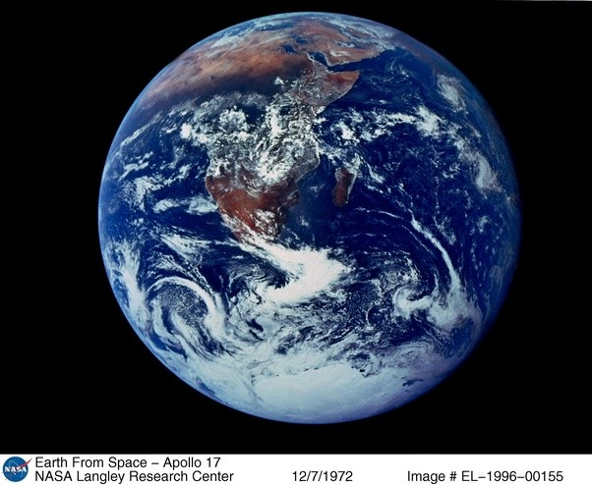
What happens to solar radiation?
Reflection and Scattering cont.
c. Albedo – measure for reflectance or optical brightness (Latin, "whiteness") of a surface.
Two main contributors to Earth’s albedo.
Clouds
Polar Ice Caps

Slide 23
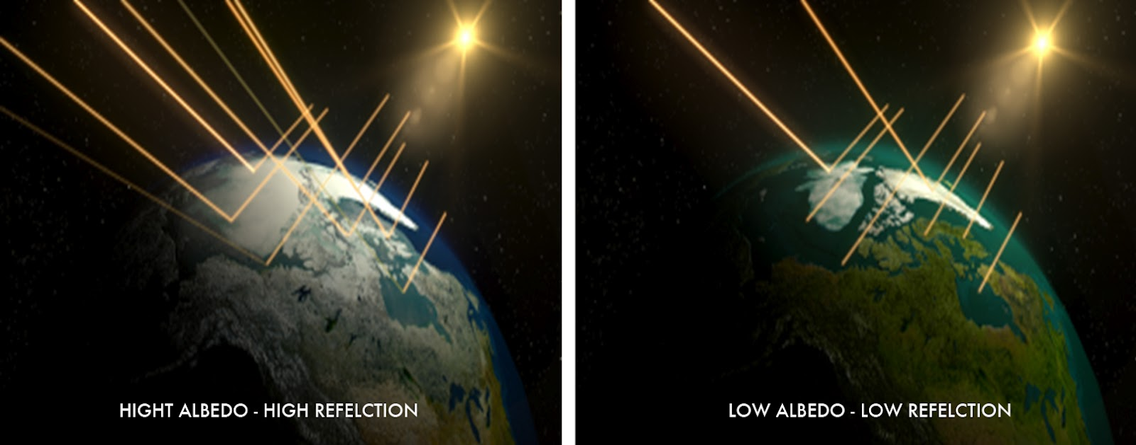

Slide 24
What happens to solar radiation? cont.
Absorption
50% of solar energy reaches Earth’s surface.

Slide 25
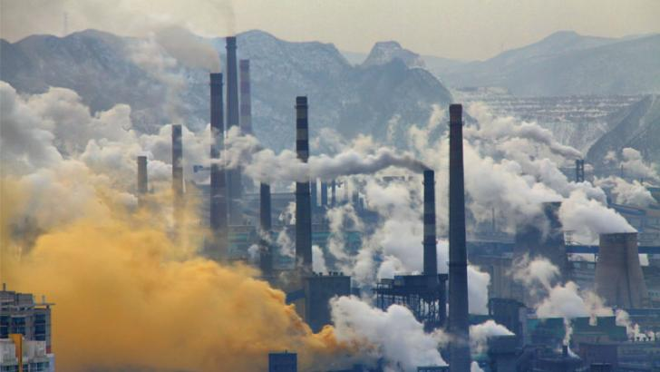
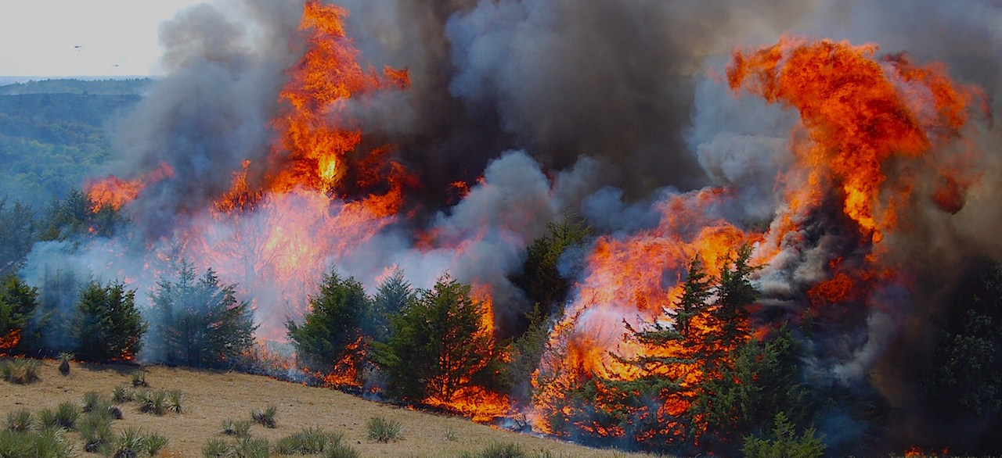
Greenhouse Effect
The Greenhouse Effect
• The greenhouse effect is a natural warming of both Earth’s lower atmosphere and Earth’s surface from solar radiation being absorbed and emitted by the atmosphere.
Two Primary Greenhouse Gasses
Carbon Dioxide, Water Vapor
Carbon Dioxide = 0.039% of gas that makes up clean dry air
Carbon Dioxide – transparent to short-wavelength solar radiation
absorbs and reemits many longer-wavelength radiation

Slide 26
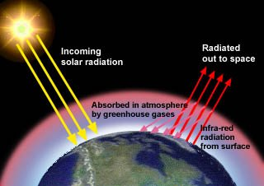
Greenhouse Effect
Trace Gasses
- Absorb outgoing radiation that would otherwise escape into space.
• Methane (CH4)
• Nitrous Oxide (N2O)
• Chlorofluorocarbons (CFCs)

Slide 27
Atmospheric Pressure - force exerted by atmospheric gas molecules on a given area
When air masses move around the earth due to differential heating, this value can change.
Elevation also changes the value of atmospheric pressure.
Atmospheric pressure is often called barometric pressure, as it is measured with a barometer.
https://www.youtube.com/watch?v=EkDhlzA-lwI

Slide 28
Atmospheric pressure units
Atmospheric pressure is often measured in millibars
(1000 mb = 1 bar).
Standard pressure at sea level is approximately 1000 mb.
American pilots and TV weatherman express atmospheric pressure in “inches mercury” where 29.9 inches = standard pressure at sea level.

Slide 29
Measuring barometric pressure – the modern way
Mercury barometers are dangerous and difficult to use.
Modern aneroid barometers use changes within a partially evacuated chamber to move the pointer to the correct value.

Slide 30
Pressure and wind
Wind – movement of air from high to low pressure areas.
Wind is caused by pressure differences due to unequal heating of Earth’s atmosphere

Slide 31
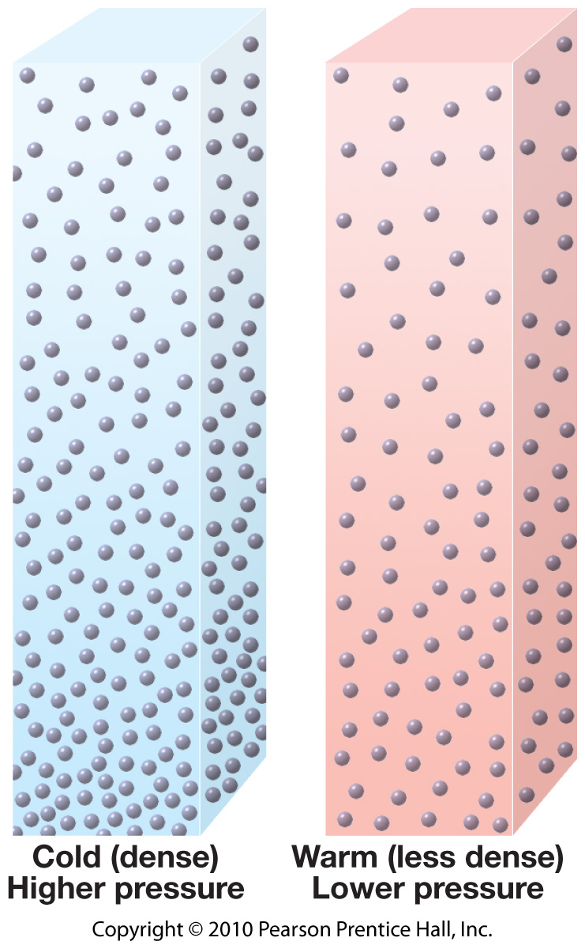
Cold air
(dense)
Higher Pressure
Warm air
(less dense)
Lower Pressure
Air Pressure
Air Pressure
Air Pressure
Air Pressure
Graph A
Graph B
Graph C
Graph D
Altitude
Altitude
Altitude
Altitude

