Slide 1
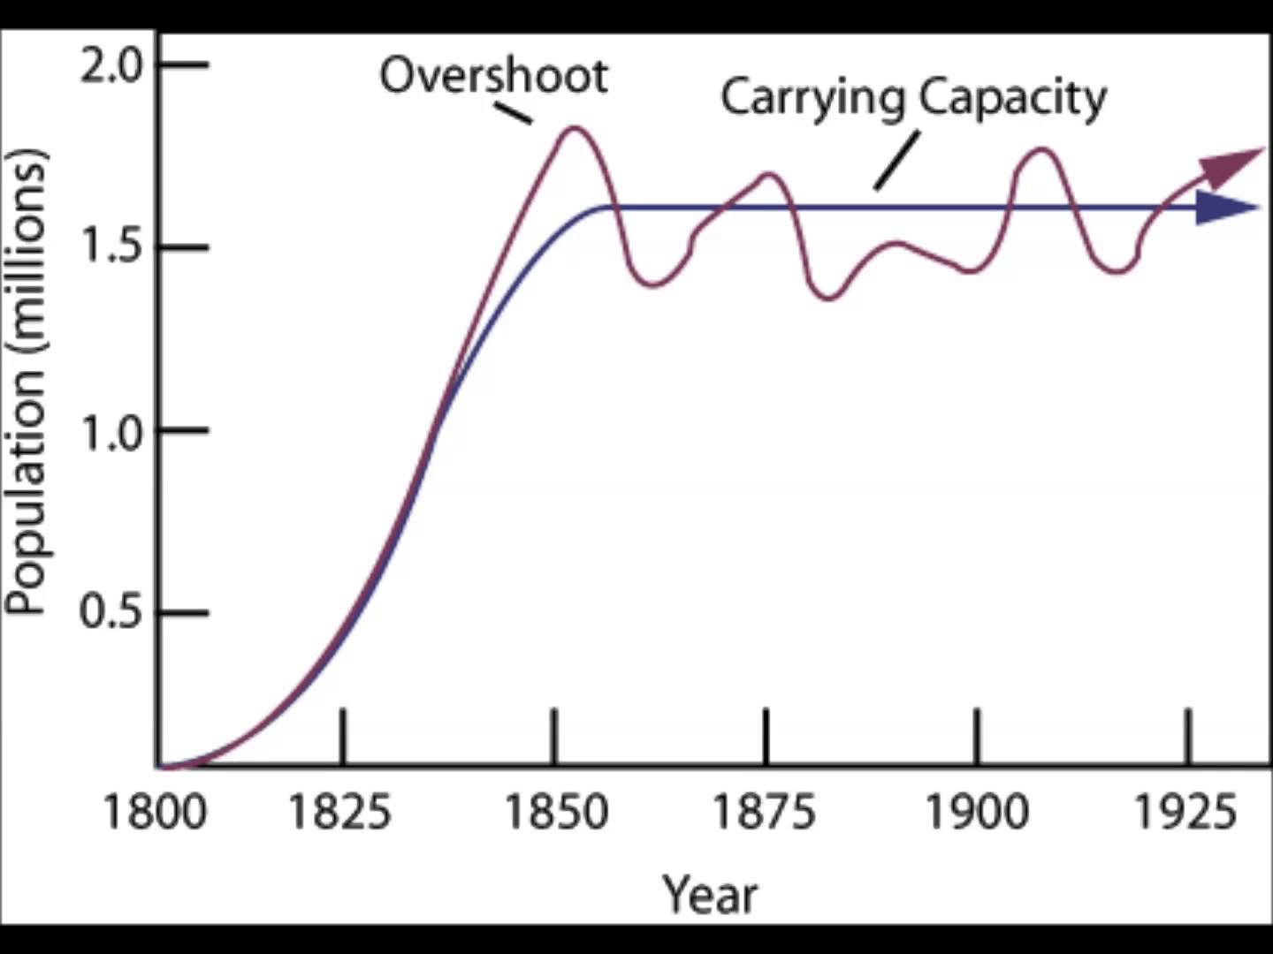
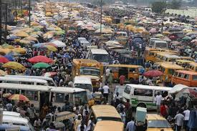
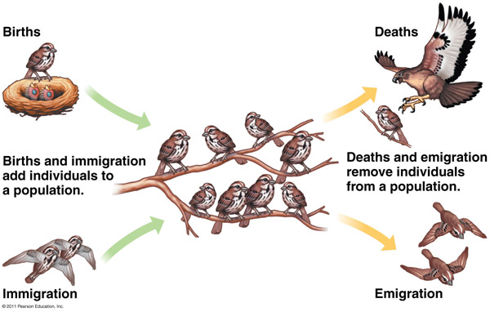
Population Dynamics
https://www.youtube.com/watch?v=ZaOe_pBEgSE

Slide 2
Population Dynamics:
Impact of birth rate and death rate on population growth
b = birth rate = 0.5 d = death rate = 0.25

Slide 3
The relationship between a barnacle attaching itself to the skin of a whale is often considered a form of symbiosis called ______________.
Parasitism
Mutualism
Commensalism

Slide 4
Which of the following is considered a keystone species in coastal waters of the Pacific Northwest?
Sea Urchins
Kelp
Sea Otter
Starfish

Slide 5
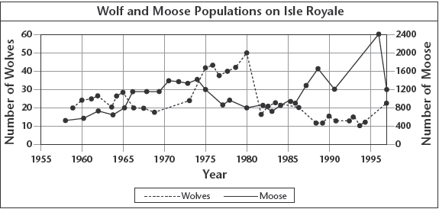
What is the most likely cause of the decrease in wolf population immediately after 1980?
(CPV) outbreak, Density Independent Factor
(CPV) outbreak, Density Dependent Factor

Slide 6
Which of the following is a density-independent limiting factor?
A struggle for food, water, space, or sunlight
Predator/prey relationships
The eruption of a volcano
Parasitism and disease

Slide 7
Why are wildfires a density independent limiting factor?
Because it happens whether there are 10 animals living in an area or 1000 animals
Because it changes rates if there are more animals
Because it changes rates if there is a higher population density

Slide 8
The relationship between a barnacle attaching itself to the skin of a whale is often considered a form of symbiosis called ______________.
Parasitism
Mutualism
Commensalism

Slide 9
Which of the following is considered a keystone species in coastal waters of the Pacific Northwest?
Sea Urchins
Kelp
Sea Otter
Starfish

Slide 10
What is the most likely cause of the decrease in wolf population immediately after 1980?
(CPV) outbreak, Density Independent Factor
(CPV) outbreak, Density Dependent Factor

Slide 11
Which of the following is a density-independent limiting factor?
A struggle for food, water, space, or sunlight
Predator/prey relationships
The eruption of a volcano
Parasitism and disease

Slide 12
Why are wildfires a density independent limiting factor?
Because it happens whether there are 10 animals living in an area or 1000 animals
Because it changes rates if there are more animals
Because it changes rates if there is a higher population density

Slide 13
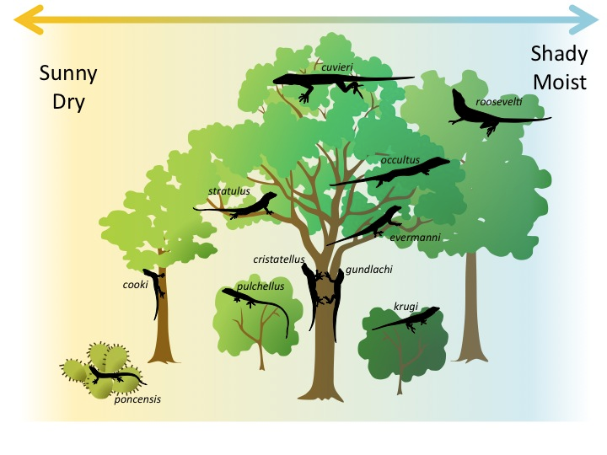
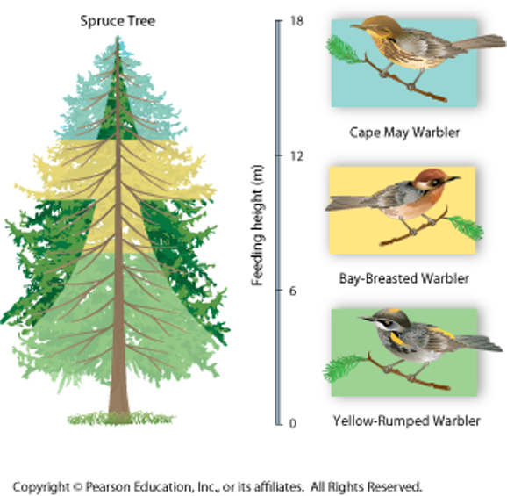
Niches and Community Interactions
Community

Slide 14
Niche
Why do these warblers live in different parts of the tree?​
Community

Slide 15
Niche
Range of physical and biological conditions in which a species lives​
​Every niche has a combination of specific…​
Resources​
Physical (abiotic) aspects​
Biological (biotic) aspects

Slide 16
Factors that Effect Biological Diversity
1. Competition
Competition shapes a community​
Competitive Exclusion Principle
No two species can occupy exactly the same niche in exactly the same habitat at exactly the same time-

Slide 17
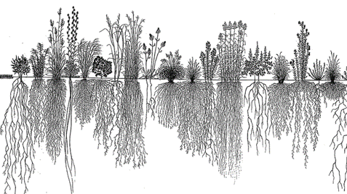
1. Competition
Competition divides the resources​:
Helps determine the number of species
and type of species in a community

Slide 18
1. Competition
Example​: Mountain meadow after introduction of an Invasive Species
Noxious weed monocultures fill all niches for soil nutrients and water. Consequently choking out most native plants
Healthy plant communities include diverse species with root systems occupying all niches for soil nutrients and water.

Slide 19
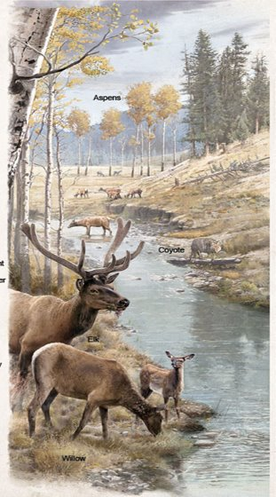
2. Herbivory – Plant Relationships
Herbivores can affect:
the size and distribution of plant populations in a community
the places that certain plants can survive and grow.

Slide 20
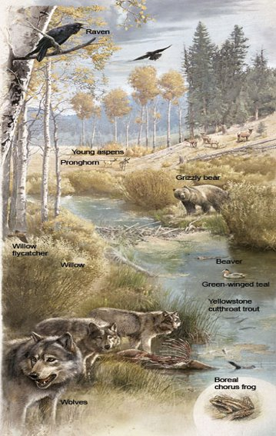
3. Predator – Prey Relationships
Predators affect:
the size of prey populations in a community
the places prey can live

Slide 21
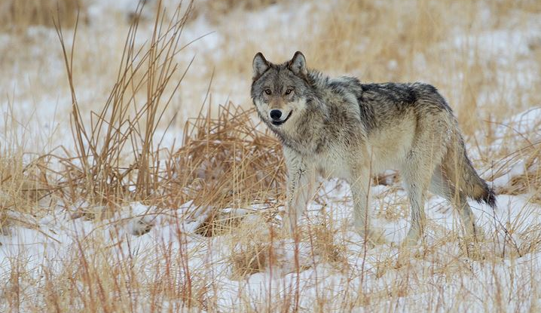
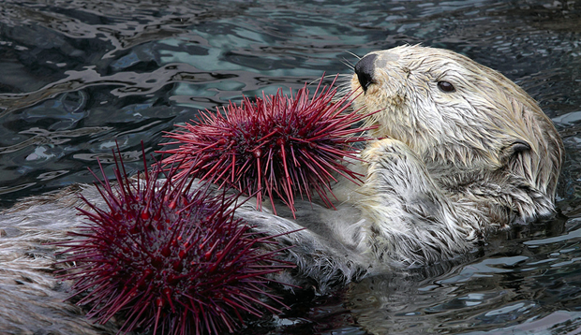
z
Keystone Species
a species on which other species in an ecosystem largely depend, such that if it were removed the ecosystem would change drastically.

Slide 22
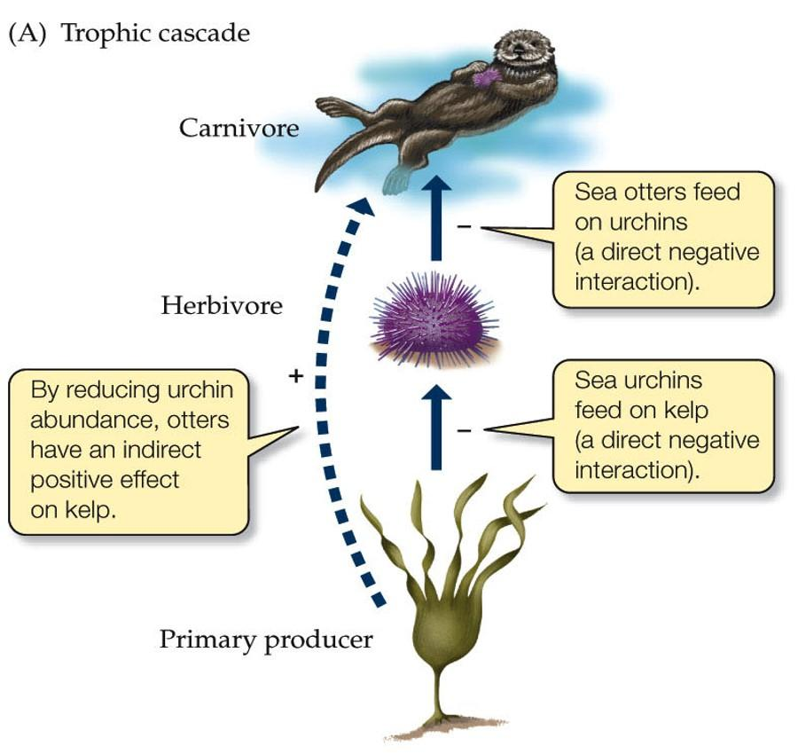
Trophic Cascade
direct and indirect effects from a species at or near the top of the food chain propagate down and regulate the species and population sizes in the rest of the community.

Slide 23
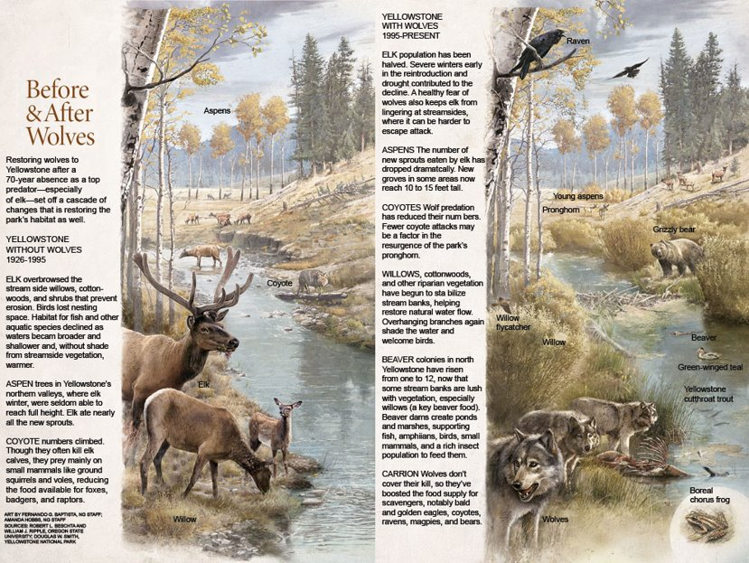
How Wolves Change Rivers

Slide 24
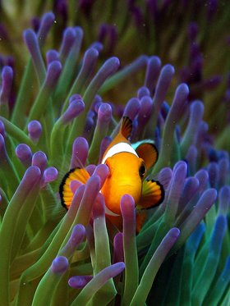
Symbiosis & Interspecies Interactions
Mutualism- both organisms’ benefit. (Cow birds)​
Commensalism- one organism benefits and the other is unharmed. (Nemo)​
​
Parasitism- one organism benefits and the other is harmed. (pine beetles)

Slide 25
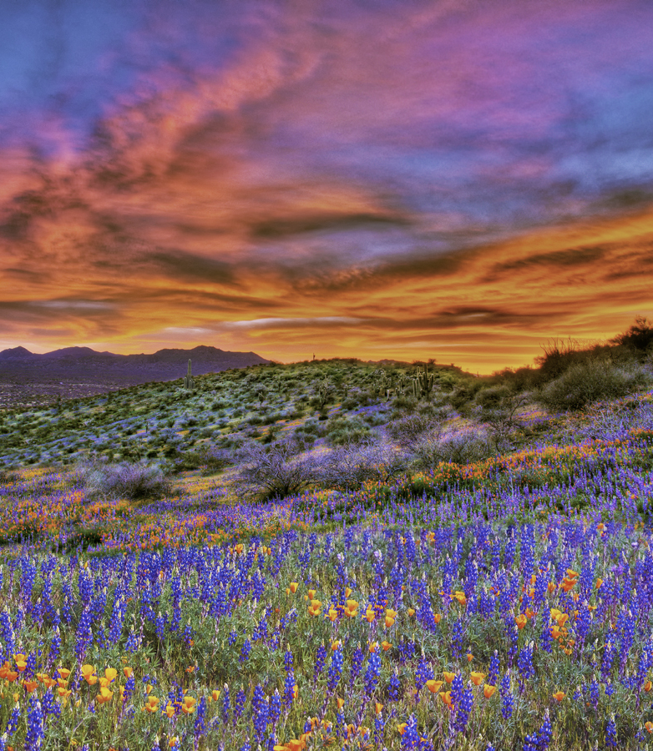
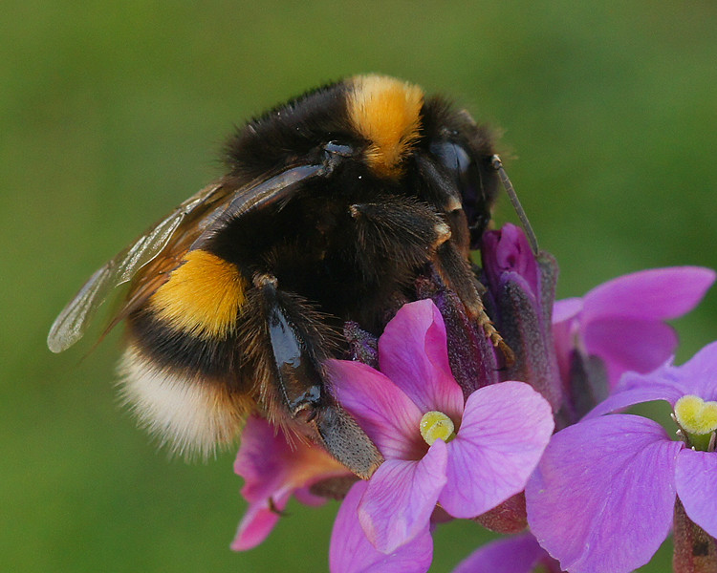
Chapter 5 Populations

Slide 26
z
5.1 & 5.2
Populations & Growth

Slide 27
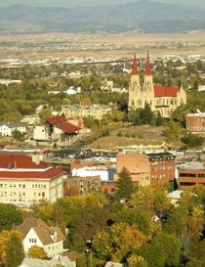
Describing Populations
z
What is the population of Helena, MT? ​
What factors go into answering this question?​
Population: group of individuals of the same species that live in the same area

Slide 28
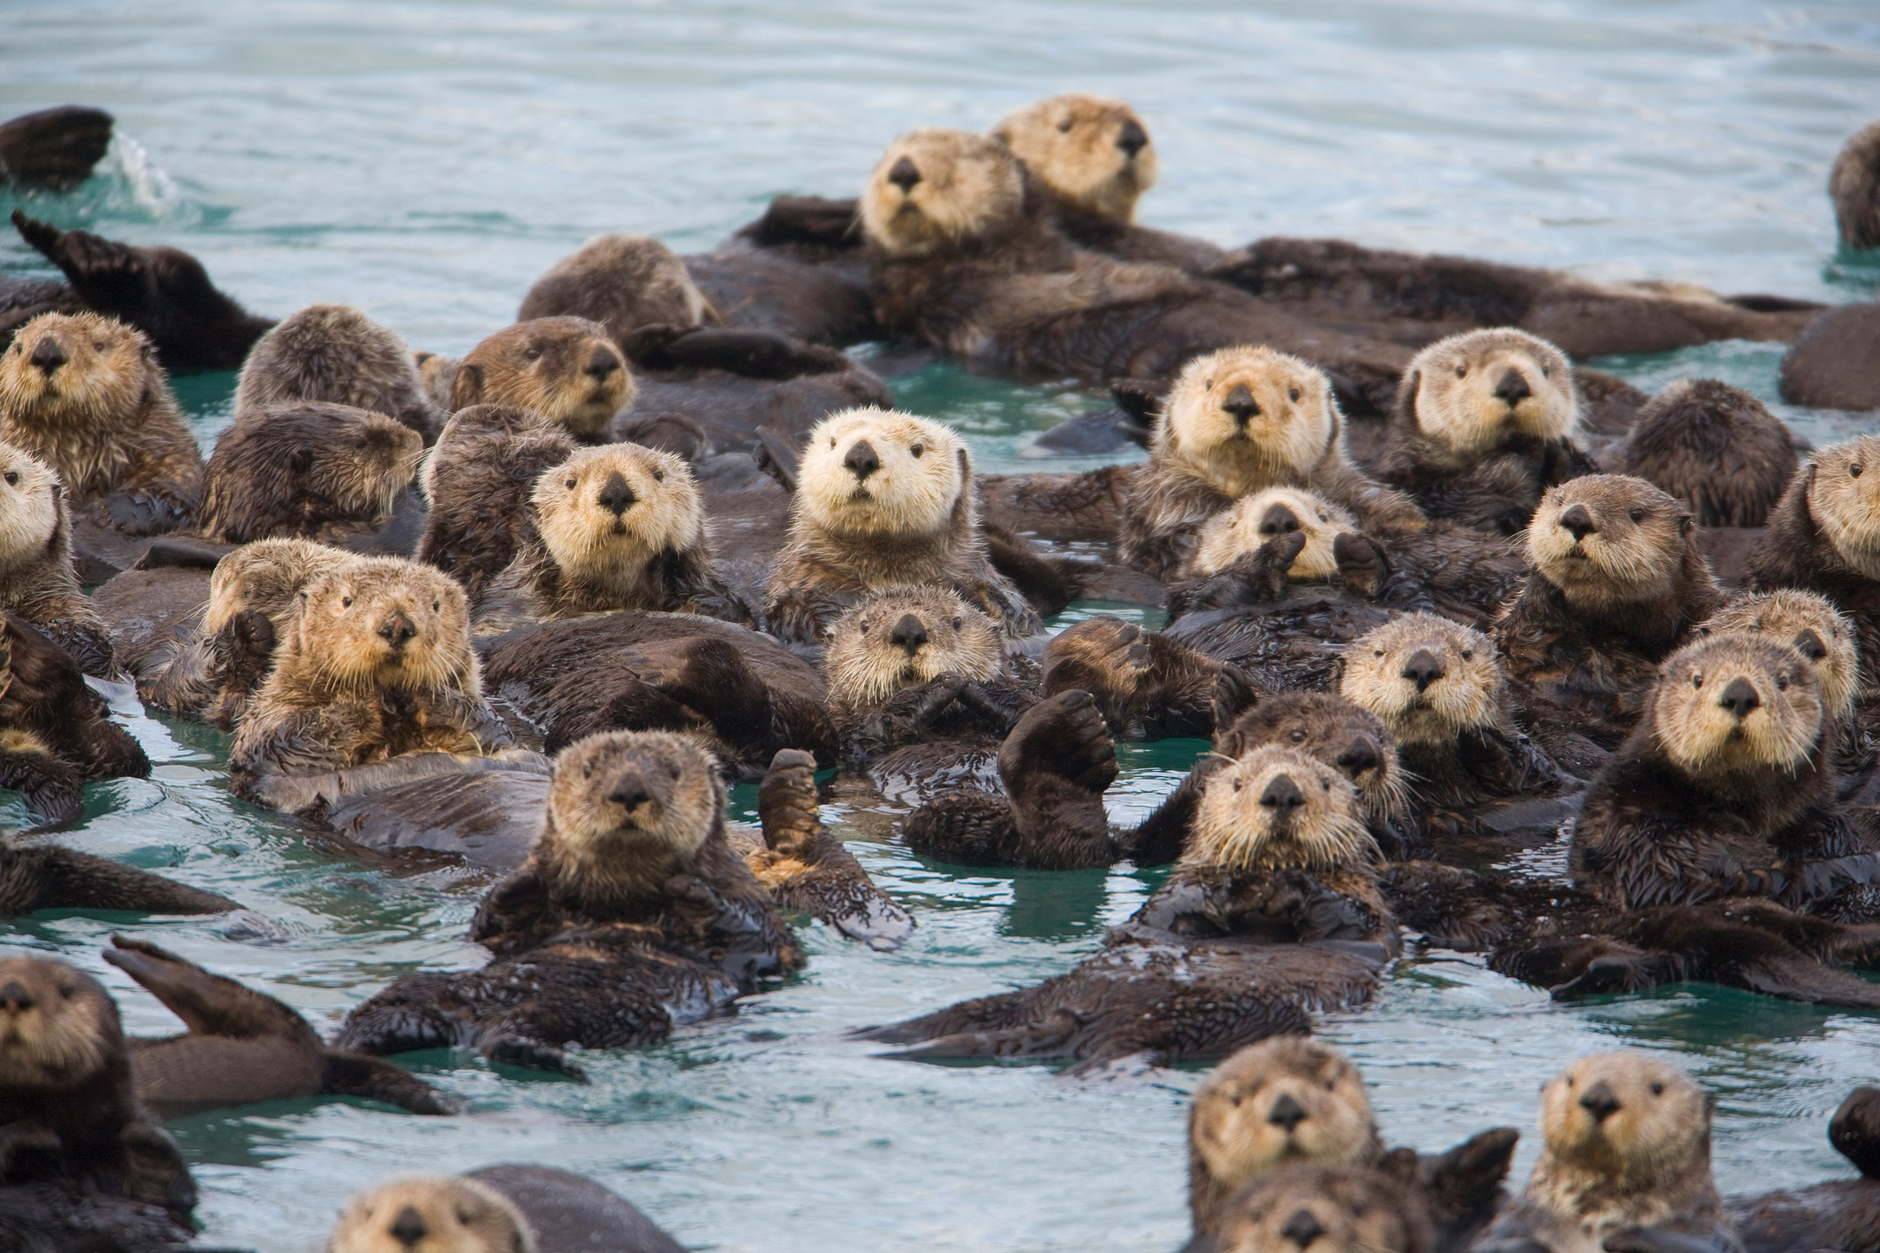
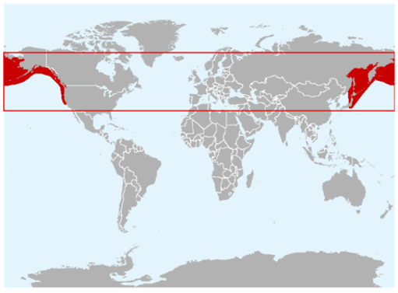
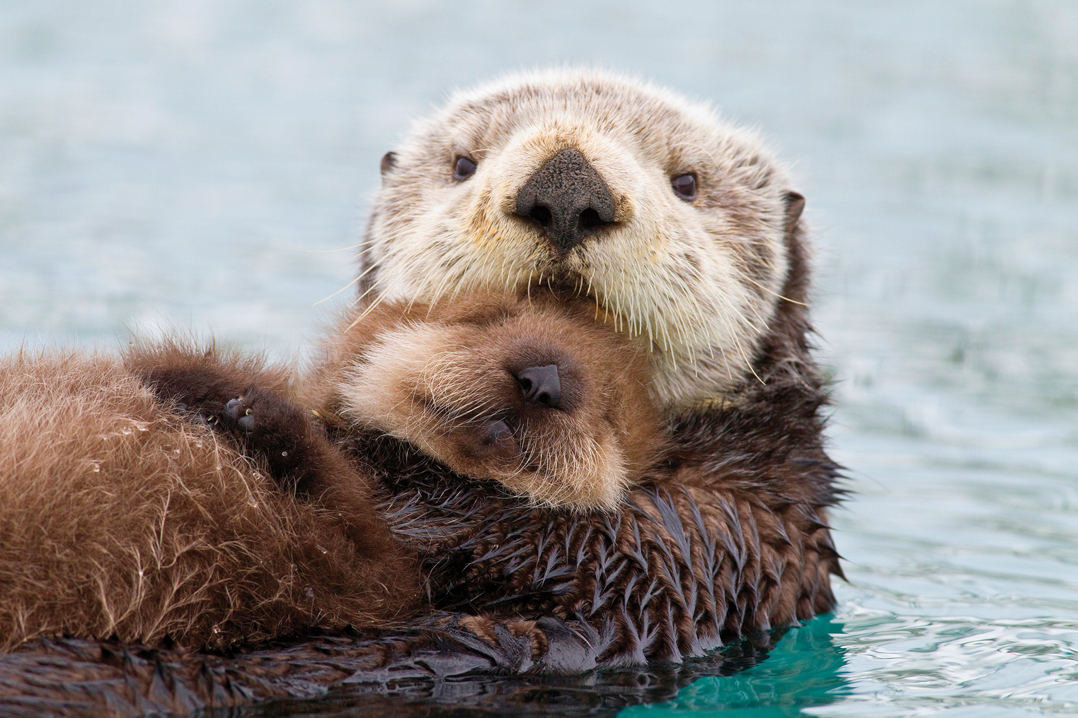
How Ecologists Describe Populations
3 Main Factors
1. Geographic Range​: Area inhabited by the population

Slide 29
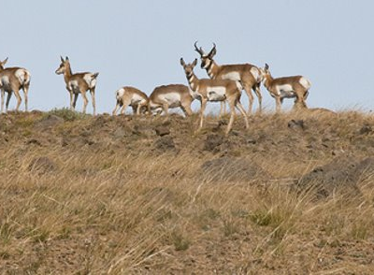
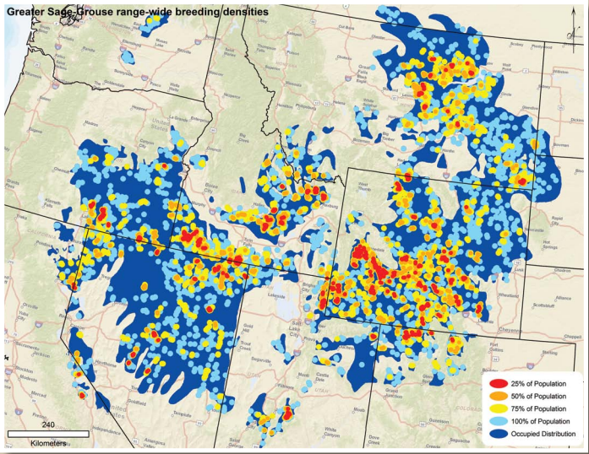
How Ecologists Describe Populations
3 Main Factors
z
2. Growth Rate​ / Density of Population
Is the population increasing, decreasing or staying constant?
How many individuals in an area?

Slide 30
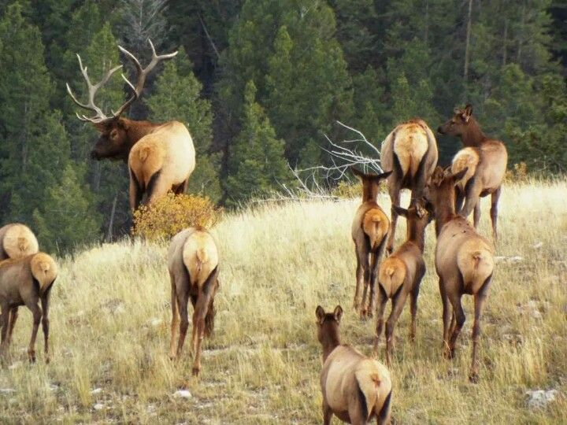
How Ecologists Describe Populations
3 Main Factors
3. Age Structure​
How many males / females
Age distribution

Slide 31
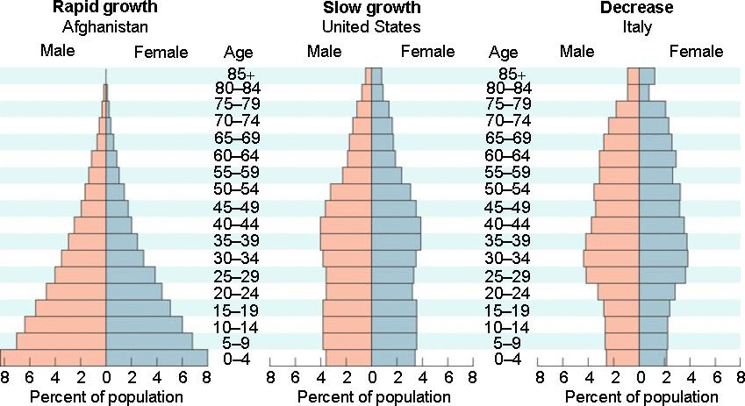
Example: Human Age Structure​

Slide 32
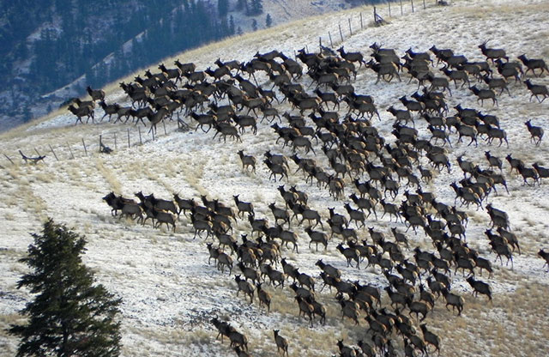
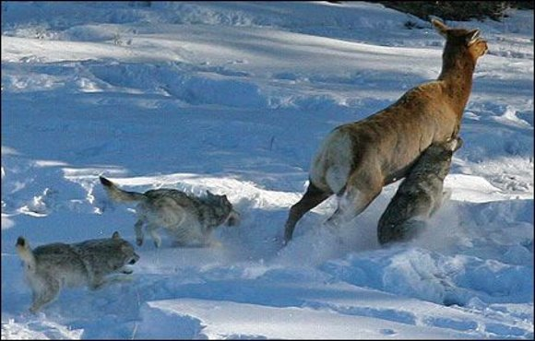
Population Growth

Slide 33
Factors Effecting Growth
Birth / Death rates​
​
​
​
​
​
​
Immigration: Moving into a habitat​
Emigration: Moving out of a habitat

Slide 34
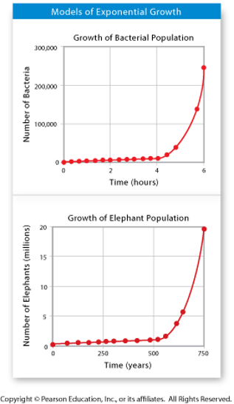
Exponential Growth
Almost any organism provided with ideal conditions for growth and reproduction will experience a rapid increase in its population (Example - Humans!)

Slide 35
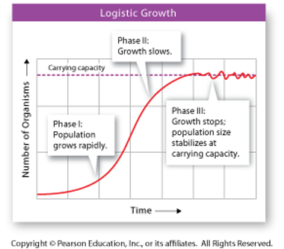
Logistic Growth
Most organisms go through 3 growth phases
Phase 1 – population grows rapidly
Phase 2 – growth slows
Phase 3 – population size stablizes
​
Carrying ​capacity
the steady state of ​population size.
Limited by…
Food availability
Competition

Slide 36
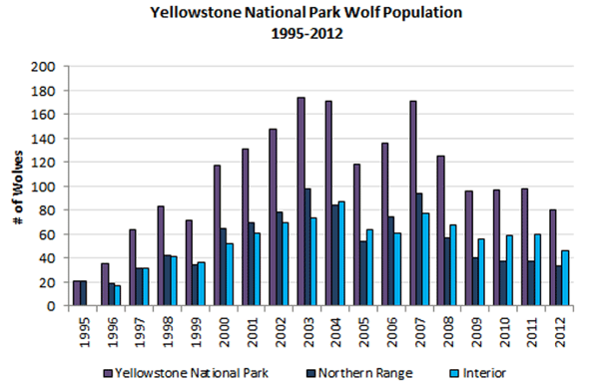
Population Growth before & after Carrying Capacity

Slide 37
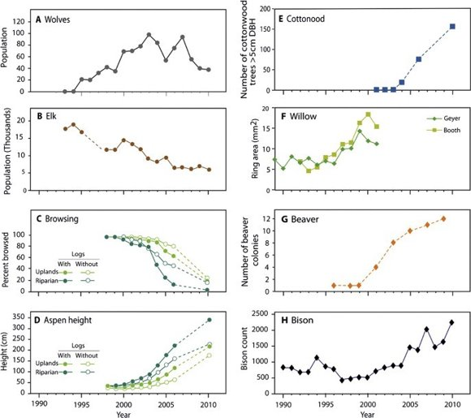
Population Interdependence
Table from Ripple and Beschta 2012. Trophic Cascades in Yellowstone: The first 15 years after wolf reintroduction. Biological Conservation 145:1 (215-213)

Slide 38
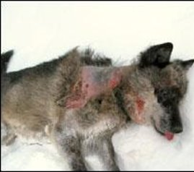
Density Dependent Limiting Factors
(Occur when populations are large)​
Competition​
Predation​
Herbivory​
Parasitism and Disease​
Crowding and Stress
Affects of mange on a Yellowstone wolf

Slide 39
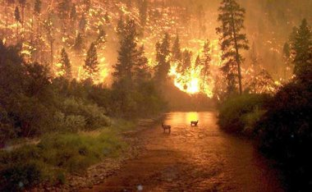
Density Independent Limiting Factors
(Can limit large or small populations)​
Weather​
Natural disasters​
Human activities- ex damming of rivers or clear-cutting forests.​
Seasonal cycles

Slide 41
Succession
1. Primary Succession
https://www.youtube.com/watch?v=TLpc71YOtcE
3:30

Slide 42
Succession
2. Secondary Succession

Slide 43
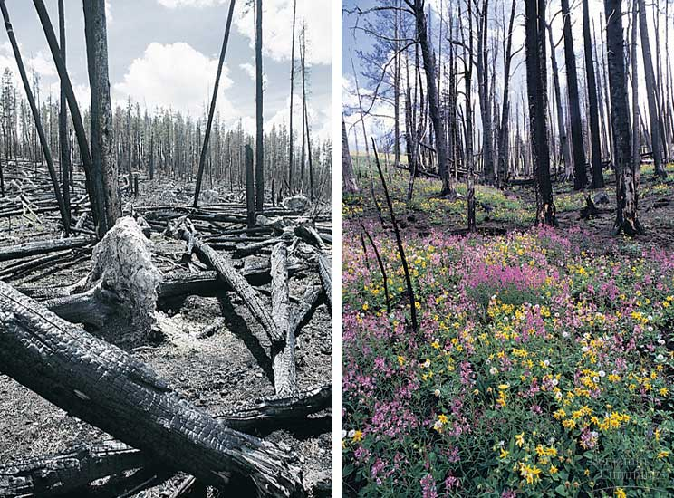
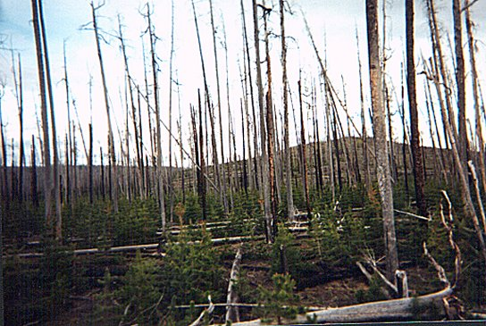
Succession
2. Secondary Succession

Slide 44
Biodiversity
The term Biodiversity was first coined by Walter G. Rosen in 1986.

Slide 45
Three types of biodiversity
Diversity of Species
Diversity of Ecosystem
Diversity of Genes

Slide 46
Flora and fauna diversity
depends on:
Climate
Altitude
Soils
Presence of other species
Most of the biodiversity
concentrated in Tropical region.
BIODIVERSITY HOTSPOTS
- A region with high biodiversity

Slide 47
BIODIVERSITY AND BALANCE OF NATURE
Trophic Level: Elimination of species from trophic level can cause destruction of ecosystem as well as biodiversity.
Keystone Species: Loss or addition of species causes detectable changes in ecosystem rates.

Slide 48
BENEFITS OF BIODIVERSITY
Consumptive value:
Food/Drink
Fuel
Medicine
Better crop varieties
Industrial Material
Non-Consumptive Value:
Recreation
Education and Research
Traditional value

Slide 49
Ecological services:
Balance of nature
Biological productivity
Regulation of climate
Degradation of waste
Cleaning of air and water
Cycling of nutrients
Control of potential pest and disease causing species
Detoxification of soil and sediments
Stabilization of land against erosion
Carbon sequestration and global climate change
Maintenance of Soil fertility

Slide 50
THREATS TO BIODIVERSITY
Natural causes:
Narrow geographical area
Low population
Low breeding rate
Natural disasters
Anthropogenic causes:
Habitat modification
Overexploitation of selected species
Introduction of exotic species

Slide 51
Anthropogenic causes continued:
Pollution
Over hunting
Climate Change
Agriculture

Slide 52
RECENT ISSUES ON BIODIVERSITY
75%of the genetic diversity of crop
plants been lost in the past century.
Some scientists estimate that as many as 3 species per hour are going extinct and 20,000 extinctions occur each year.
Roughly one-third of the world’s coral reef systems have been
destroyed or highly degraded.
About 24% of mammals and 12% of bird species are
currently considered to be globally threatened.
More than 50% of the world’s wetlands have been drained,
and populations of inland water and wetland species have declined
by 50% between 1970 and 1999.

Slide 53
Human Population Growth
and
The Sixth Extinction
https://www.youtube.com/watch?v=z9gHuAwxwAs
9:00

Slide 54
CONSERVATION OF BIODIVERSITY
https://www.youtube.com/watch?v=uAl8dSpkNWs
5:00

