Slide 1
Meiosis

Slide 2
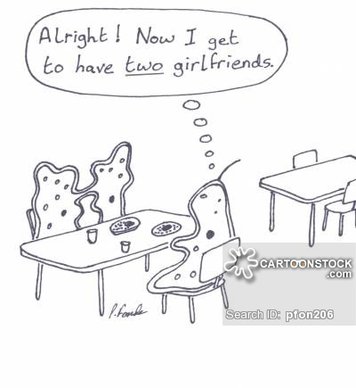
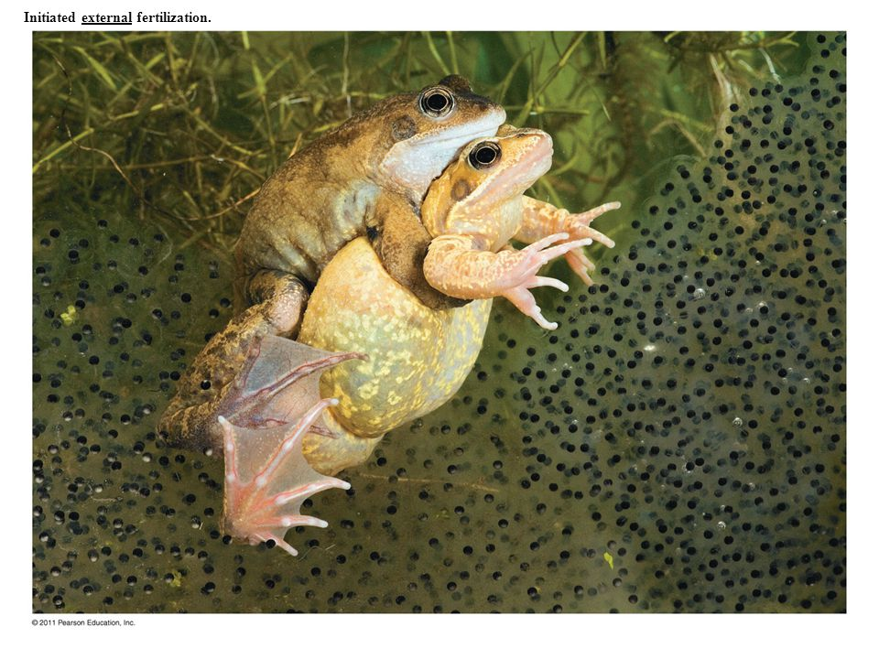
Introducing Alleles
Asexual reproduction produces genetically identical copies of a parent (clones)
Sexual reproduction introduces variation in the combinations of traits among offspring

Slide 3
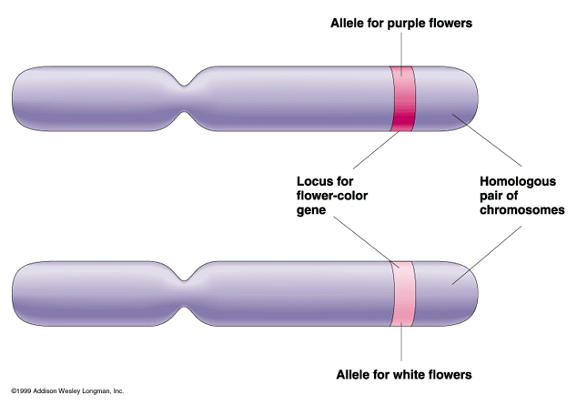
Genes and Alleles
Genes are regions in an organism’s DNA that encode information about heritable traits
In sexual reproduction, pairs of genes are inherited on pairs of chromosomes, one maternal and one paternal
Alleles are different forms of the same gene
Offspring of sexual reproducers inherit new combinations of alleles, the basis of traits

Slide 4
Chromosome Pair: Maternal and Paternal

Slide 5
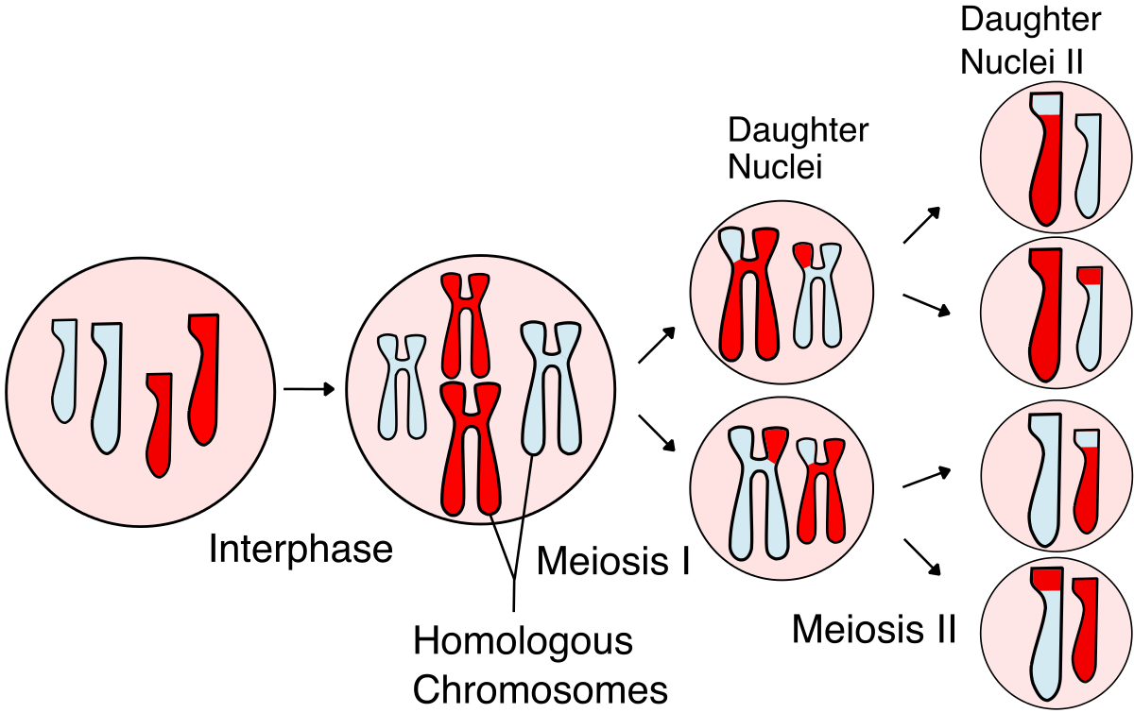
10.2 What Meiosis Does
Meiosis
A nuclear division mechanism that precedes cytoplasmic division of immature reproductive cells in sexually-reproducing eukaryotic species

Slide 6
Halving the Diploid Number
A diploid cell has two nonidentical copies of every chromosome (except XY sex chromosomes)
Humans have 23 pairs of homologous chromosomes
Meiosis in germ cells halves the diploid number of chromosomes (2n) to the haploid number (n), producing haploid gametes
Eggs and sperm have 23 unpaired chromosomes

Slide 7
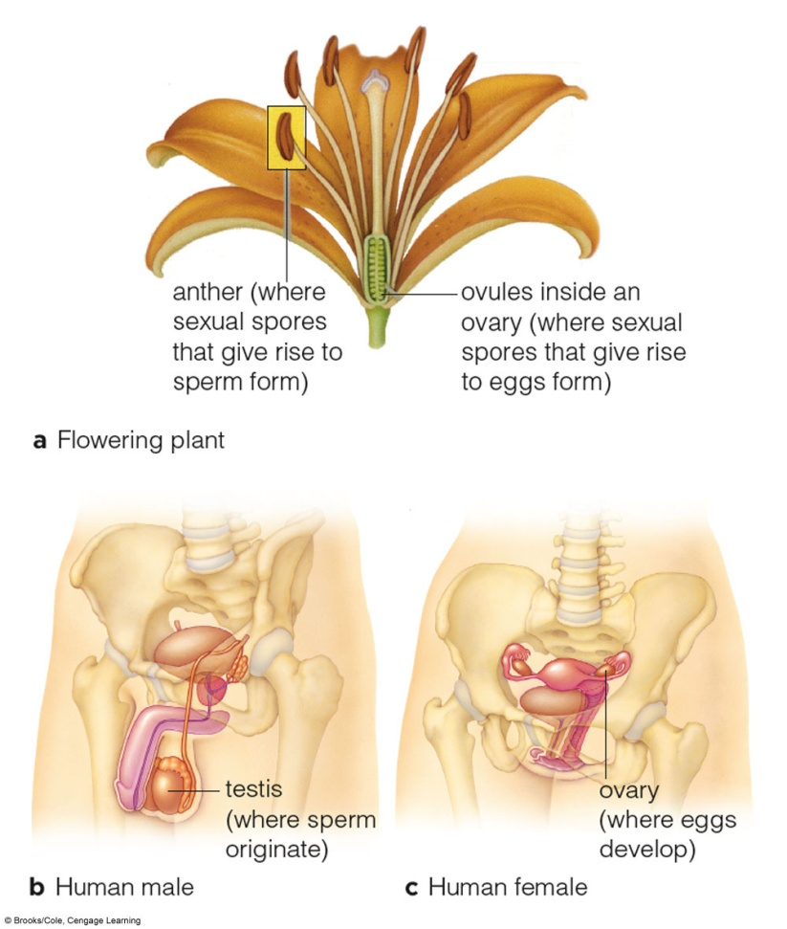
Gamete Production
Gametes are produced in specialized reproductive structures or organs

Slide 8
Human Chromosomes: Homologous Pairs

Slide 9
Restoring the Diploid Number
Human gametes (eggs and sperm) have 23 chromosomes – one of each homologous pair
The diploid number (23 pairs) is restored at fertilization, when two haploid gametes fuse and form a diploid zygote, the first cell of a new individual

Slide 10
Two Divisions, Not One
In meiosis, DNA is replicated once and divided twice (meiosis I and meiosis II), forming four haploid nuclei
In meiosis I, each duplicated homologous chromosome is separated from its partner
In meiosis II, sister chromatids are separated

Slide 11
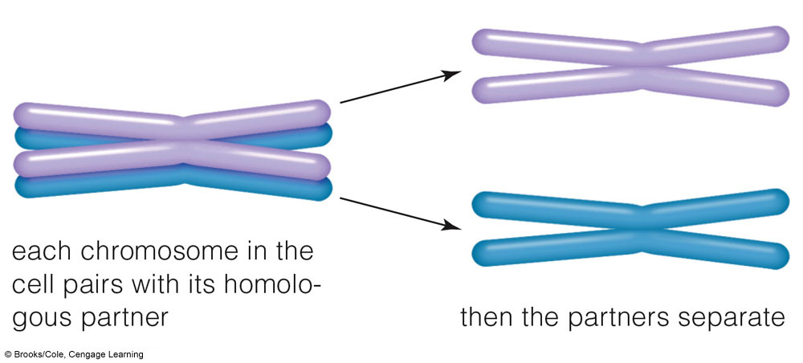
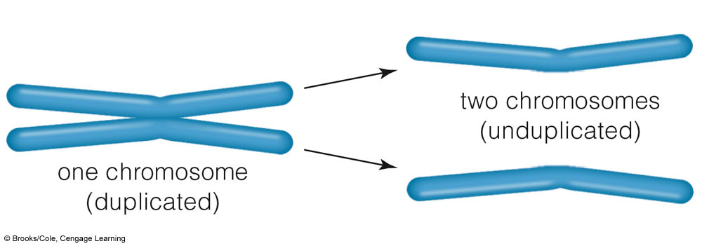
Two Divisions, Not One
Meiosis I
Meiosis II

Slide 12
10.3 Visual Tour of Meiosis

Slide 13
10.3 Visual Tour of Meiosis

Slide 14
Modeling Meiosis -use Chapter 10
Make a model of meiosis. Include the following:
A drawing and explanation of 4 phases of meiosis 1 and 4 phases of meiosis 2 including correct chromosome structure and number, cell structures, and cells.
Use 6 chromosomes – use different colors for the chromosomes in a homologous pair
Label each with the following:
Haploid or diploid
Chromosome number
Label at least one of each of the following:
Homologous chromosome
Where crossing over occurs
Tetrad

Slide 15
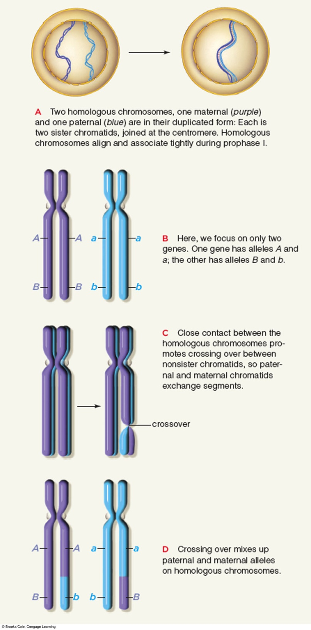
Crossing Over in Prophase I
Crossing over
The process by which a chromosome and its homologous partner exchange heritable information in corresponding segments
Occurs during condensation in prophase I

Slide 16
Segregation of Chromosomes into Gametes
Homologous chromosomes can be attached to either spindle pole in prophase I, so each homologue can be packaged into either one of the two new nuclei
Random assortment produces 10²³ (8,388,608) possible combinations of homologous chromosomes

Slide 17
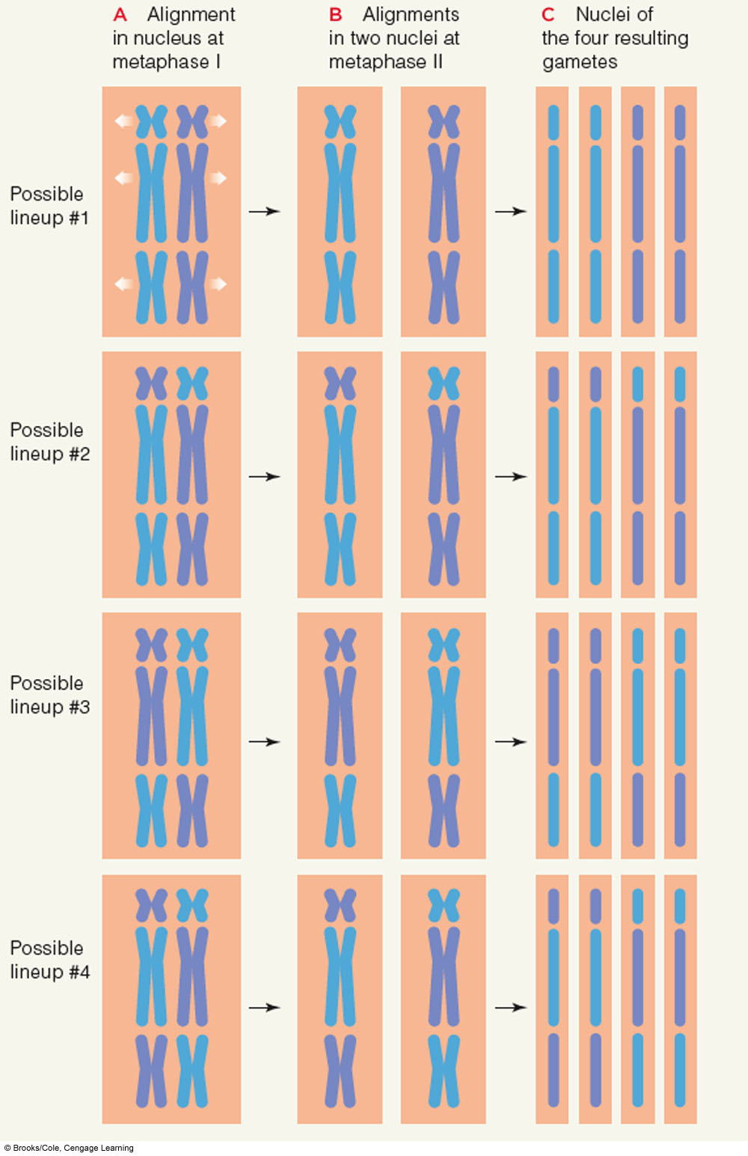
Random Assortment

Slide 18
Review of Meiosis Video
Review - 5 minutes
Meiosis - 3 minute Review

Slide 19
Gamete Formation in Animals
Males
Meiosis of primary spermatocytes produces four haploid spermatids, which mature into sperm
Females
Meiosis of a primary oocyte forms cells of different sizes; the secondary oocyte gets most of the cytoplasm and matures into an ovum (egg); other cells (polar bodies) get little cytoplasm and degenerate

Slide 20
Sperm Formation in Animals

Slide 21
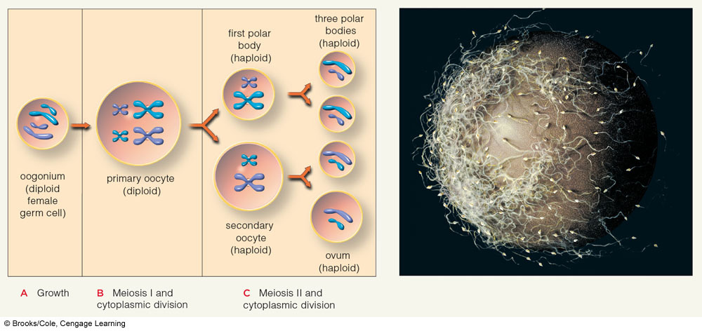
Egg Formation in Animals

Slide 22
More Shufflings at Fertilization
Chance combinations of maternal and paternal chromosomes through fertilization produce a unique combination of genetic information
Fertilization
The fusion of two haploid gametes (sperm and egg) resulting in a diploid zygote

