Slide 1
CHAPTER 13
RNA and Protein Synthesis

Slide 2
Differences between DNA and RNA
DNA
RNA
Sugar = Deoxyribose
Double stranded
Bases
Cytosine
Guanine
Adenine
Thymine
Sugar = Ribose
Single Stranded
Bases
Cytosine
Guanine
Adenine
URACIL (U)
These chemical differences make it easy for the enzymes in the cell to tell DNA and RNA apart

Slide 3
What is RNA?
Remember that DNA carries the genetic information in cells
RNA = a single-stranded nucleic acid that contains ribose as its sugar
RNA is involved in putting the genetic information into action!!!
The instructions from DNA are copied as RNA. RNA can be used to make proteins

Slide 4
The role of DNA and RNA in the cell
The roles played by DNA and RNA are similar to the master plans and blueprints used by builders.
DNA = The master plan = has all the information needed to construct a building. Builders never bring a valuable master plan to the building site!!!!!
RNA = Blueprint = Inexpensive, disposable copies of the master plan called blueprints.

Slide 5
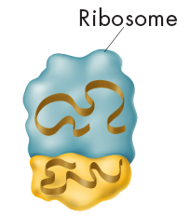
The 3 main types of RNA
Messenger RNA (mRNA)
Carry a copy of the instructions from the nucleus to other parts of the cell
Ribosomal RNA (rRNA)
Makes up the structure of ribosomes
Transfer RNA (tRNA)
Transfers amino acids (proteins) to the ribosomes to be assembled

Slide 6
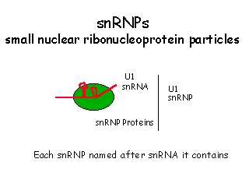
A 4th type of RNA (not in your book)
Small nuclear RNA (snRNA)
Edits the mRNA before it leaves the nucleus
The mRNA may be edited in many ways which will code for many different proteins!!!! (THIS IS NEW RESEARCH)
snRNA is found in the nucleus with proteins called snRNP (small ribonucleoproteins). The the snRNP-snRNA complexes are called splicesomes.

Slide 7
How is RNA made?
Transcription = DNA segments serve as templates to produce complementary RNA molecules (mRNA)
In eukaryotes transcription takes place in the nucleus
mRNA is the disposable copy of the DNA instructions
Many mRNA molecules can be made from one gene

Slide 8
Bozeman Biology Transcription and Translation
Click here for Bozeman Biology Transcription and Translation

Slide 9
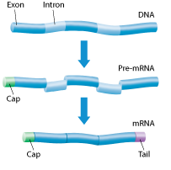
The role of RNA polymerase
RNA polymerase = an enzyme that binds to DNA
1) Separates the DNA strand
2) Uses one DNA strand as a template to create a RNA molecule
Promoter = region of DNA with specific base sequences that signal the RNA polymerase where to start making RNA
mRNA is edited before it leaves the nucleus
Introns = regions that are cut out
Exons = regions that form the final RNA

Slide 10
RNA editing
Biologists don’t have a complete answer as to why cells use energy to make a large RNA molecule and then throw parts of that molecule away.
Some pre-mRNA molecules may be cut and spliced in different ways in different tissues, making it possible for a single gene to produce several different forms of RNA.
Introns and exons may also play a role in evolution, making it possible for very small changes in DNA sequences to have dramatic effects on how genes affect cellular function.
2 minute transcription animation
2 minute translation animation

Slide 11
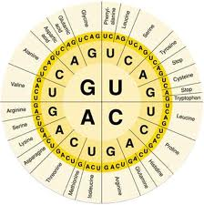
The Genetic Code
The bases in DNA and RNA - A, C, G, T (U)
code for making proteins
The 4 bases code for 20 different amino acids (proteins)
The genetic code is read three “letters” at a time, so that each “word” is three bases long and corresponds to a single amino acid
These amino acids can be combined into long chains = polypeptides
The sequence of amino acids determines the structure of the protein

Slide 12
Codon
Codon = each three-letter “word” in mRNA
consists of three consecutive bases that specify a single amino acid to be added to the polypeptide chain

Slide 13
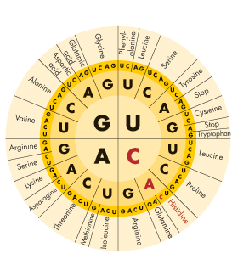
The Genetic Code
There are 64 possible three-base codons (4 × 4 × 4 = 64) in the genetic code.
To read a codon, start at the middle of the circle and move outward.
GAG = Glutamic Acid
CGU = Arginine
Start codon = AUG = methionine
Stop codon = UGA, UAA, UAG

Slide 14
Translation
Translation = the decoding of an mRNA message into a protein.
Ribosomes use the sequence of codons in mRNA to assemble amino acids into polypeptide chains

Slide 15
tRNA
Each tRNA molecule carries just one kind of amino acid.
Anticodon = three unpaired bases—which is complementary to one mRNA codon.

Slide 16
The process of translation
1) A ribosome attaches to a mRNA molecule in the cytoplasm.
2) As the ribosome reads each codon of mRNA, it directs tRNA to bring the specified amino acid into the ribosome.
3) One at a time, the ribosome then attaches each amino acid to the growing chain and breaks the bond between the tRNA and amino acid

Slide 17
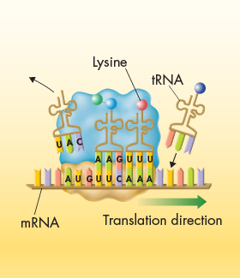
Translation
4) The tRNA moves into a third binding site, from which it exits the ribosome.
5) The ribosome moves to the third codon, where tRNA brings it the amino acid specified by the third codon.

Slide 18
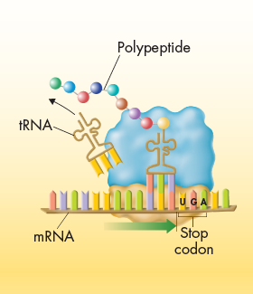
Translation
6) The polypeptide chain continues to grow until the ribosome reaches a “stop” codon on the mRNA molecule.
7) When the ribosome reaches a stop codon, it releases both the newly formed polypeptide and the mRNA molecule, completing the process of translation.
2 minute translation animation

Slide 19
Central Dogma
Information is transferred from DNA to RNA to PROTEIN
Exceptions include retroviruses (ex HIV) where information is
moved from RNA to DNA
Gene expression - the way in which DNA, RNA, and proteins are involved in putting genetic information into action in living cells.

Slide 20
The Genetic Code
The genetic code is near-universal
Some organisms show slight variations in the amino acids assigned to particular codons but the code is always read three bases at a time and in the same direction.

Slide 21
Mutations
Mutations are heritable changes in genetic information
There are two categories of mutations
1) Gene mutations = mutations that produce changes in a single gene
2) Chromosomal mutations = mutations that produce changes in whole chromosomes

Slide 22
Gene Mutations
Point mutations = mutations that involve changes in one or a few nucleotides
Occur at a single point in the DNA sequence
Usually occur during replication.
If a gene in one cell is altered, the alteration can be passed on to every cell that develops from the original one.

Slide 23
Types of Gene Mutations
Substitution - one base is changed to a different base
May change one amino acid
Insertion – one base in inserted
Deletion – one base is deleted
Insertion and deletions are frameshift mutations – they shift the reading frame of the message and change multiple amino acids

Slide 24
Chromosomal Mutations
Deletion – involves the loss of part of a chromosome
Duplication – involves an extra copy of part or all of the chromosome
Inversion – reverses the direction of part of the chromosome
Translocation – when part of one chromosome breaks off and attaches to another

