Slide 1
Chapter 20
Viruses and Prokaryotes

Slide 2
Viruses
A nonliving (?) particle made of proteins, nucleic acids, and sometimes lipids (fats)
Viruses only reproduce by infecting living cells
Most viruses can only be seen with an electron microscope
The first virus isolated was the tobacco mosaic virus in 1935

Slide 3
Structure of Viruses
Capsid – protein coat surrounding the virus
Genetic information – DNA or RNA
Viruses have specific proteins that bind to the host cell. Because of this they infect specific cells
Influenza Virus

Slide 4
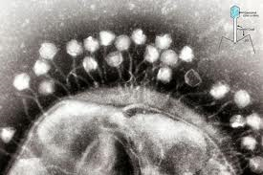
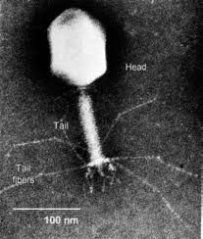
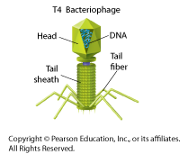
Bacteriophages
Viruses that infect bacteria are called bacteriophages

Slide 5
Viral Infections
Inside living cells, viruses use their genetic information to make multiple copies of themselves. Some viruses replicate immediately, while others are inactive in the host.
Lytic infection – the virus enters a cell, makes copies of itself and bursts the cell (lyse)
Lysogenic infection – the viral DNA/RNA is inserted into the host’s DNA and copies itself without immediately killing the cell

Slide 6
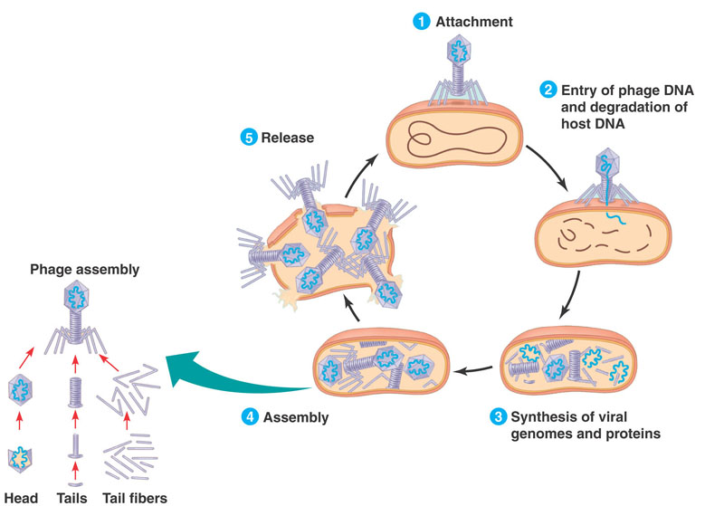
Lytic Infection (ex. T4 bacteriophage)
The virus injects its DNA into the cell.
The cell then begins to make virus proteins and genetic material (nucleic acid).
The viral nucleic acid and proteins are then assembled into new virus particles
Viral proteins lyse (cut
open) the cell
New viruses can infect
other cells

Slide 8
Lysogenic Infection
Lysogenic infection –viral DNA/RNA is inserted into the host’s DNA and copies itself without instantly killing the cell
In each cell division the new cell is infected with the virus
When bacteriophage DNA is imbedded in the host’s DNA it is called a prophage
A trigger (heat, chemicals, radiation, etc) causes the prophage to remove itself from the host DNA and become a lytic infection.

Slide 9
RNA Viruses
70% of viruses have RNA instead of DNA
RNA viruses cause colds, AIDS, cancer and others

Slide 10
The common cold
The virus is brought in the host cell (nose, etc.)
The host cell makes viral protein and RNA
Within 8 hours the hose cell bursts and releases hundreds of new viruses

Slide 11
HIV
HIV is a retrovirus – the genetic information is copied from the RNA to DNA
The viral DNA remains inactive for many cell divisions
When activated, the viruses damage the host’s immune system.

Slide 12
VIRUSES vs. CELLS
Viruses have many characteristics of cells
Viruses depend on living things and therefore were not likely to be the first living organisms.

Slide 13
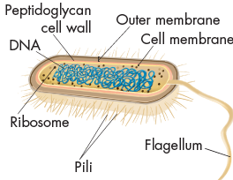
Prokaryotes
Prokaryote – unicellular organism
without a nucleus
DNA is found in the cytoplasm
2 Domains of prokaryotes
1) Bacteria
-Live almost everywhere (fresh and salt water, land, other organisms
-Have a cell wall made of peptidoglycan (sugar and amino acids)
-some have flagella and second cell membrane
2) Archea
-DNA is more similar to eukaryotes
-many live in harsh environments (digestive tract, hot spring

Slide 14
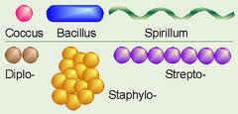
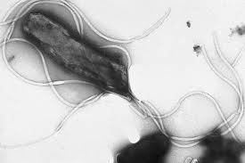
Structure and Function
Prokaryotes vary in their size and shape, the way they move and the way the use energy
Shapes –
Movement
Some don’t move
Flagella
Move in slime they make

Slide 15
Obtaining Energy

Slide 16
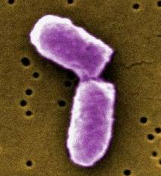
Growth and Reproduction
Binary fission – a prokaryote replicates its DNA and divides in half, producing two identical cells
Asexual reproduction
Can occur every 20 minutes
Endospore – a structure produced in unfavorable conditions
- A thick internal wall encloses the DNA and cytoplasm

Slide 17
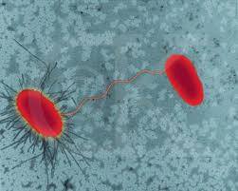
How do prokaryotes evolve?
Mutation – random changes in DNA
-passed on to daughter cells
-one of the main way prokaryotes evolve
Conjugation – a hollow bridge forms between two bacterial cells and genetic material moves from one cell to the other
-increases genetic diversity
-many times a gene that enables the bacteria to live in a new environment is transferred in form of a plasmid (circular piece of DNA)

Slide 18
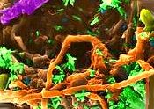
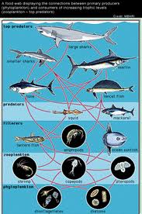
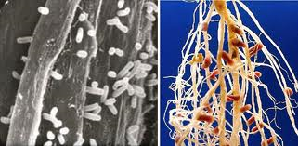
The Importance of Prokaryotes
Decomposers – assist in breaking down dead organisms
Producers – food chains are dependent
on bacteria for producing food
1 cyanobacterium (Prochlorococcus) is the
most abundant photosynthetic organism –
makes over ½ of food in the open ocean
Nitrogen Fixers – converts nitrogen
into a form plants use (N2 to NH3)
90% of the nitrogen organisms use comes from fixation

Slide 19
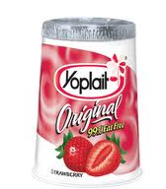
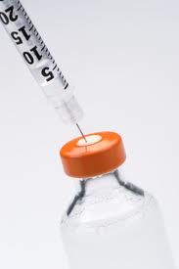
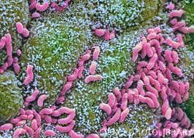
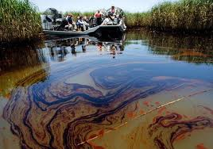
Human Uses of Prokaryotes
Production of Food – yogurt, cheese, vinegar
Clean oil spills
Remove human waste and poison from water
Medicine – synthesize drugs – insulin, human growth hormone
Digestion

Slide 20
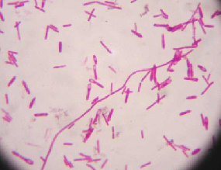
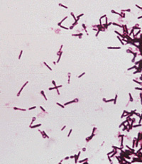
Bacterial Diseases
Pathogen = a virus or bacteria that causes disease
Bacteria cause disease by
Destroying living cells directly of cause tissue damage when they provoke an immune response from the host
- Tuberculosis (TB) is inhaled into the lungs and the immune response destroys tissue
Release toxins that upset the normal activities of the host
Botulism – food poisoning
tetanus – causes lockjaw, muscle spasms

Slide 21
Bacterial Diseases

Slide 22
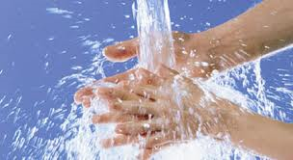
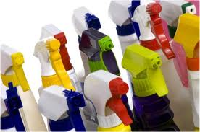
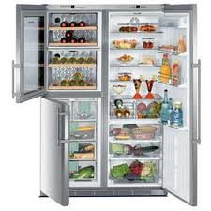
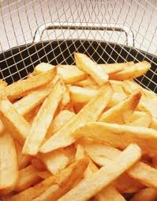
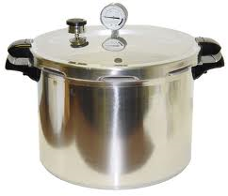
Controlling Bacteria
Physical Removal
– hand washing removes bacteria
Disinfectants
- chemicals that kill bacteria
Food Storage –
- refrigeration/freezing slows the growth
Food Procession
– boiling, frying, steaming kills bacteria
Sterilization by Heat
– kills bacteria

Slide 23
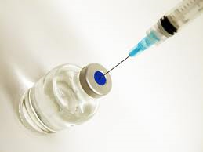
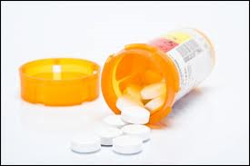
Controlling Bacteria (Cont.)
Vaccines – a preparation of weakened or killed pathogen or inactivated toxin
- The vaccine stimulates the body to produce immunity to a specific disease
Antibiotics – block the growth and reproduction of bacteria
Disrupt proteins or cell processes specific to bacterial cells
Do not harm host’s cells

Slide 24
Viral Diseases
Viruses also cause disease by
destroying cells directly
2) interrupting cellular processes

Slide 25
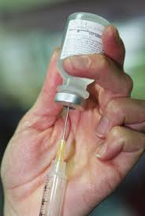
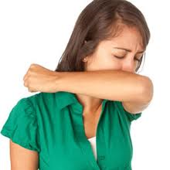
Prevention and Treatment for Viral Diseases
Preventing viral diseases
Vaccines
Personal hygiene
-wash hands
-avoid sick people
-cough into a tissue or sleeve
Antibiotics DO NOT WORK for viral infections
There are a handful of antiviral drugs
- Speed recovery from flu/may reduce spread of HIV

Slide 26
Emerging Diseases
Emerging diseases = an unknown disease that appears in a population for the first time or a well-known disease that has become harder to control
Pathogens that cause emerging diseases are threatening because humans have little or no resistance for them and control methods have not been developed
Human populations once isolated are now connected –quick spread of disease

Slide 27
Emerging Diseases

Slide 28
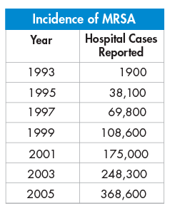
Superbugs
Use of antibiotics has lead to bacteria that are resistant to antibiotics
Penicillin killed many infections in the 1940s when it was introduced. Now is has lost effectiveness
Bacteria that are resistant to penicillin reproduce and pass resistance on through conjugation
MRSA – skin infection spread
by close contact

Slide 29
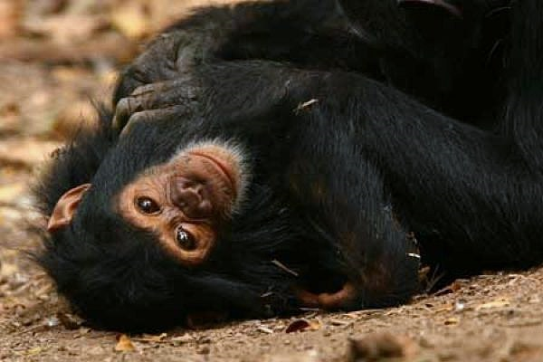
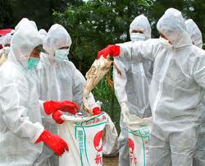
New Viruses
Genetic makeup of viruses changes quickly and allows a virus to jump form one species to another.
AIDS may have jumped from nonhuman primates
“Bird flu” is a concern because it may jump to humans and is similar to some of the most deadly human versions of the flu

Slide 30
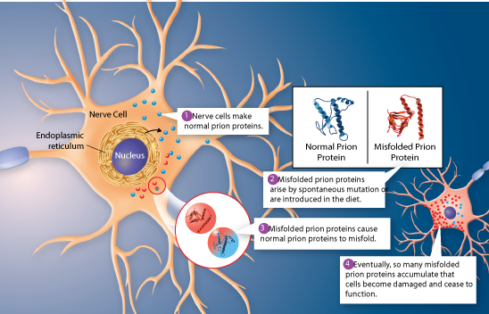
Prions
Prion – protein particle that causes disease
misfolded proteins in the brain that cause a chain reaction of misfolding in other normal proteins they contact, clogging the brain tissue and causing disease.
Sheep – scrapies
Cow – mad cow

