Slide 1
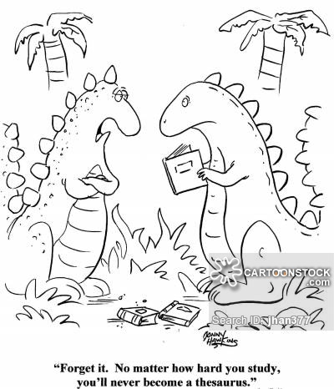
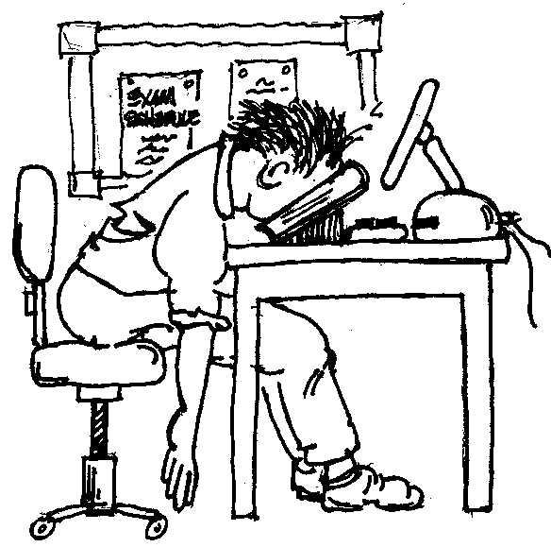
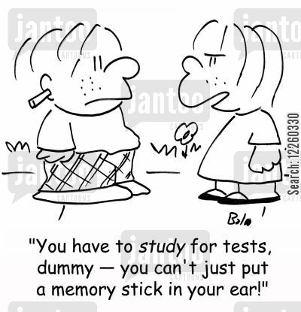
AP Biology Review
You have made it this far – A little bit of work now could bump you a point on the AP test

Slide 2
WE ARE THE CHAMPIONS!!!!!

Slide 3
Standard Deviation and a Bell Shaped Curve Bozeman Biology Video on Standard Deviation
Standard deviation measures the spread or the variation in the data
68% of the individuals are within 1 standard deviation

Slide 4
Do men or women have a higher standard deviation?

Slide 5
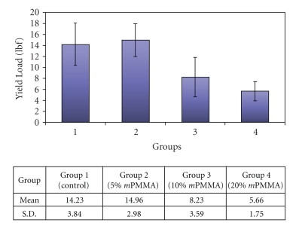
Standard deviation error bars
1) Is Group 1 statistically different from the other treatments?
2) Which treatment had the largest standard deviation? What does this mean?
3) When drawing error bars, do you draw them from individual data or the mean?

Slide 6
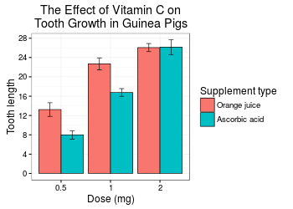
Standard Error of the Mean SE_{x} or SEM Bozeman Biology on SEM
Standard deviation divided by the square root of the sample size

Slide 7
Graphs and error bars…..

Slide 8
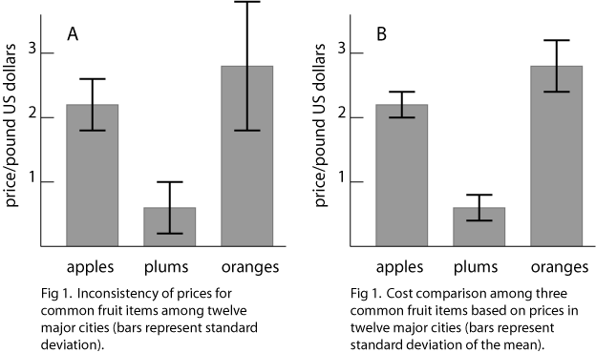
Interpret the graphs = left = standard deviation right = standard error of the mean
Standard deviation =
Spread in data
Standard error =
How precisely you know
The true mean (how confident
We are that the mean is the “true
Mean”)

Slide 9
Correlation does NOT = Causation

Slide 10
Chi-square
Dihybrid Cross with two plants RrYy x RrYy
R = round r = wrinkled
Y = yellow y = green
Write a null hypothesis:
The following are the observed results: complete the chi-square test to determine if the results support your null hypothesis:
Round Yellow Peas | Round Green Peas | Wrinkled Yellow Peas | Wrinkled Green Peas
219 | 81 | 69 | 31

Slide 11
Expect a 9:3:3:1 Ratio!

Slide 12
Find the full explanation at this link
Phenotype | Observed (O) | Expected (E) | O – E | (O – E)²
Round Yellow Peas | 219 | 225 | -6 | 36
Round Green Peas | 81 | 75 | 6 | 36
Wrinkled Yellow Peas | 69 | 75 | -6 | 36
Wrinkled Green Peas | 31 | 25 | 6 | 36
Total | 400 | 400
Phenotype | (O – E)² | E | (O – E)² / E
Round Yellow Peas | 36 | 225 | 0.16
Round Green Peas | 36 | 75 | 0.48
Wrinkled Yellow Peas | 36 | 75 | 0.48
Wrinkled Green Peas | 36 | 25 | 1.44
Total |  |  | 2.56

Slide 13
Do we accept or reject the null hypothesis?
Chi square = 2.56
Degrees of freedom = # of groups -1 = 4-1 = 3
P = .05
Critical value = 7.81
The chi-square values is less than the critical value so we ACCEPT the null hypothesis. There is no statistical difference between what we expected in the dihybrid cross and the observed result.

Slide 14
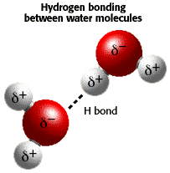
H2O Review
Water is a POLAR molecule (unequal sharing of electrons)
High Specific Heat
Surface Tension
Lower density as a solid than liquid (turnover in lakes)
Cohesion/adhesion – transpiration
pH
Log scale
Low pH = acidic = high H+ ions
High pH = basic = low H+ = high OH- ions
pH of 1 has 100x more H+ ions than pH of 3

Slide 15
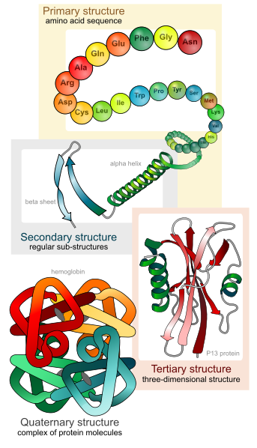
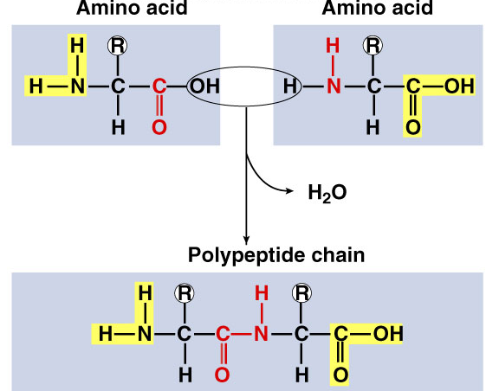
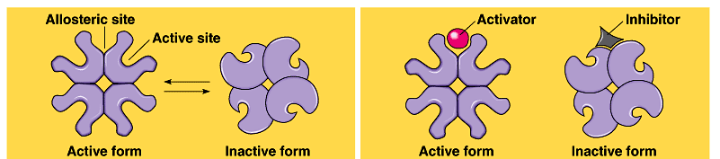
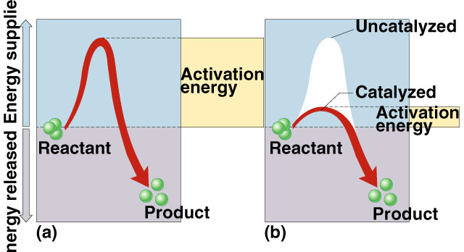
Macromolecules
Protein – Carboxyl group, amine group, R side chain (C, H, O, N, some S)
Enzymes – organic catalyst – lower activation energy
Exergonic – release energy
Endergonic – energy input

Slide 16
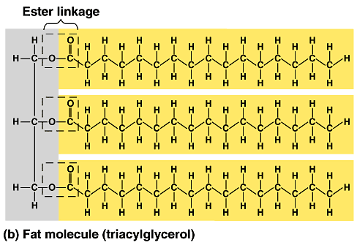
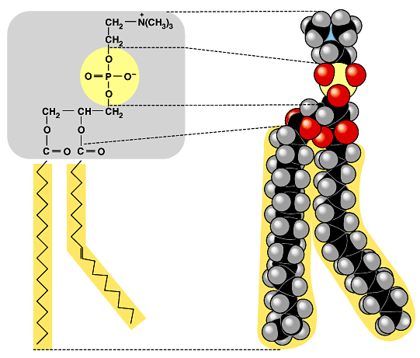
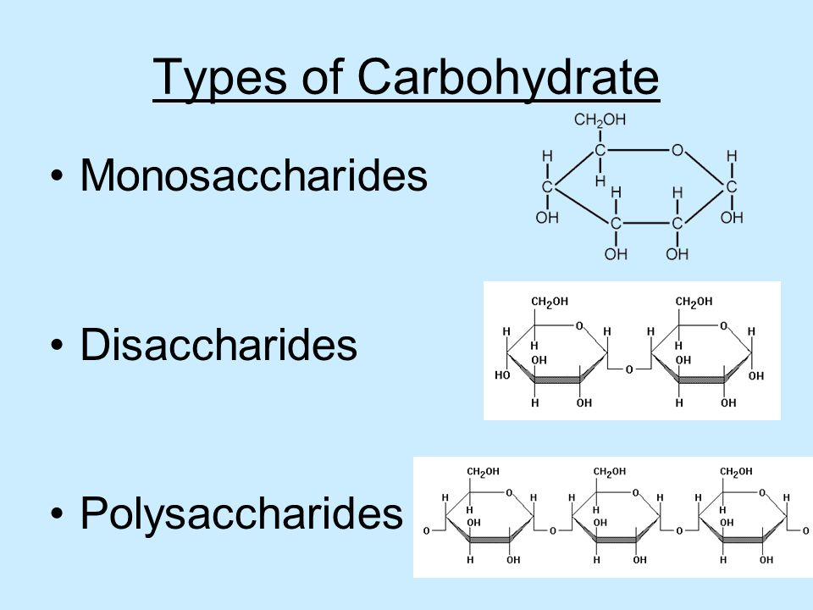
More Macromolecules
Carbohydrates CH₂O –
Energy, energy storage, structure (cellulose, glucose, glycogen)
Lipids (C, H, O – P in phospholipids)
Energy storage, membranes, hormones
Nucleic Acids (C, H, O, P, N) (purine = A and G)
DNA, RNA, ATP

