Slide 1
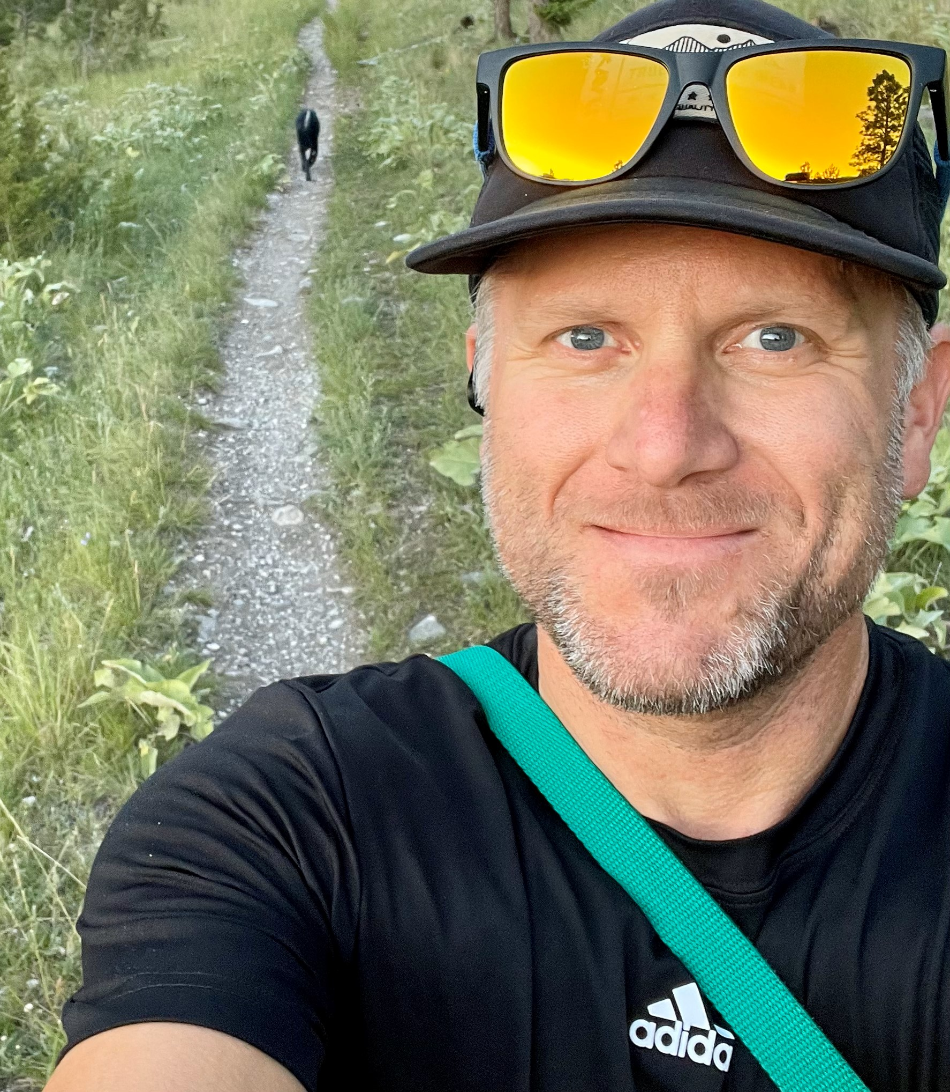
CLASS SYLLABUS
AP Language
& Composition
HELENA HIGH SCHOOL: 2024-2025
- About the Teacher-
Hello! My name is Collin Salisbury. This is my 16th year teaching at HHS, and 18th overall.. I’m excited to be your student’s AP Lang/Comp teacher this year. I look forward to watching students’ critical thinking evolve along with their perspectives, and the deep, philosophical discussions that they generate.
I have long been a lover of stories in whatever incarnation they arrive to be experienced: novels, short stories, films, music, lyrics, theatre, podcasts, campfires, et al.
I am a grateful Dad to two teenagers. I am one of the Bengal Boys soccer coaches, and still get out and play some soccer. I’m also a supporter of Liverpool Football Club.
-Be Responsible-
-Course-
DESCRIPTION
Arrive on time and be prepared. You will need:
1 ½” - 2” binder
Black or Blue pens
Highlighters (3 or more colors)
1-2 bright colored pens
loose leaf or perforated notebook paper.
Ask for assistance if you do not understand what is expected of you in class or on an assignment.
Please limit your time out of the classroom during class time.
Absences: It is YOUR responsibility to see a teacher about makeup work.
This class will prepare students for the AP Language and Composition exam, which offers college credit for passing students.
We will study argumentation, rhetoric, and analysis. Most of our texts will be non-fiction, though we will also read The Things They Carried by Tim O’Brien and one additional junior-level novel (TBD). We will write extensively, including processed essays, journal-style “quick-writes,” and timed writes.
AP courses are intended to be taught as college-level courses. This course will be challenging, requiring intellectual engagement, and rigorous preparation. I expect to be able to treat you as a student serious about your education.
- Be Involved -
Contribute to class discussions.
We will establish class norms at the beginning of the year to help ensure a respectful, safe, and comfortable learning environment for all students.
Mr. Salisbury is always ready to support each student’s educational and social- emotional needs; please message me if you need help or have concerns.
Reading Recommendations:
--For this course, students should read high quality non-fiction in both short form (articles in The Atlantic or The New Yorker, for example) and long form essays.
--Reading local and national newspapers is also a great idea!
--For fun, I recommend reading anything that sparks your intellectual curiosity. For example, this summer, I read Killers of the Flower Moon by David Grann and American Prometheus by Kai Bird and Martin J. Sherwin.
-Expectations-
School & Classroom
-Be Respectful-
Honor the ideas of others. We all benefit from hearing the perspectives and experiences of those around us.
LIMITED PERSONAL ELECTRONIC DEVICE USAGE IN CLASS.
Treat the classroom and its contents with care.
Classroom materials, including books, are not permitted to leave the classroom without express permission from an instructor.
-Be a Graduate-
CONTACT INFORMATION
Mr. Collin Salisbury
AP Language meets one of the 4 English credits (23 HPS Graduation Credits total).
You are your community: your behavior reflects not only on yourself, but also on this class and the school as a whole.
(See back for Grading and other policies).
406-324-2259
csalisbury@helenaschools.org
Teams: @csalisbury
https://staff.helenaschools.org/staff_page/csalisbury/

Slide 2
AP Language & Composition 2023-2024
Summative:
Assessments administered at the end of an instructional unit. These assessments are intended to evaluate student learning.
Examples of summative assessments are final drafts of essays, cumulative projects or presentations, and final grammar and vocabulary assessments.
Accounts for 60% of each quarter grade.
How will I be graded in AP Lang?
AP Lang is graded in the following three categories:
Practice:
New skills, standards, and content that students are learning for the first time. The intention is to practice to gain proficiency.
Examples of practice work are graphic organizers, grammar practice, introductory assignments, etc.
Accounts for 10% of each quarter grade.
Formative:
Evaluating the students' knowledge as they learn. This is a method of on-going assessment, and it involves questions and exercises to help monitor learner progress during the course.
Examples of formative work are essay rough drafts, quick write assignments, and daily class discussions.
Accounts for 30% of each quarter grade.
-Grading Scale-
(A) range 90%-100%
(B) range 80%-89%
(C) range 70%-79%
(D) range 60%-69%
(F) 0-59%
S1= 80% + Exam 20% = 100%
Other Class Policies:
Bathroom: You must notify the teacher before leaving class, take the pass with you, and limit time outside the class to a minimum. You may not take your phone to the bathroom.
Food/Drink: Please do not bring food to class. Drinks are permitted. You are responsible for thoroughly cleaning all spills or messes you make.
Teams Chat: You are always free to send Mr. Salisbury a chat with your questions, concerns, etc. but please note that messages may not be answered between 8:00PM-7:50AM or on weekends and holidays. This also applies to emails.
Agenda Emails: Mr. Salisbury posts an agenda to Staff Webpage each week along with posting it in TEAMS.
PowerSchool: Grades will be updated weekly. Please be aware that some items may take longer to grade than others. If you have questions, please contact Mr. Salisbury anytime.
-Late Work-
Formative and summative assignments will be accepted and graded up to FIVE school days beyond the final date of the unit.
No late work will be graded for practice assignments.
-Academic Honesty-
This class is about developing YOUR own original voice and writing. Plagiarism will earn you a zero and will result in a referral to building administration.

