Slide 1
Standard Deviation and Standard Error of the Mean

Slide 2
Standard Deviation and a Bell Shaped Curve Bozeman Biology Video on Standard Deviation
Standard deviation measures the spread or the variation in the data
68% of the individuals are within 1 standard deviation

Slide 3
Do men or women have a higher standard deviation?

Slide 4
What does that mean?
S = standard deviation
∑ = sum
√ = square root
n = # of data points = sample size
X = value
X = mean

Slide 5
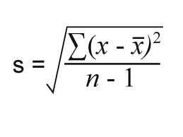
Calculate standard deviation of the following data set:
DATA SET
= 10
1
2
3
4
5
S = √10/4
S = 1.58

Slide 6
Calculating SD using Excel
Enter data into the cells
To calculate the MEAN (Average) click an empty box and type the letters in black. The highlight data letters in white are not typed, just highlight the data:
=average(highlight data)
To calculate SD
=stdev(highlight data)

Slide 7
Standard Error of the Mean SE_{x} or SEM Bozeman Biology on SEM
Standard deviation divided by the square root of the sample size

Slide 8
Graphs and error bars…..

Slide 9
Correlation does NOT = Causation

Slide 10
Sample Brine Shrimp Data

