Slide 1
Active Transport:
Energy Required

Slide 2
Active Transport
Process that moves materials across the plasma membrane
Requires energy from the cell in the form of ATP
Materials move against the concentration gradient:
low concentration high concentration
3 Kinds: Pumps, Endocytosis, and Exocytosis

Slide 3
Active Transport Pumps
An ATP molecule breaks down into ADP, releasing a phosphate group and a whole lot of energy.
The phosphate group attaches to a protein pump, causing it to change its shape so that it can move a small molecule or ion across the plasma membrane.
The protein changes shape again so that the molecule can be released on the other side.
There are many types of carrier proteins and they only carry specific molecules across the plasma membrane.

Slide 4
Example of active transport: sodium-potassium pump in nerve cells
Sodium ions are kept at low concentrations inside the cell and potassium ions are at higher concentrations. Outside the cell, it is the opposite. When a nerve message is sent, the ions pass across the membrane to send the message. After the message has passed, the ions must be actively transported back to their starting positions across the membrane.
Source: www.mhhe.com/biosci/genbio/enger/student/olc/art_quizzes/genbiomedia/0645.jpg

Slide 5
Endocytosis
When a cell actively takes large molecules into itself by folding the plasma membrane inward, forming a vesicle
Source: http://kenpitts.net/bio/images/endocytosis.gif

Slide 6
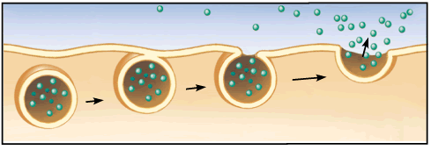
Exocytosis
When a cell actively releases large molecules by folding the plasma membrane outward, forming a vesicle
Source: http://kenpitts.net/bio/images/exocytosis.gif

Slide 7
How vesicles carry materials from the ER Golgi apparatus plasma membrane
​Ribosome makes a protein.
ER forms a vesicle (vacuole) and places protein in it.
Vesicle carries protein to Golgi apparatus and drops it off.
Protein is modified in Golgi apparatus.
Golgi apparatus forms new vesicle and places protein in it.
If protein is leaving the cell, the vesicle moves to the plasma membrane and fuses with it.
Exocytosis – protein is moved out of the cell.

Slide 8
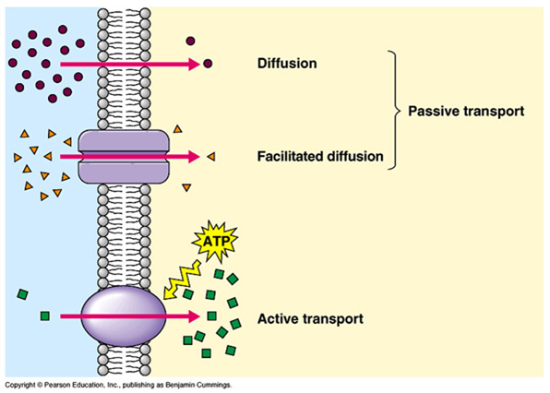
Active Transport vs. Passive Transport
Source: http://thebasisoflife.wikispaces.com/file/view/c8x16types-transport.jpg/30540339/c8x16types-transport.jpg

Slide 9
Active Transport: Review
Pumps, Endocytosis, Exocytosis
Molecules move against the concentration gradient
Requires energy from the cell (ATP)

