Slide 1
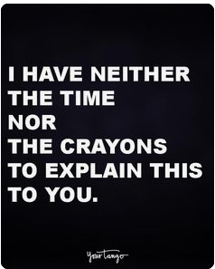
If all food were free and you could have anything you wanted anytime, how much would you change your eating habits? Would you eat more than you do now? What foods would you abandon?
Straub Health Bell Ringers

Slide 2
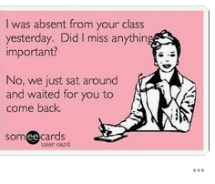
If you could take a pill that would permanently make your sense of smell as acute as a dog’s, would you? WHY?

Slide 3
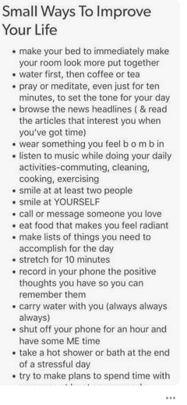
If you could go on one of the first commercial space flights, would you? WHY?

Slide 4
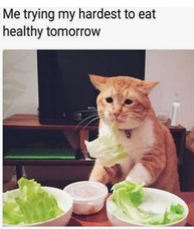
Would you rather be extremely successful in an unconventional way that few people can relate to or in a conventional way that people identify with more easily? WHY?

Slide 5
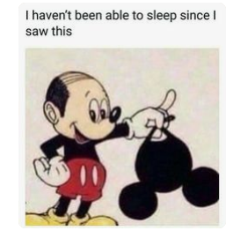
Are you more likely to walk or stand still when you are going up an escalator? What do you think this reveals about you?

Slide 6
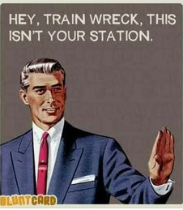
Do you more often feel that life is too short or too long? Why?

Slide 7
Your child has fallen in love with a good person of another race but won’t marry without your approval. Would you oppose the marriage? What do your thoughts on this tell you about how America has changed since Martin Luther King’s death nearly 50 years ago?

Slide 8
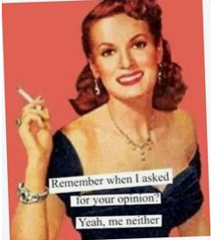
If you ruled the world and could dictate any policies you wished, how would you change things?

Slide 9
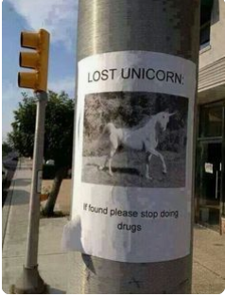
Is it important for you to have a private area in your home that is exclusively yours and never disturbed by others?

Slide 10
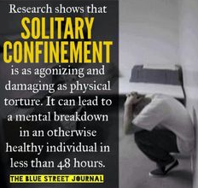
If you were sentenced to a year of solitary confinement with only one of the following, which would you pick: a pet, 25 books, 25 songs, or a pen and ample paper? If you chose the books or songs, which ones would you definitely include?

Slide 11
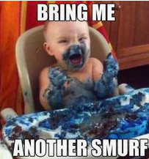
How much does waste bother you? If you were too stuffed to enjoy the fancy dessert you ordered at a restaurant, would you go ahead and eat it? Assume that no one else wanted it and you couldn’t take it home. If so what do you think that would accomplish?

Slide 12
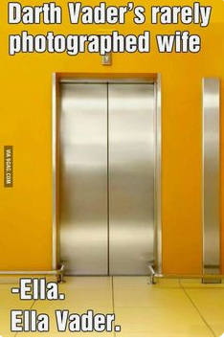
Do you like to hear about the details of your partner’s daily activities? Do you enjoy telling people about what happens to you during the day?

Slide 13
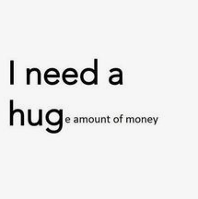
When you spend money, do you consider who is profiting from your purchase?

Slide 14
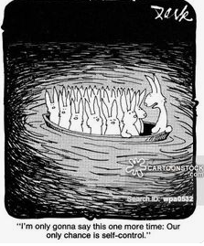
Do you think people see you as you really are? If not, how might you better show your true self?

Slide 15
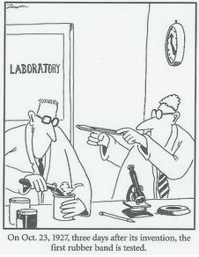
Do you consciously do things to test people? If so, why do you feel this is necessary? How would it make you feel if a friend were doing that to you?

Slide 16
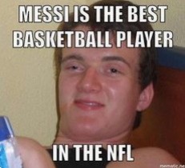
If you could be a world-class athlete in the sport of your choice, which sport would you select? Why?

Slide 17
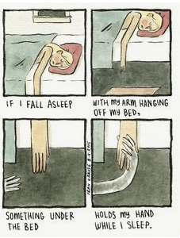
Do you have any fears that you think are irrational? If so, which ones, and how have you tried to overcome them?

Slide 18
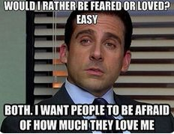
Would you prefer being a great artist, musician, writer or actor? Why?

Slide 19
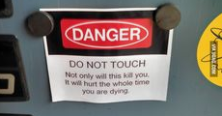
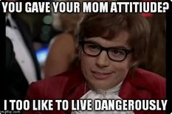
What are the most dangerous things you enjoy? How dangerous would an activity have to be before you would avoid it? Do you get more reckless or more cautious when you are feeling good about life?

Slide 20
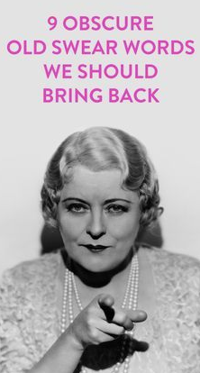
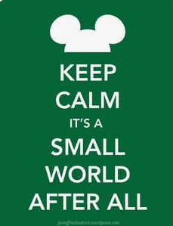
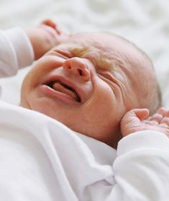
If you were sentenced to hear one sound for an hour a day for the next 5 years, which of the following would be most unbearable: a baby crying, someone screaming in fear, someone yelling at a child, an old man cursing, or the song “It’s a small world”?

