Slide 1
Bell Ringer
1. Get your notebook from the crate.
2. Read the paragraph below and identify the claim, the evidence and reasoning.
Knuckle cracking does not lead to arthritis of the fingers. Over a 50-year period John Burke cracked his knuckles on the left hand twice a day. He did not crack the knuckles on his right hand. After 50 years both hands did not have arthritis. It is possible the repeated cracking of the knuckles resulted in an exercise effect that created a joint lubricant.

Slide 2
Learning Target
I can correctly identify the elements of a scientific argument.

Slide 3
Agenda
Bell Ringer
Review elements of a scientific argument
CER Card Sort
Exit Ticket

Slide 5
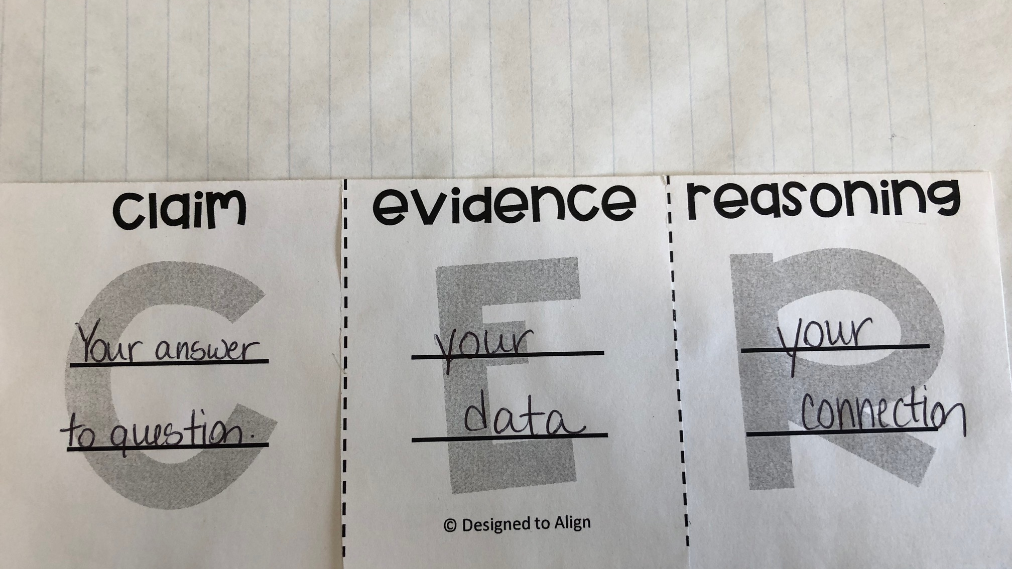

Slide 6
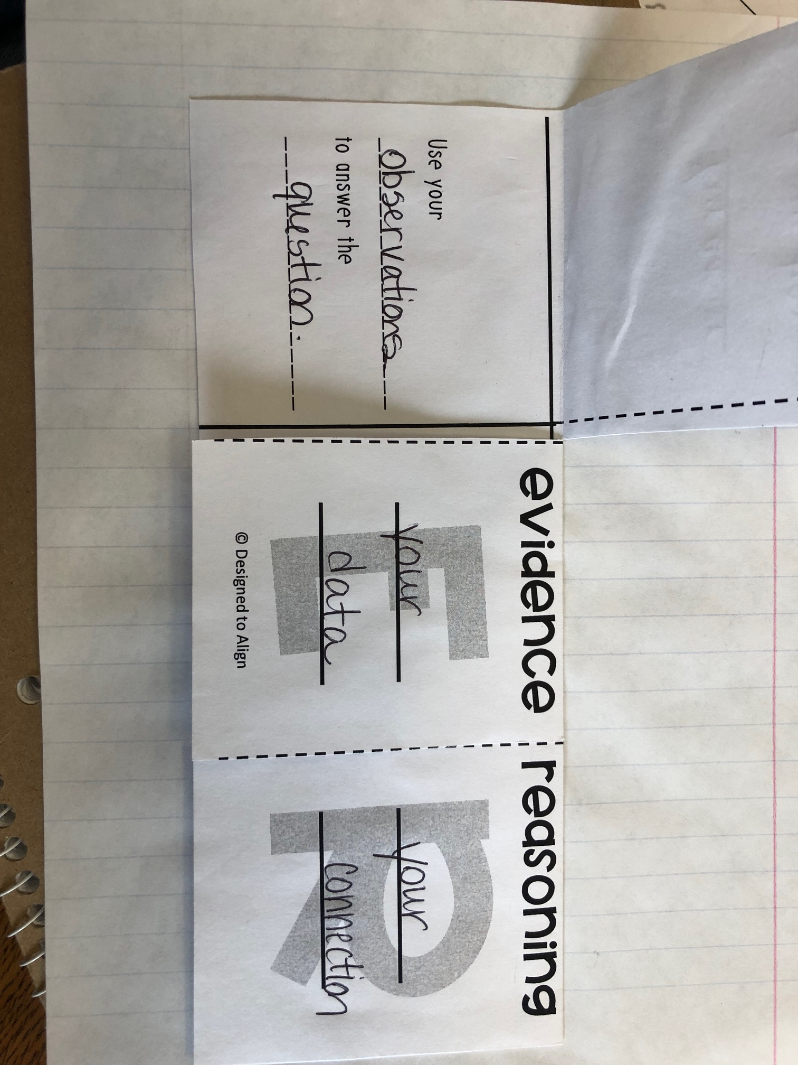

Slide 7
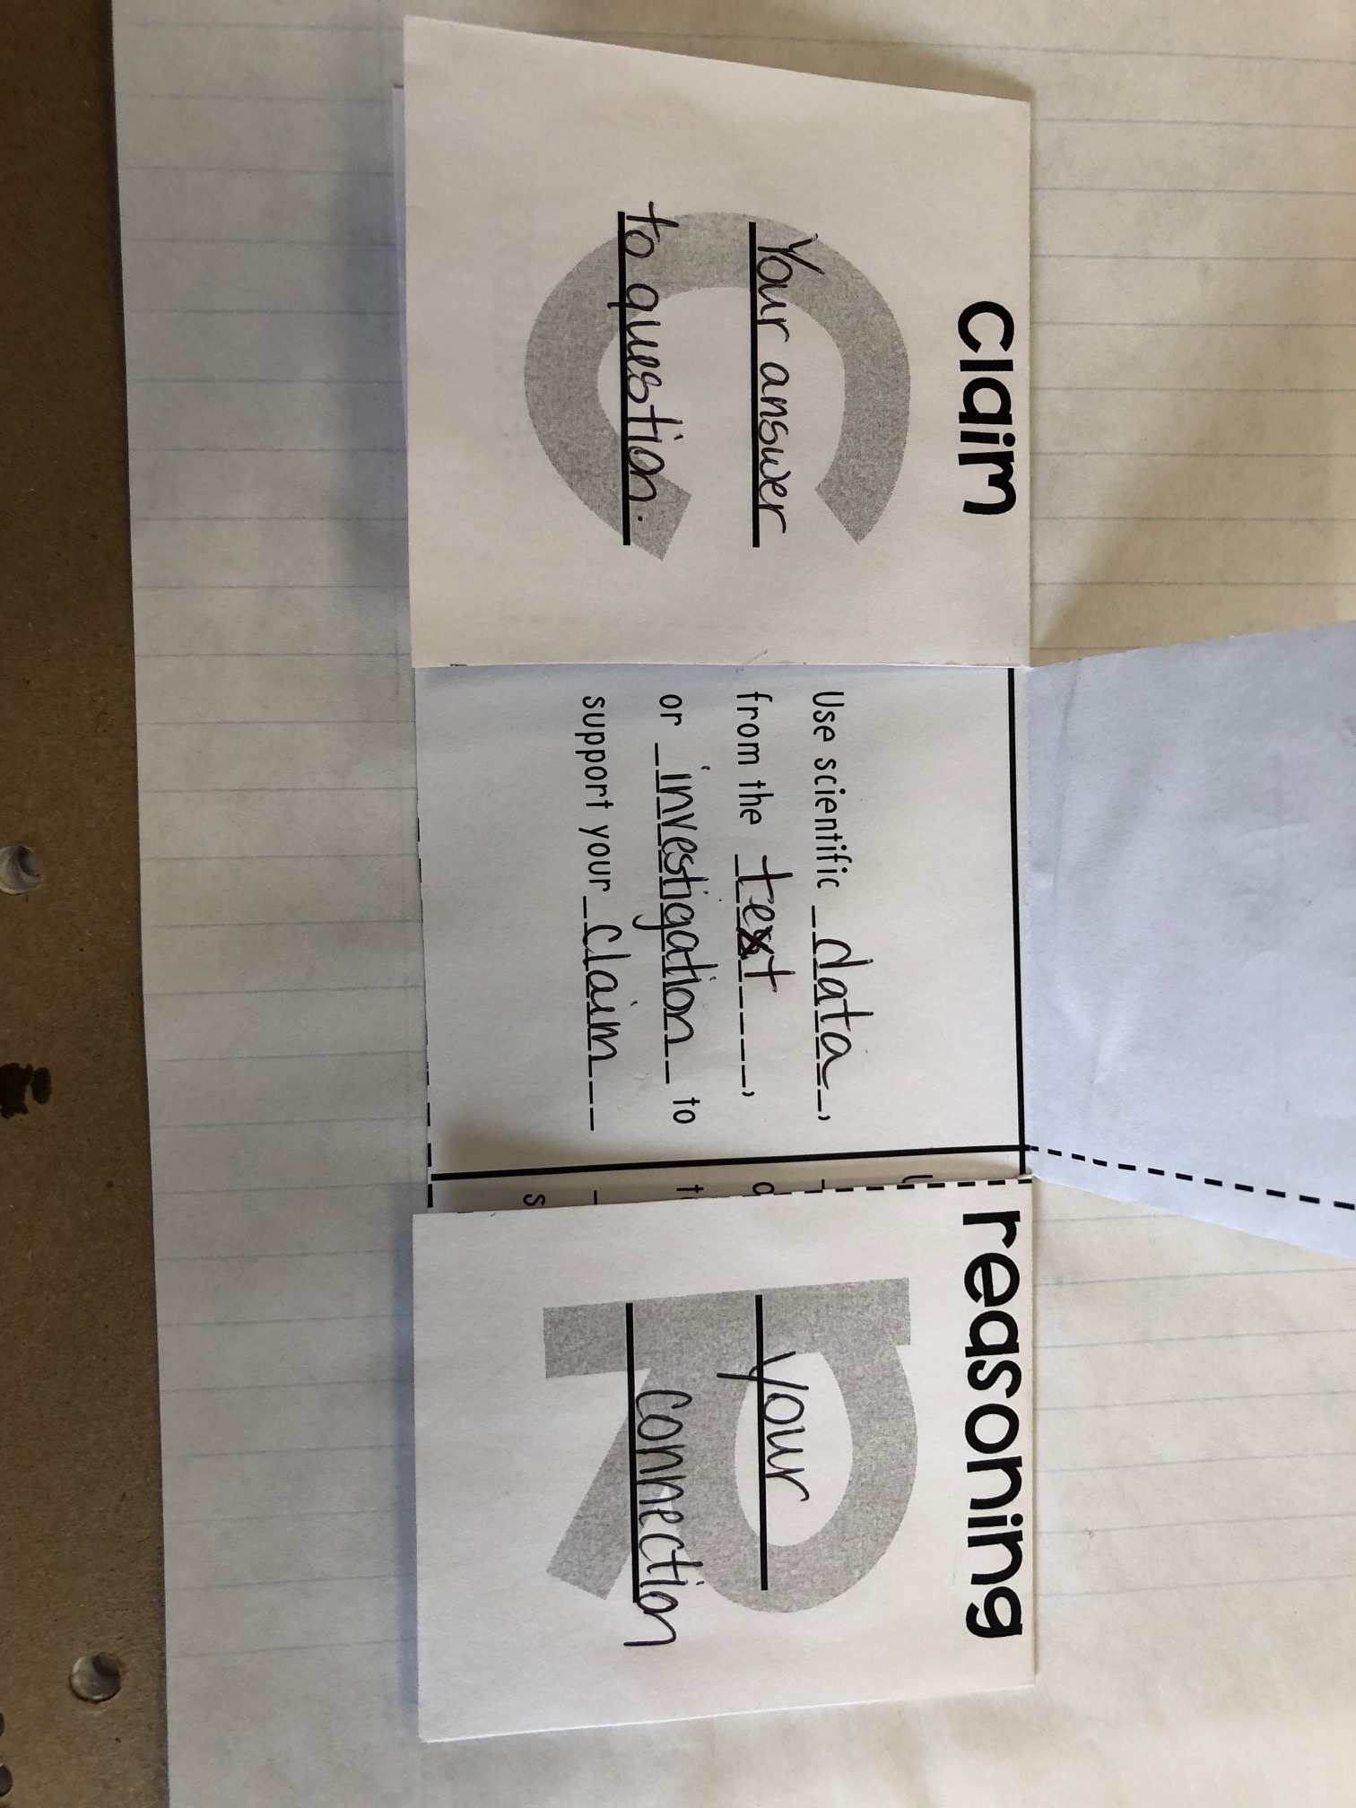

Slide 8
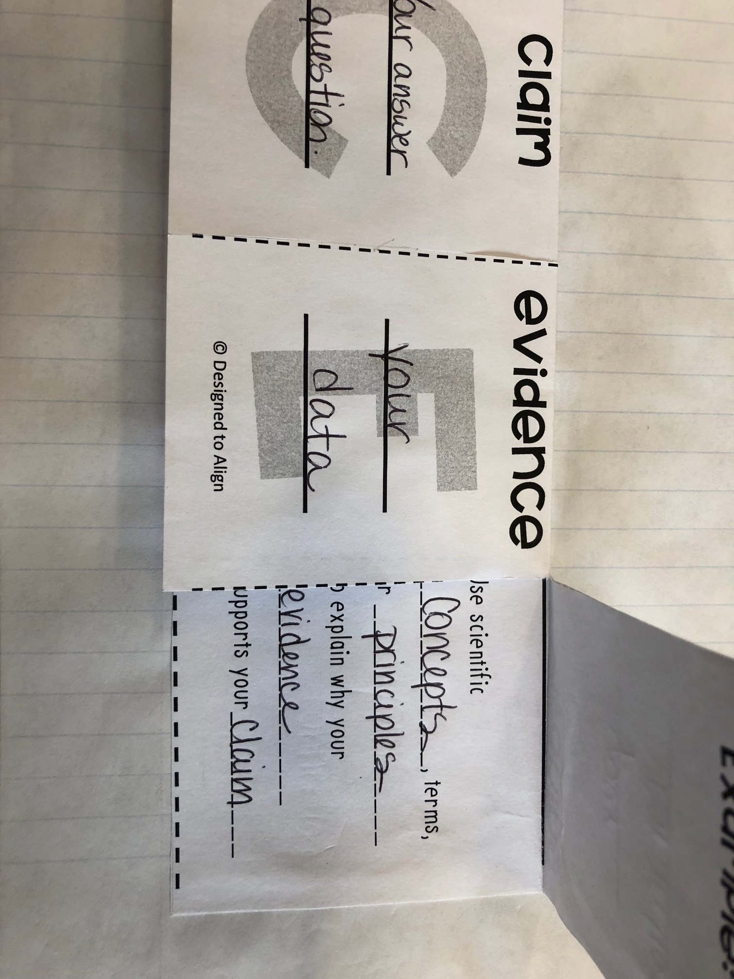

Slide 9
C.E.R. Card Sort: Student Directions
Clear off your table and put all your things under the table.
Stand at one end of the table. See diagram to the right.
Place the red C.E.R. cards horizontally across the top.
Place the green question cards in a column on the left side.
Starting with the first question card row, try to find the corresponding C, E, and R statements from the yellow cards. Place in the correct column.
Once you have sorted all 8 sets have a seat and we will check our work when everyone is finished.

Slide 10
Exit Ticket - Example for Foldable
1. Pick one of the rows you created to add as an example to the top part of your foldable flaps.
2. Copy into your foldable. Tape foldable into your notebook. Make sure you can still lift the flaps.
3. Clean up the Cards
Mix up the yellow CER cards so they are not matched up for the next class.
Paper clip them together.
Paper clip the green question cards together.
Paper clip the red CER heading cards together. Put back in the aluminum container and return to the table by the window.
Please return to your seat and wait to be excused.

