Slide 1
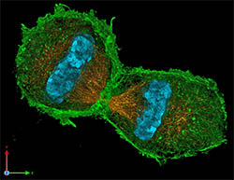
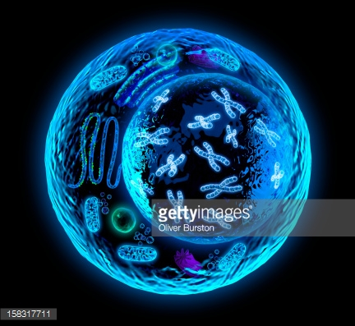
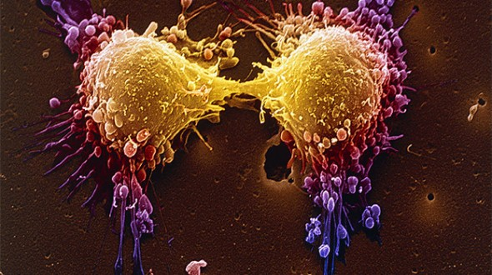
T=Cell Cycle

Slide 2
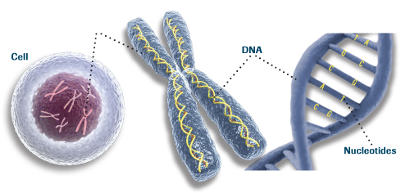
Cell Size
What problems do cells face as they get larger?
Larger cells put more demand on DNA.
Larger cells are less efficient at bringing in nutrients and removing waste.

Slide 3
Limits to Cell Size
Why would cells divide?
DNA overload
Movement of nutrients and waste
Lack of mobility (overcrowded)
Replace old cells
Fight infections
Make the organism bigger

Slide 4
Cell City
DNA holds the information used to build new molecules and grow the cell.
DNA stays the same size even if the cell grows.
If a cell is larger, there is a greater need for DNA.
This “information
overload” is similar
a city’s need for books
in a library.
More people need
more books.

Slide 5
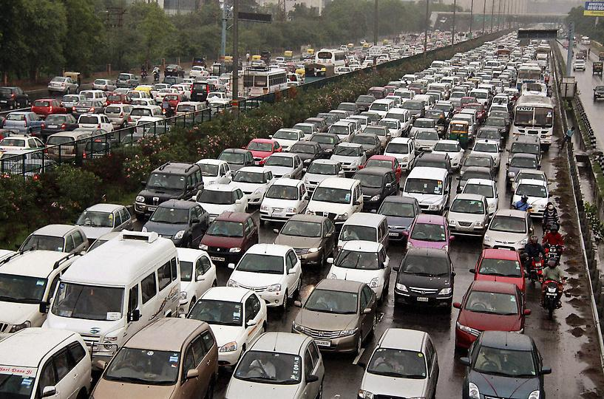
Return to Cell City
If a city continues to grow, more cars will be entering and leaving the city.
More roads must be built or there would be traffic jams everywhere!!
This is the same with the nutrients and waste of a cell.

Slide 6
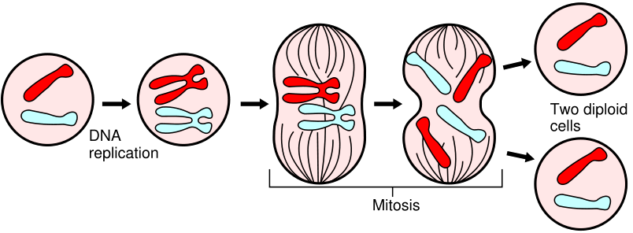
What is cell division?
Cell Division – the process of one cell becoming two new cells.
The original cell is called the parent cell.
The 2 resulting cells are called daughter cells.
Parent Cell
Daughter Cells

Slide 7
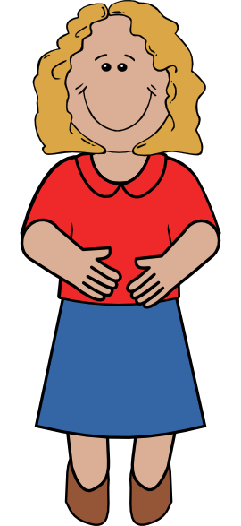
- The End Result
Since the DNA was replicated, each daughter cell receives a complete copy of the parent’s genetic information.
This means both daughter cell’s are identical to the parent cell.

Slide 8
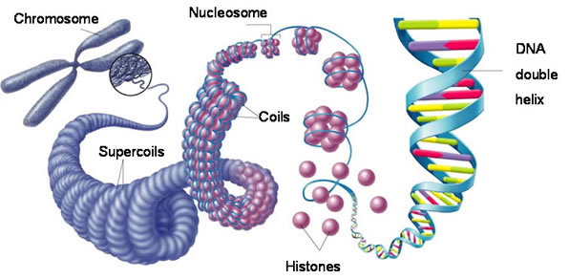
Chromosome Structure
- DNA wraps around proteins called histones.
- Histones group together to form nucleosomes.
- Groups of nucleosomes are called chromatin.
- Very tightly coiled chromatin is what makes a chromosome.

Slide 9
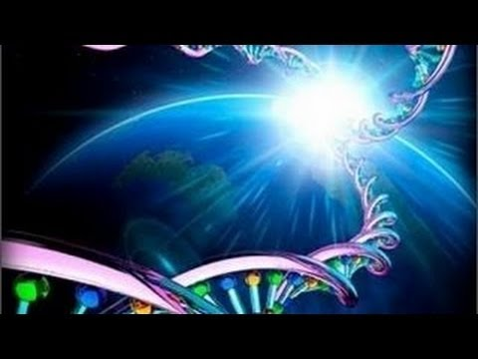
Fun Facts…That Sounds Unnecessary!!
Why package our DNA into chromosomes?
Chromosomes help make sure we separate the same amount of DNA into each daughter cell.
Also, we have a lot of DNA to fit in a small space.
6 feet of DNA in one tiny cell.
DNA of one human
would stretch to the Sun
and back about 65 times!!!!!!

Slide 10
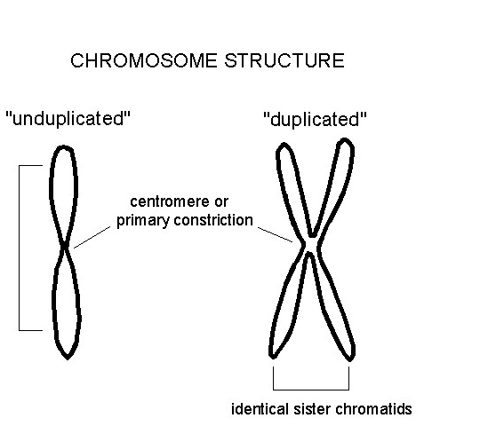
Parts of a Chromosome
- Before replication, a chromosome is a linear package of DNA.
- Once replicated, the two copies connect which makes one chromosome.
- Each individual copy is
called a sister chromatid.
- The chromatids are
connected by the
centromere.

Slide 11
Cell Cycle in Eukaryotes
3 phases of the cell cycle:
-Interphase (G₁, S, G₂)
- Mitosis
Prophase
Metaphase
Anaphase
Telophase
- Cytokinesis

Slide 12
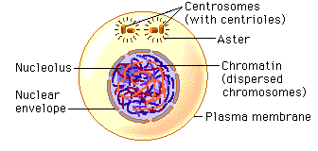
Interphase
Interphase is the phase between division.
G₁: cells are growing as new proteins and organelles are made.
S: new DNA is synthesized as chromosomes are replicated.
G₂: organelles and molecules needed for cell division, such as centrioles, are made.

Slide 13
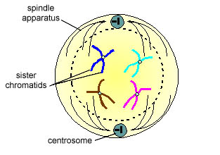
Mitosis – Prophase
- Chromatin in the nucleus condenses to form chromosomes consisting of two sister chromatids connected by a centromere.
- Spindle fibers form at the centrioles, and the centrioles start moving to opposite sides.
- The nuclear envelope breaks down, exposing the chromosomes.

Slide 14
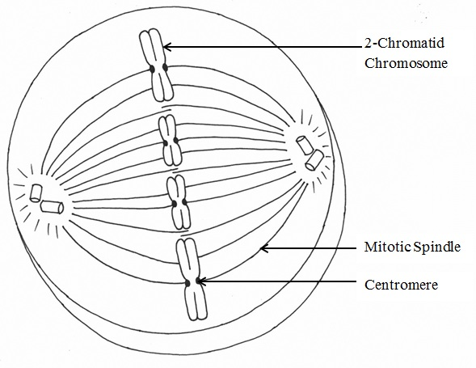
Mitosis – Metaphase
- Centromeres of the chromosomes line up across the center of the cell.
- Spindle fibers connect the centromeres to opposite sides of the cell.

Slide 15
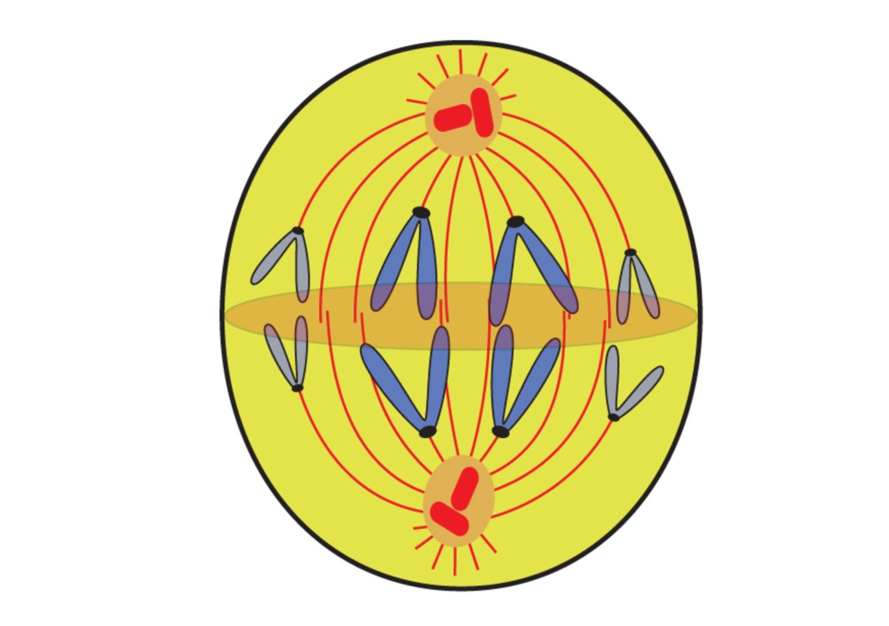
Mitosis – Anaphase
- Sister chromatids separate and move along spindle fibers to opposite sides of the cell.
- Each chromatid is now its own chromosome.

Slide 16
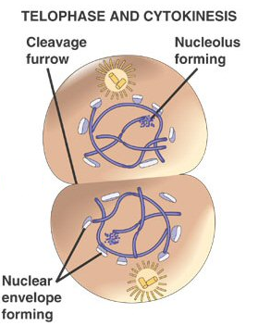
Mitosis - Telophase
- A nuclear envelope starts to re-form.
- Chromosomes spread out to become chromatin again.
- The spindle breaks apart.

Slide 17
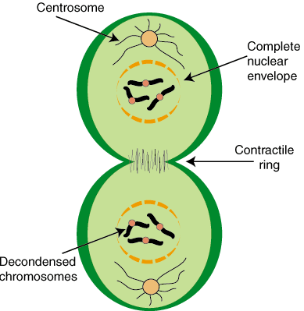
Cytokinesis
- Following mitosis, two nuclei are present, each with a duplicate set of DNA.
- Cytokinesis completes the division by separating the cell into two separate cells.
- In animal cells, the cell membrane is moved together until the cytoplasm is pinched in two.

Slide 18
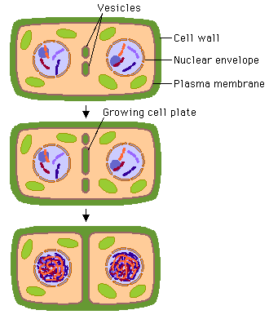
Cytokinesis in Plants
Unlike animals, plants have rigid cell walls which can’t be pinched together.
A cell plate forms between the two nuclei which then turns into a cell wall.
Hello from the other siiiiiiide!!!!

Slide 19
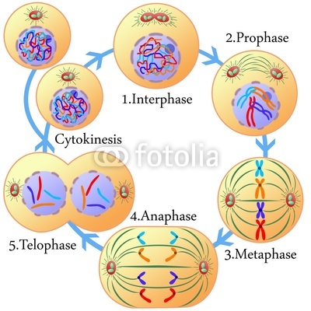
Copy this down in your notes!

Slide 20
Phase | Chromosome Appearance & Location | Important Events
Interphase | DNA is copied; chromatin | DNA replication; cell grows and makes organelles
Prophase | Chromosomes coil up | Nuclear envelope disappears; spindle fibers form
Metaphase | Chromosomes line up in the middle | Spindle fibers connect to chromosomes
Anaphase | Chromosome copies separate and move apart | Spindle fibers pull chromosome copies apart to opposite ends
Telophase | Chromosomes uncoil into chromatin | Nuclear envelopes form around nuclei; spindle fibers fade
Cytokinesis | Chromatin | Cell membrane and cytoplasm divide

Slide 21
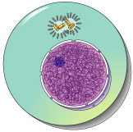
End Result of the Cell Cycle
2 identical daughter cells with the same amount of genetic information.

Slide 22
Memory Trick
I – not as “I”nteresting
P – chromosomes first a”P”pear
M – chromosomes align in the “M”iddle
A – they move “A”way
T – you have “T”wo new cells

Slide 23
Why study cell division?

Slide 24
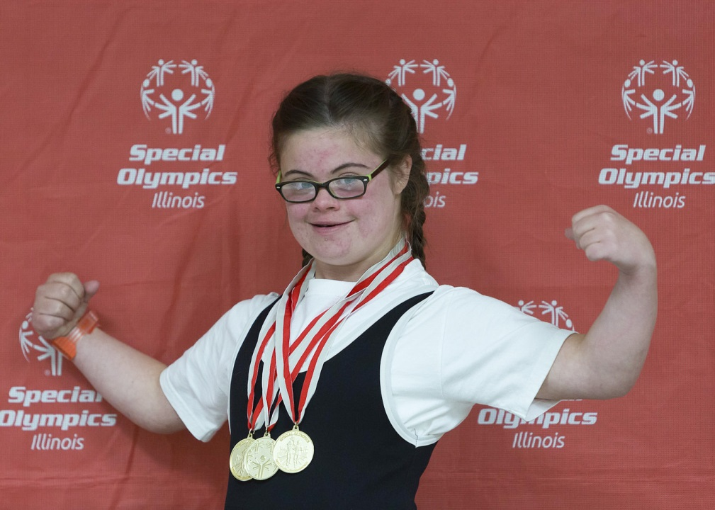
Complications
If genetic information is not separated equally, problems usually occur.
Down syndrome occurs when paired chromosomes do not separate completely during anaphase in sexual reproduction.
A resulting daughter cell then has an extra chromosome.

Slide 25
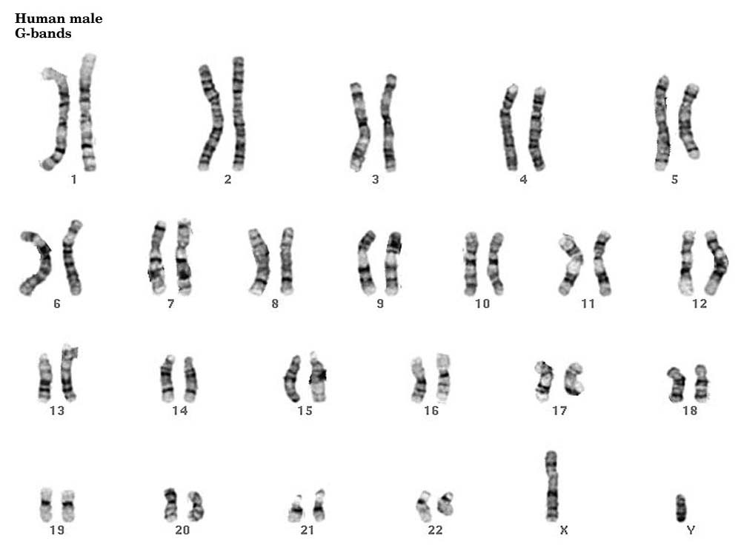
Chromosome Family Picture
Karyotype – picture of chromosomes.
Selfie time!!

Slide 26
Extra Chromosome

Slide 27
Other Applications
Cancer occurs when cell division gets out of control and form tumors.
Stem cells are types of cells that can divide to form different kinds of cells.
We can learn a lot about the spreading of diseases from studying cell division.
Our bodies use cell division to heal wounds.

