Slide 1
Bell Ringer
Get your notebook.
Review your Chapter 1 Notes

Slide 2
Learning Target
I can demonstrate my understanding of vocabulary and key concepts from Chapter 1

Slide 3
Agenda
Bell Ringer
Chapter 1 Assessment in Teams
Videos
What does the atmosphere do?
What is Climate Change?
Exit Ticket: 2 Questions

Slide 4
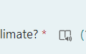
Chapter 1 Assessment: What is the ice on Earth's surface melting?
You will complete the assessment in Teams.
Please go there and find the assignment
You may use your notes during the assessment.
Be sure to click Submit when you are finished.
If you finish early, you may read quietly, work on other homework or draw.
Each question can be read to you by clicking on this icon next to the text.

Slide 5
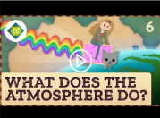
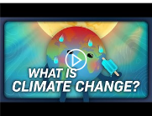
Videos
https://www.youtube.com/watch?v=11ZI9aqurfA
https://www.youtube.com/watch?v=9PFhrpyWV-w

Slide 6
Exit Ticket
In your notebook trace your hand on a blank page.
Write the topic "Atmosphere and Climate Change" inside the hand.
Then write 5 facts you learned from the videos, one fact in each finger.
Atmosphere and Climate Change

