Slide 1
Past Climate Changes on Earth
ECC – Lesson 2.2 -
Notes:
Lesson 2.1 purpose: to introduce a frame for thinking about energy—tracking the amount that enters and exits a system—that will help students explain the mechanism by which climate change occurs
Lesson 2.2 purpose: to show that climate changes have happened in the past and that all climate changes are tied to the relationship between how much energy enters the Earth system relative to the amount of energy that exits the system
Please refer to this lesson’s Materials & Preparation section in the digital Teacher’s Guide or the print Teacher’s Guide for information about preparing to teach this lesson, including any applicable safety notes. Copy and paste the below URLs into your browser to access the resources used in this lesson.
Earth’s Changing Climate Simulation
https://apps.learning.amplify.com/earthschangingclimate
Energy Token Model copymaster
https://learning.amplify.com/m/4c867194dd6bfecf/original/MSSCI_ECC_CU_134.pdf?5514FE42-B5A5-49B3-96B782C675949869
Printable Energy Tokens
https://learning.amplify.com/m/65945cfb49f65136/original/MSSCI_ECC_CU_255.pdf?9BAA672C-A2AA-44D0-99DAFB1A59B4F22A
Earth's Changing Climate Investigation Notebook, pages 32–39
https://learning.amplify.com/m/60fdabb7b7f57c2c/original/ECC_Investigation_Notebook_Pages_32-39_NA18.pdf?107DD67E-FE93-4121-AE49E3929D60A6EC
Earth's Changing Climate Glossary
https://ereader.learning.amplify.com/#/reader/1fd0444c-2ab5-4c69-922b-adf7582b0126/0.0.0
Earth's Changing Climate Multi-Language Glossary
https://ereader.learning.amplify.com/#/reader/fc02db5e-ed0b-4863-84f0-3a4101f3284b
Note: These materials are made available exclusively for use by students and teachers for whom the corresponding materials have been purchased or licensed from Amplify. Any alterations you make should only be shared within your own school or district. Any other distribution or reproduction of these materials is forbidden without written permission from Amplify.

Slide 2
Bell Ringer - Lesson 2.2
Complete Lesson 2.2 Activity 1 in Amplify. Leave computer open when done.
Get your notebook.

Slide 3
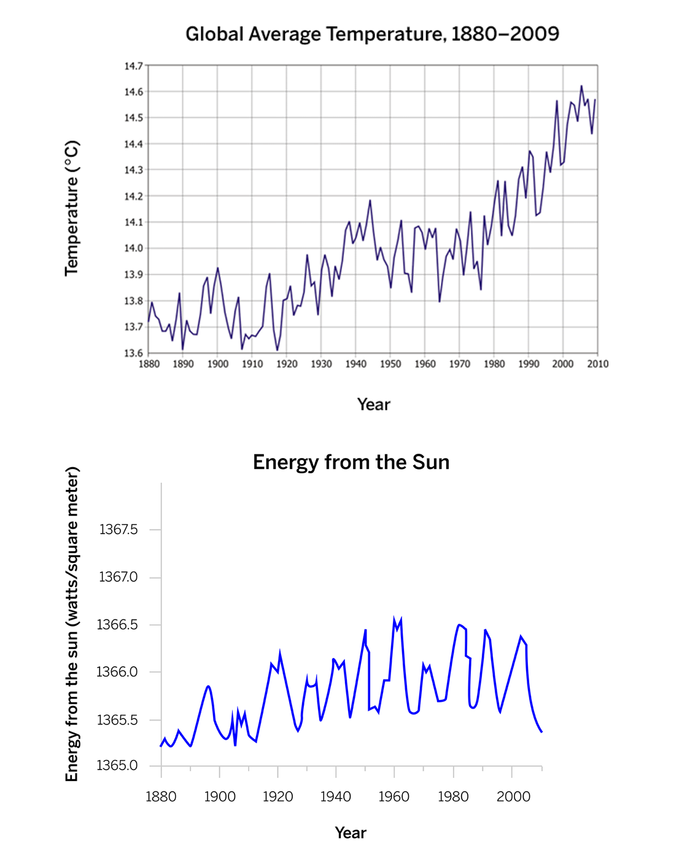
Earth's Changing Climate: Lesson 2.2
Activity 1
Discuss the graphs, and share your responses to the Warm-Up questions.
Notes:
👉Teacher action:
Direct pairs to discuss the graphs and share their responses.

Slide 4
Learning Target
I can gather evidence from an article to explain how Earth’s climate has changed over time.

Slide 5
Agenda
Exit Ticket-Modeling Past Climates in the SIM
Bell Ringer
Reading " Past Climate Changes on Earth"
Discuss Annotations

Slide 6
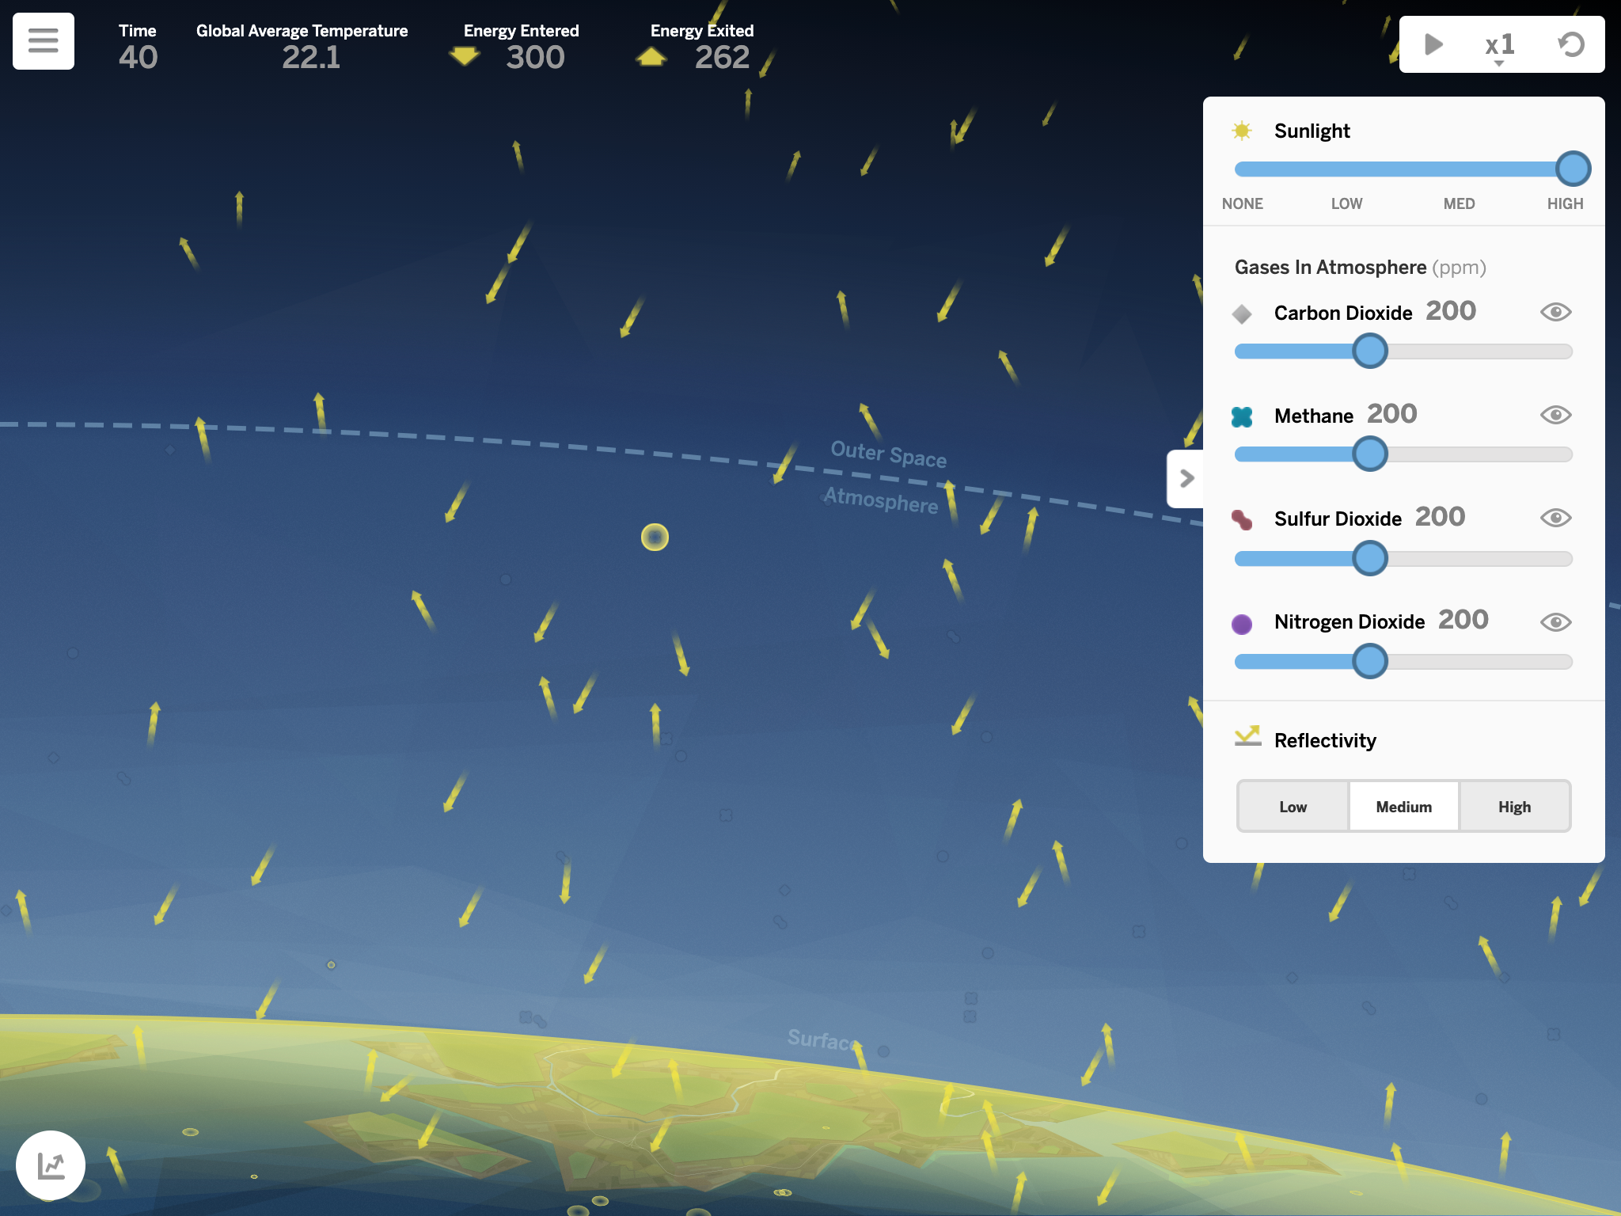
Earth's Changing Climate: Lesson 2.2
Activity 1
We have seen in the Sim test that increasing sunlight causes temperature to increase. If this explained the current warming climate, we would expect to see an increasing trend for sunlight.

Slide 7
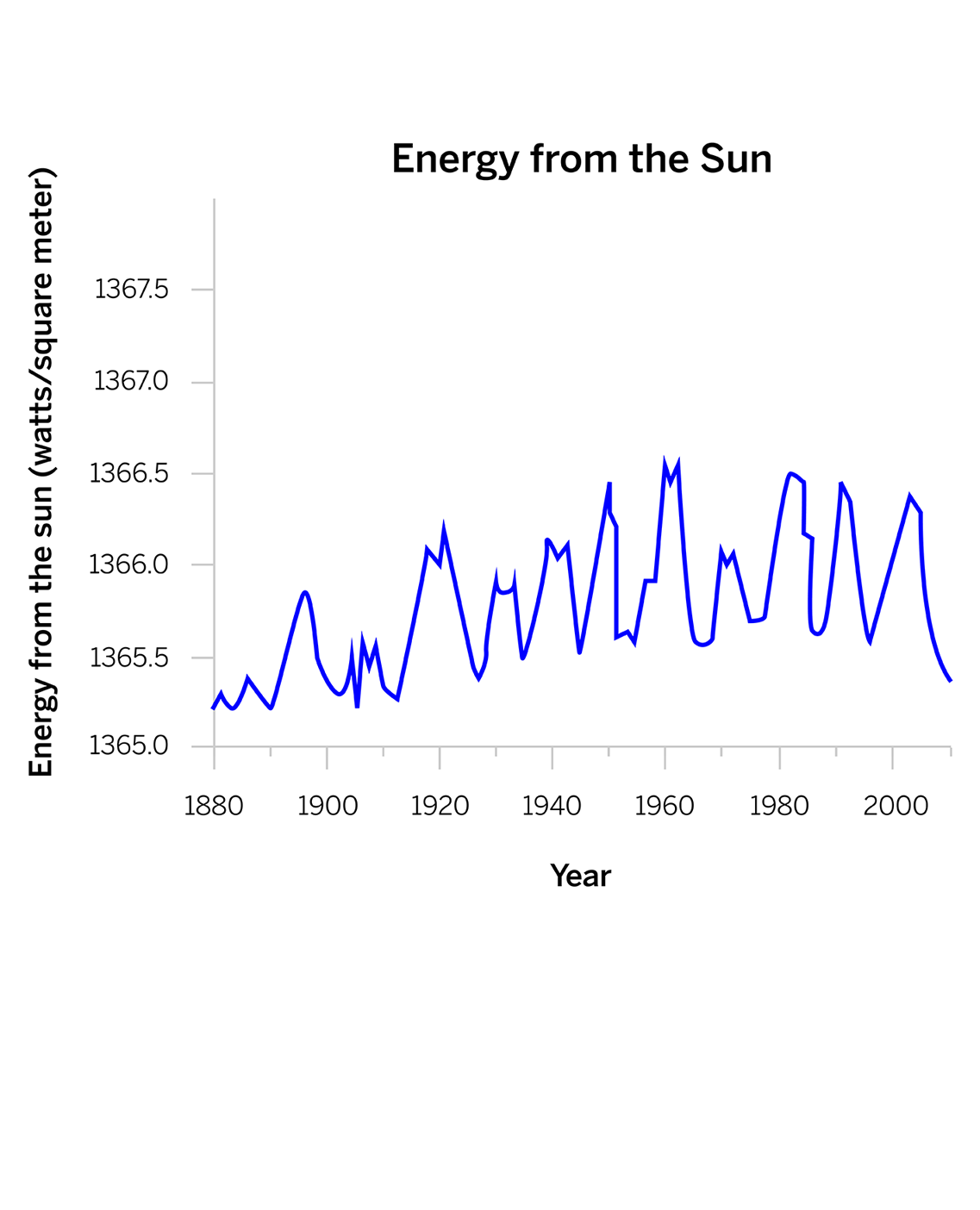
Earth's Changing Climate: Lesson 2.2
Activity 1
The sunlight data shows fluctuations, but overall, the trend looks more or less stable. Remember, we must focus on trends rather than fluctuations when looking at climate change.
Notes:
💬Suggested teacher talk:
If you only looked at data from a short period of time, you might see a sharp increase in energy from the sun, and you could be fooled into thinking it was the cause of the current climate change.

Slide 8
Why is the ice on Earth’s surface melting?
Earth's Changing Climate: Lesson 2.2
Activity 1
We found in the Sim that an increase in sunlight does cause temperatures to increase and ice to melt. But the graph is strong evidence that this is not what has happened since 1880.
Claims:
Increased energy from sunlight
Sun brighter/stronger
Sun closer
Changes to Earth’s atmosphere
pollution
ozone hole
increasing carbon dioxide ✔
increasing methane ✔
decreasing sulfur dioxide
Notes:
👉Teacher action:
Cross out the “Increased energy from sunlight” claims on the chart.

Slide 9
Earth’s Changing Climate: Lesson 2.2
Activity 2
We will continue to gather evidence to answer this question:
Investigation Question: How can the amount of energy absorbed by Earth’s surface change?
Notes:
👉Teacher action:
Point out the Investigation Question written on the board.
💬Suggested teacher talk:
The data in the Warm-Up allowed us to eliminate another claim from the Claims chart, but the remaining claims need further investigation.

Slide 10
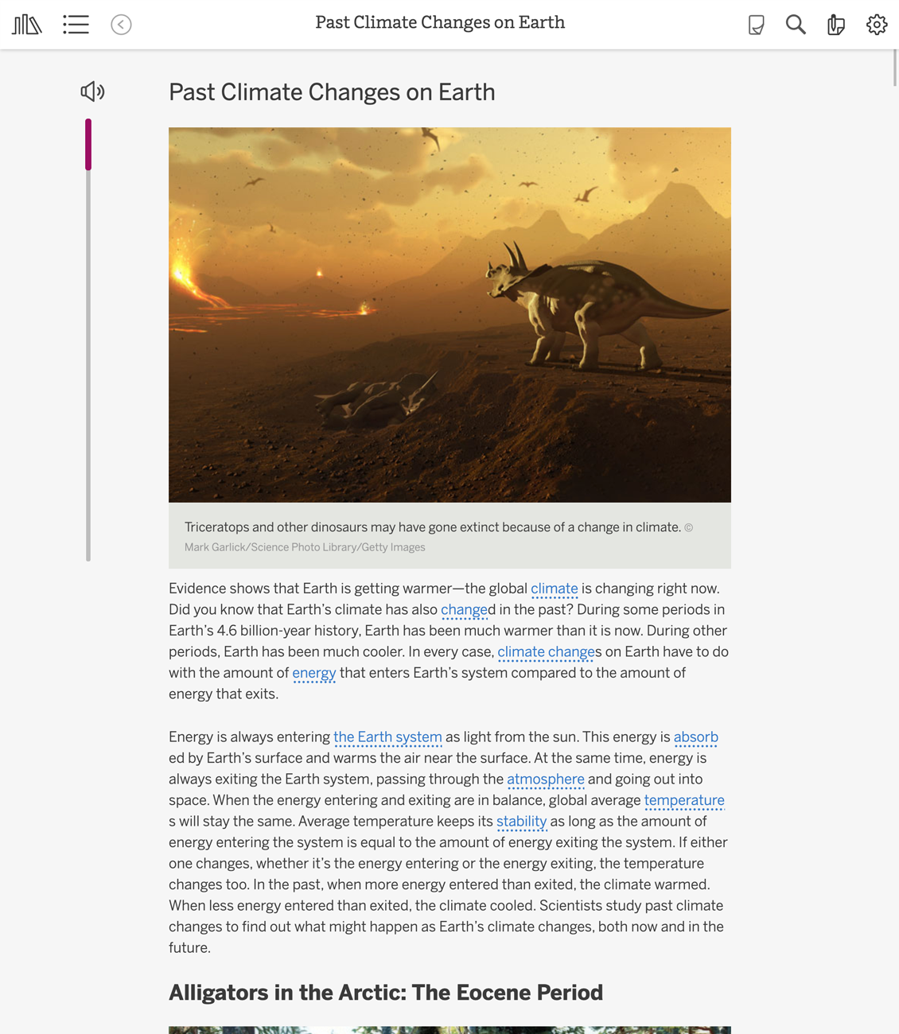
Earth's Changing Climate: Lesson 2.2
Activity 2
To help with your investigation, you will read an article that describes past periods of climate change on Earth.
Notes:
💬Suggested teacher talk:
The article describes scientists’ best understanding of why these periods of change occurred, based on evidence they collected and are still collecting. Thinking about these other climate change events can help scientists better understand what is happening today.

Slide 11
Earth's Changing Climate: Lesson 2.2
Activity 2
As you read, you should pay attention to how changes to energy entering and exiting affected Earth's climate in the past.
When the amount of energy that enters is equal to the amount that exits, the system and temperature are stable. When they are not equal, the system and temperature change.
Notes:
👉Teacher action:
Point out the relevant key concepts from Lesson 2.1 posted on the classroom wall:
6. A system can be stable, even as something flows into and out of the system. If this balanced flow is disrupted, there may be changes to the system.
7. A change to either the amount of energy entering or exiting the Earth system affects how much energy is absorbed by the surface.
8. Temperature increases if more energy enters than exits.

Slide 12
Past Climate Changes on Earth
Go to Lesson 2.2 Activity 2 in Amplify.

Slide 14
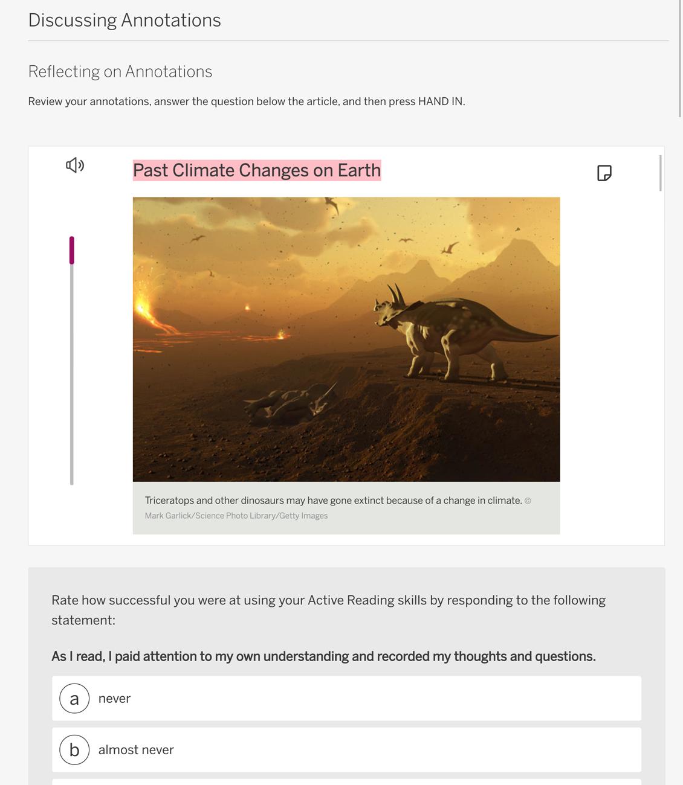
Earth’s Changing Climate: Lesson 2.2
Activity 3 - Screen 2
Review your annotations, and then answer the reflection question.
Notes:
👉Teacher action:
The “Past Climate Changes on Earth” article and each student's annotations should be visible on their student screens. Have students answer the reflection question and, if they are using digital devices, submit their annotated articles by pressing HAND IN.
👉Teacher action (to introduce the homework):
If needed, make additional time to explain the homework. If students do not have access to Amplify Science at home, adjust your schedule to make time to complete the Sim activity in class.
On-the-Fly Assessment 5: Insight from Student Annotations Look for: Review submitted student annotations after class. You can use these annotations to assess students’ annotation skills, reading comprehension, and content understanding. Use the Annotation Tracker and Annotation Tracker Instructions for guidance. Now what? See the Annotation Tracker Instructions for suggestions on how to further support students.

Slide 15
Exit Ticket: Activity 4: Testing Carbon Dioxide and Methane in the SIM
For this activity, you will use the Sim to continue focusing on the relationship between energy and temperature.​
First, make a prediction.
Then, test your predictions.
Finally, answer the questions in Amplify.
Notes:
Both choices (either carbon dioxide or methane) will cause more energy to leave than enter Earth’s system, resulting in a decrease in temperature.

Slide 16
Earth’s Changing Climate: Lesson 2.2

