Slide 1
Cell Signaling
Specific Examples from the Endocrine System in Animals

Slide 2
Endocrine Signaling
Hormones secreted into extracellular fluids by endocrine cells reach their targets via the bloodstream
Endocrine signaling maintains homeostasis, mediates responses to stimuli, regulates growth and development
© 2011 Pearson Education, Inc.

Slide 3
Signaling by Pheromones
Members of the same animal species sometimes communicate with pheromones, chemicals that are released into the environment
Pheromones serve many functions, including marking trails leading to food, a wide range of functions that include defining territories, warning of predators, and attracting potential mates
© 2011 Pearson Education, Inc.

Slide 4
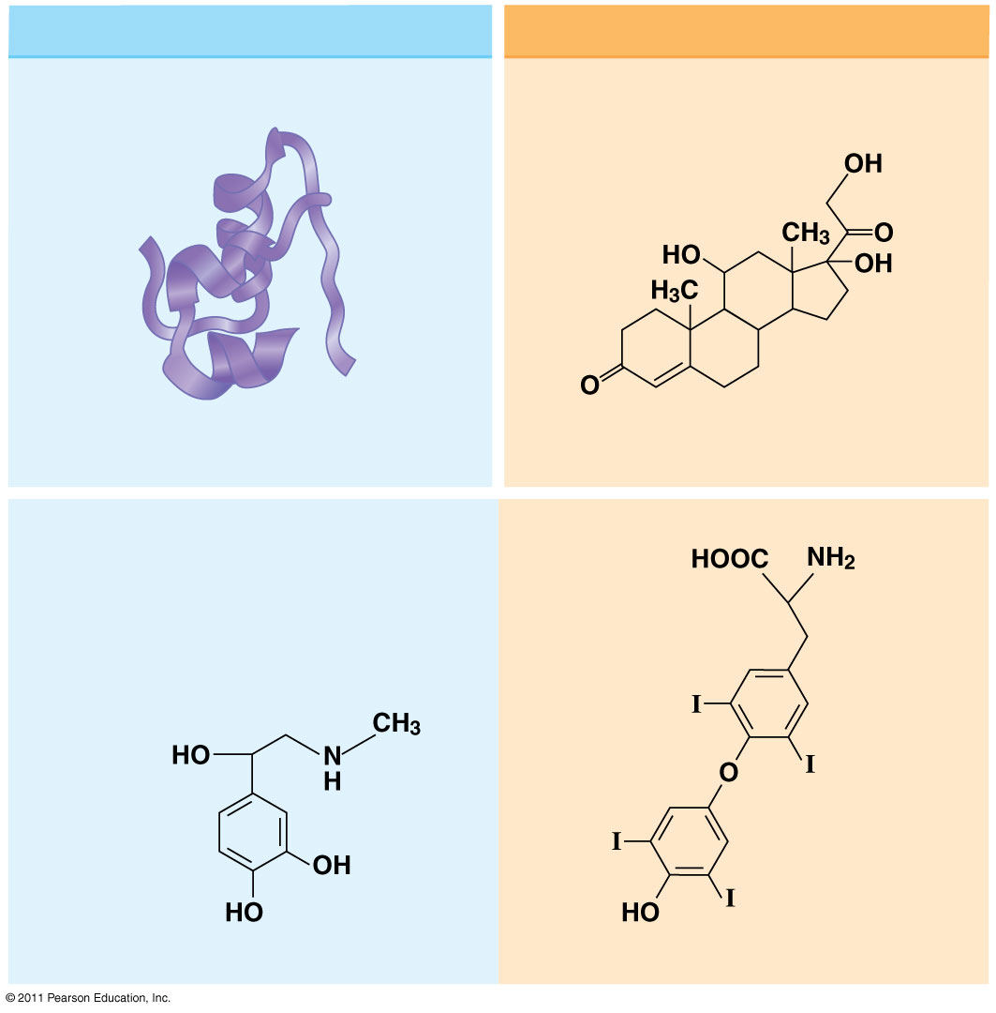
Figure 45.5
Water-soluble (hydrophilic)
Lipid-soluble (hydrophobic)
Polypeptides
Steroids
0.8 nm
Insulin
Cortisol
Amines
Epinephrine
Thyroxine
Notes:
Figure 45.5 Hormones differ in structure and solubility.

Slide 5
Cellular Response Pathways
Water and lipid soluble hormones differ in their paths through a body
Water-soluble hormones are secreted by exocytosis, travel freely in the bloodstream, and bind to cell-surface receptors
Lipid-soluble hormones diffuse across cell membranes, travel in the bloodstream bound to transport proteins, and diffuse through the membrane of target cells
© 2011 Pearson Education, Inc.

Slide 6
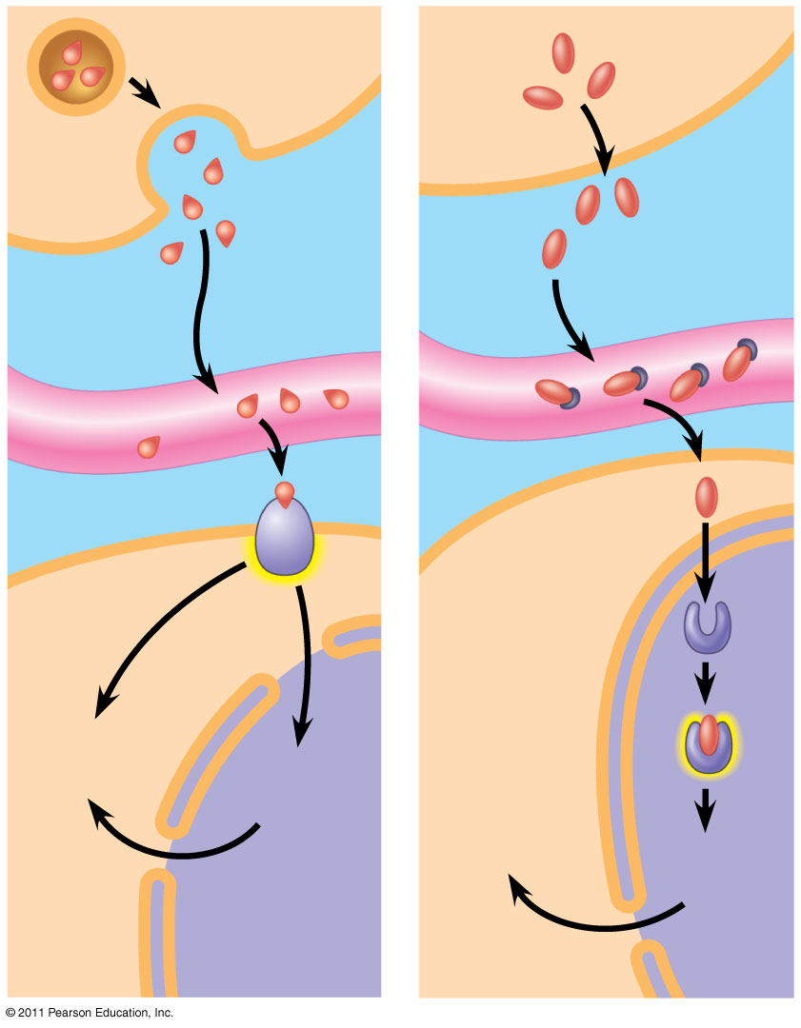
Figure 45.6-2
SECRETORY
CELL
Water-
soluble
hormone
Lipid-
soluble
hormone
VIA
BLOOD
Transport
protein
Signal receptor
TARGET
CELL
OR
Signal
receptor
Cytoplasmic
response
Gene
regulation
Cytoplasmic
response
Gene
regulation
NUCLEUS
(a)
(b)
Notes:
Figure 45.6 Receptor location varies with hormone type.

Slide 7
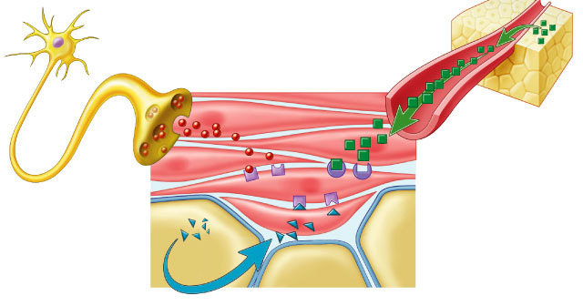
Regulation by chemical messengers
Neurotransmitters released by neurons
Hormones release by endocrine glands
endocrine gland
neurotransmitter
axon
hormone carried by blood
receptor proteins
receptor proteins
Lock & Key
system
target cell

Slide 8
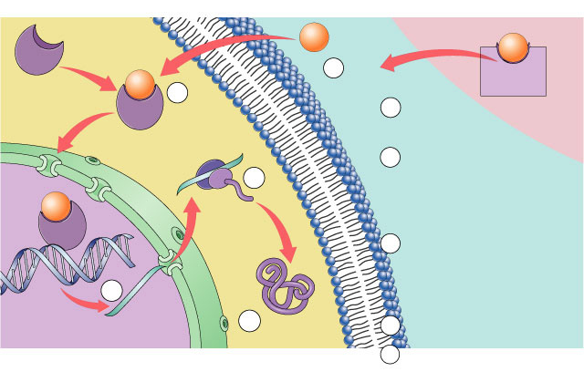
Action of lipid (steroid) hormones
target cell
steroid hormone
blood
S
1
S
cross cell membrane
protein
carrier
S
2
cytoplasm
binds to receptor protein
becomes
transcription factor
5
mRNA read by ribosome
3
S
plasma membrane
DNA
4
mRNA
nucleus
6
7
protein
protein secreted
ex: secreted protein = growth factor (hair, bone, muscle, gametes)

Slide 9
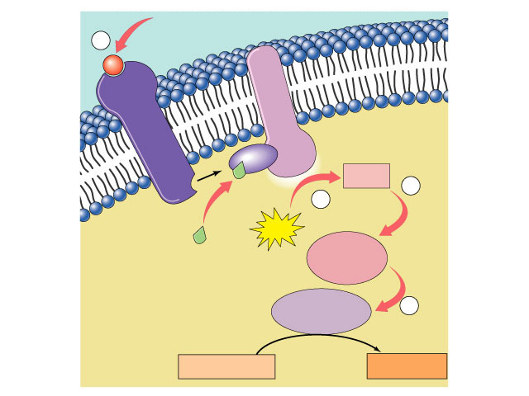
Action of protein hormones
signal-transduction pathway
1
signal
protein
hormone
P
plasma membrane
binds to receptor protein
activates
G-protein
activates enzyme
cAMP
acts as 2° messenger
receptor protein
ATP
transduction
activates
cytoplasmic
signal
GTP
ATP
activates
enzyme
2
secondary
messenger
system
cytoplasm
activates
enzyme
target cell
produces an action
3
response
Notes:
transduction: the action or process of converting something and especially energy or a message into another form

Slide 10
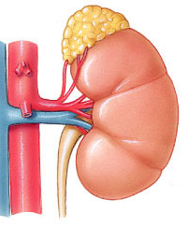
Ex: Action of epinephrine (adrenaline)
signal
adrenal gland
1
epinephrine
activates
G protein
3
receptor
protein
in cell
membrane
activates
adenylyl cyclase
GDP
cAMP
4
transduction
ATP
GTP
2
activates
protein kinase-A
5
activates GTP
activates
phosphorylase kinase
cytoplasm
activates
glycogen phosphorylase
released
to blood
7
liver cell
glycogen
6
glucose
response

Slide 11
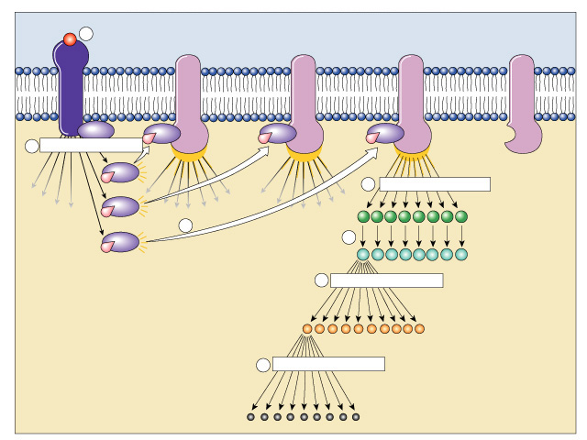
Benefits of a 2° messenger system
signal
1
receptor protein
Activated adenylyl cyclase
2
amplification
Not yet
activated
4
amplification
3
cAMP
amplification
5
GTP
G protein
protein kinase
6
amplification
Amplification!
enzyme
Cascade multiplier!
7
amplification
FAST response!
product

Slide 12
Feedback Regulation
A negative feedback loop inhibits a response by reducing the initial stimulus, thus preventing excessive pathway activity
Positive feedback reinforces a stimulus to produce an even greater response
For example, in mammals oxytocin causes the release of milk, causing greater suckling by offspring, which stimulates the release of more oxytocin
© 2011 Pearson Education, Inc.

Slide 13
Insulin and Glucagon: Control of Blood Glucose
Insulin (decreases blood glucose) and glucagon (increases blood glucose) are antagonistic hormones that help maintain glucose homeostasis
The pancreas has clusters of endocrine cells called pancreatic islets with alpha cells that produce glucagon and beta cells that produce insulin
© 2011 Pearson Education, Inc.

Slide 14
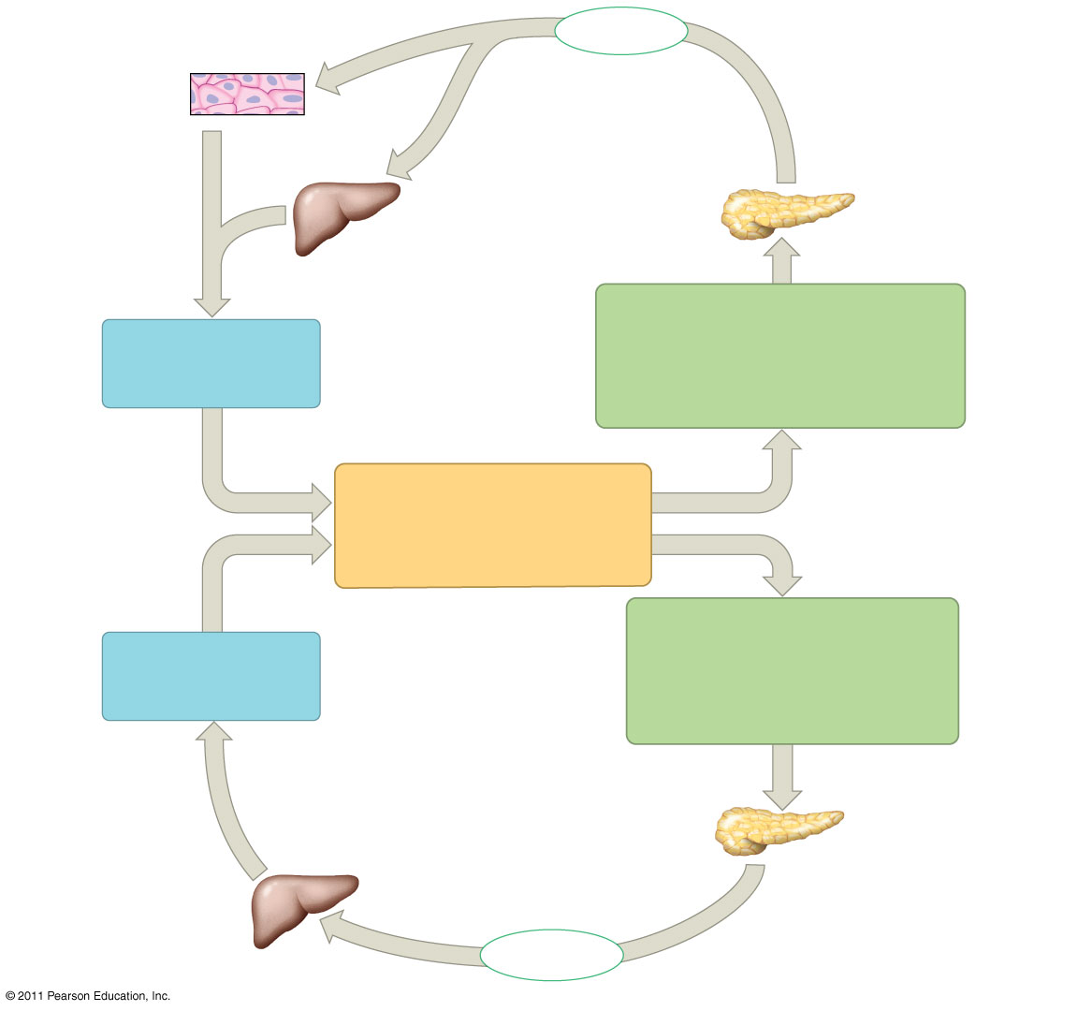
Figure 45.13
Body cells
take up more
glucose.
Insulin
Beta cells of
pancreas
release insulin
into the blood.
Liver takes
up glucose
and stores it
as glycogen.
STIMULUS:
Blood glucose level rises
(for instance, after eating a
carbohydrate-rich meal).
Blood glucose
level declines.
Homeostasis:
Blood glucose level
(70–110 mg/m100mL)
STIMULUS:
Blood glucose level
falls (for instance, after
skipping a meal).
Blood glucose
level rises.
Liver breaks
down glycogen
and releases
glucose into
the blood.
Alpha cells of pancreas
release glucagon into
the blood.
Glucagon
Notes:
Figure 45.13 Maintenance of glucose homeostasis by insulin and glucagon.

Slide 15
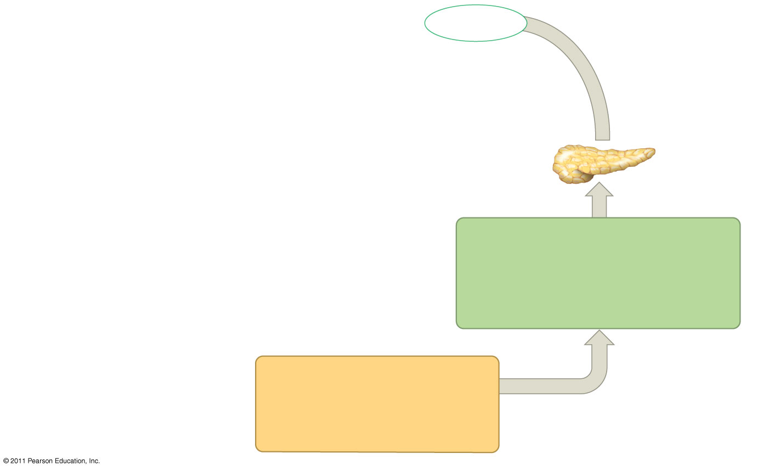
Figure 45.13a-1
Insulin
Beta cells of
pancreas
release insulin
into the blood.
STIMULUS:
Blood glucose level rises
(for instance, after eating a
carbohydrate-rich meal).
Homeostasis:
Blood glucose level
(70–110 mg/100 mL)
Notes:
Figure 45.13 Maintenance of glucose homeostasis by insulin and glucagon.

Slide 16
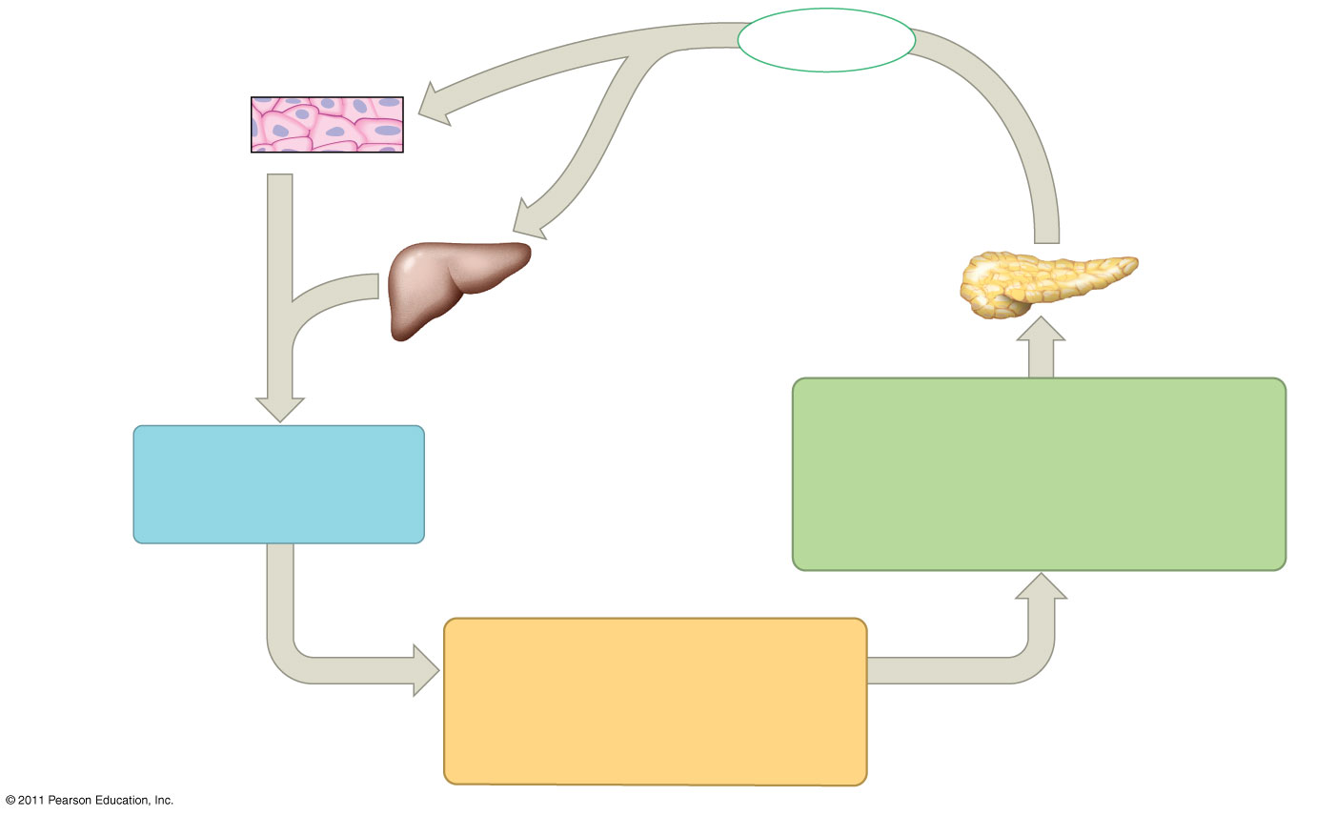
Figure 45.13a-2
Body cells
take up more
glucose.
Insulin
Beta cells of
pancreas
release insulin
into the blood.
Liver takes
up glucose
and stores it
as glycogen.
STIMULUS:
Blood glucose level rises
(for instance, after eating a
carbohydrate-rich meal).
Blood glucose
level declines.
Homeostasis:
Blood glucose level
(70–110 mg/100 mL)
Notes:
Figure 45.13 Maintenance of glucose homeostasis by insulin and glucagon.

Slide 17
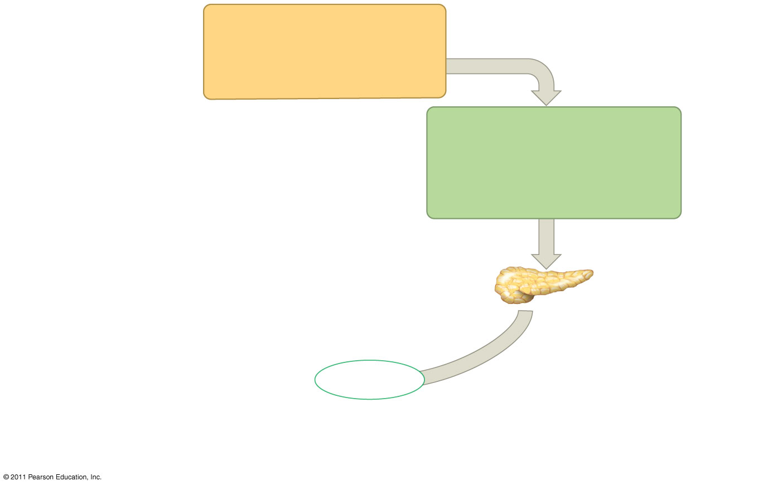
Figure 45.13b-1
Homeostasis:
Blood glucose level
(70–110 mg/100 mL)
STIMULUS:
Blood glucose level
falls (for instance, after
skipping a meal).
Alpha cells of pancreas
release glucagon into
the blood.
Glucagon
Notes:
Figure 45.13 Maintenance of glucose homeostasis by insulin and glucagon.

Slide 18
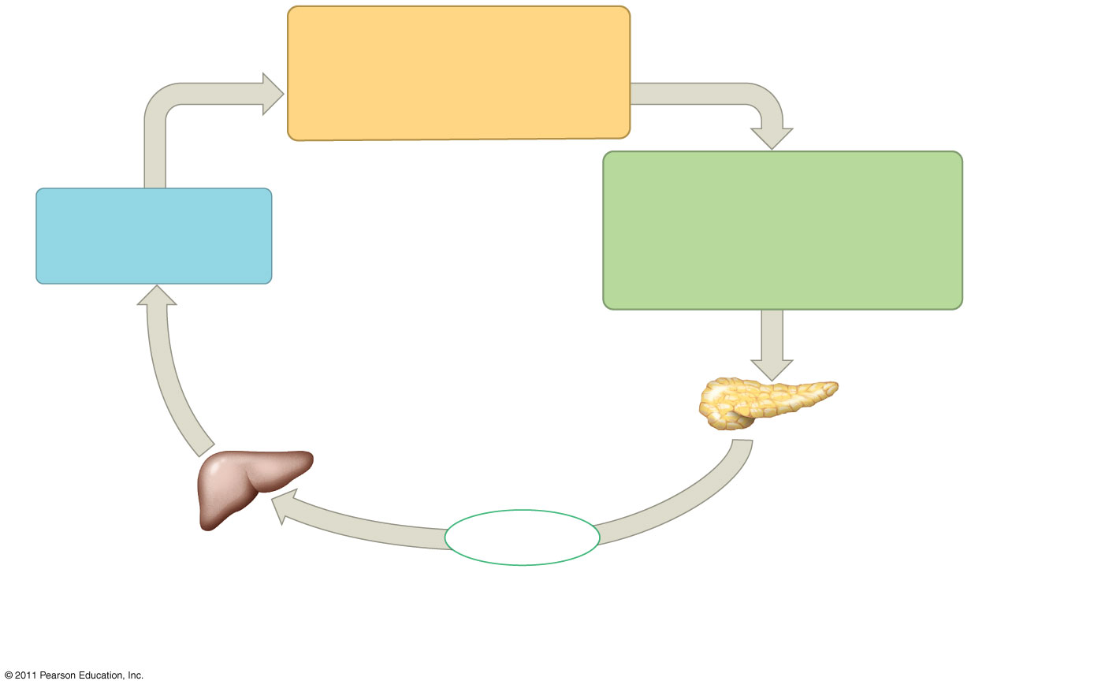
Figure 45.13b-2
Homeostasis:
Blood glucose level
(70–110 mg/100 mL)
STIMULUS:
Blood glucose level
falls (for instance, after
skipping a meal).
Blood glucose
level rises.
Alpha cells of pancreas
release glucagon into
the blood.
Liver breaks
down glycogen
and releases
glucose into
the blood.
Glucagon
Notes:
Figure 45.13 Maintenance of glucose homeostasis by insulin and glucagon.

Slide 19
Target Tissues for Insulin and Glucagon
Insulin reduces blood glucose levels by
  Promoting the cellular uptake of glucose
  Slowing glycogen breakdown in the liver
  Promoting fat storage, not breakdown
© 2011 Pearson Education, Inc.

Slide 20
Glucagon increases blood glucose levels by
  Stimulating conversion of glycogen to glucose in the liver
  Stimulating breakdown of fat and protein into glucose
© 2011 Pearson Education, Inc.

Slide 21
Diabetes Mellitus
Diabetes mellitus is perhaps the best-known endocrine disorder
It is caused by a deficiency of insulin or a decreased response to insulin in target tissues
It is marked by elevated blood glucose levels
© 2011 Pearson Education, Inc.

Slide 22
Type I diabetes mellitus (insulin-dependent) is an autoimmune disorder in which the immune system destroys pancreatic beta cells
Type II diabetes mellitus (non-insulin-dependent) involves insulin deficiency or reduced response of target cells due to change in insulin receptors
© 2011 Pearson Education, Inc.

Slide 23
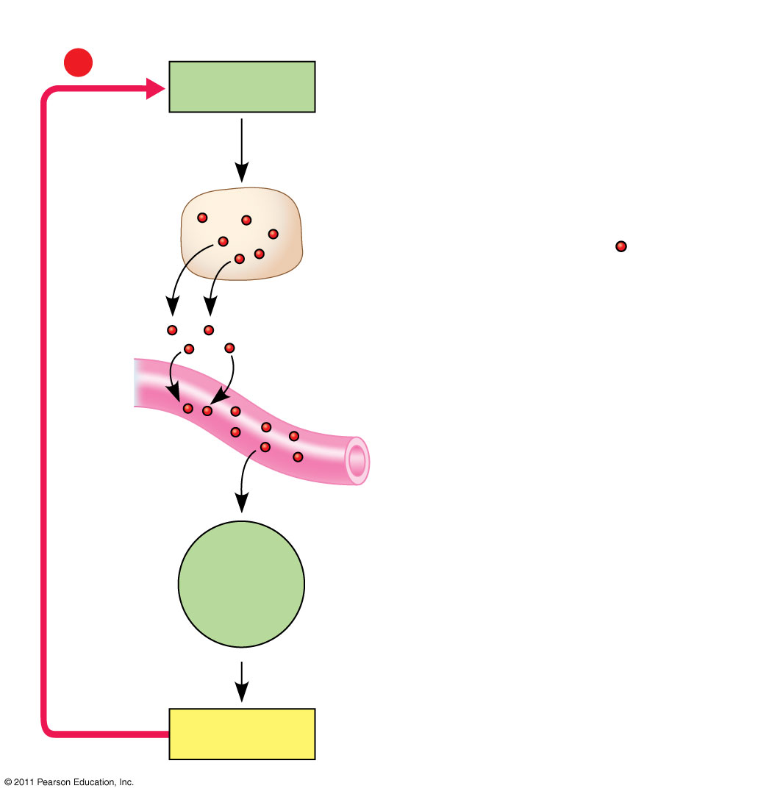
Figure 45.UN02
Pathway
Example
−
Stimulus
Low blood glucose
Pancreas secretes
glucagon ( ).
Endocrine
cell
Hormone
Negative feedback
Blood
vessel
Target
cells
Liver
Glycogen breakdown,
glucose release
into blood
Response
Notes:
Figure 45.UN02 Summary figure, Concept 45.2

