Slide 1
Genetics Review Problems

Slide 2
#1
In guinea pigs short hair is dominant to long hair. Cross two heterozygous guinea pigs. (Be sure to show the Punnett Square
A. What are the genotypes of the parents?
B. What alleles can the mother give to her kids?
C. What is the genotypic ratio?
D. What is the phenotypic ratio of the offspring?
E. If 30 guinea pigs were born, how many would you expect to have short hair?

Slide 3
#2
In guinea pigs short hair is dominant to long hair. Cross a heterozygous guinea pig with a long haired guinea pig. (Be sure to show the Punnett Square)
A. What are the genotypes of the parents?
B. What alleles can the mother give to her kids?
C. What is the genotypic ratio?
D. What is the phenotypic ratio of the offspring?
E. If 30 guinea pigs were born, how many would you expect to have short hair?

Slide 4
#3
Tall plants are dominant to short plants and green plants are dominant to yellow. A heterozygous green heterozygous tall plant is crossed with a short yellow plant.
A. What are the parental genotypes?
B. How many different combinations of alleles could each parent’s gametes (sex cells) contain?
C. Set up the Punnett square.
D. What is the phenotypic ratio of offspring?
E. If the cross yielded 1000 offspring, how many would you expect to be short and yellow?

Slide 5
#4. In sesame plants, the one-pod condition (P ) is dominant to the three-pod condition (p ), and normal leaf (L ) is dominant to wrinkled leaf (l) . Pod type and leaf type are inherited independently. What is the phenotypic ratio when you cross two heterozygous parents?

Slide 6
#5 The lubber grasshopper is a very large grasshopper, and is black with red and yellow stripes. Assume that red stripes are expressed from the homozygous RR genotype, yellow stripes from the homozygous YY genotype, and both colored stripes from the heterozygous genotype.
A) Is this incomplete or complete dominance?
B) How would this problem be different if it was the opposite answer from “A” above?
C) What will be the phenotypic ratio and genotypic ratio of the F₁ generation resulting from a cross of two grasshoppers, both with red and yellow stripes?

Slide 7
#6 A man who has type A blood marries a woman and they have 4 children. They find among their 4 children one of each of the four blood types. What is the woman’s genotype?

Slide 8
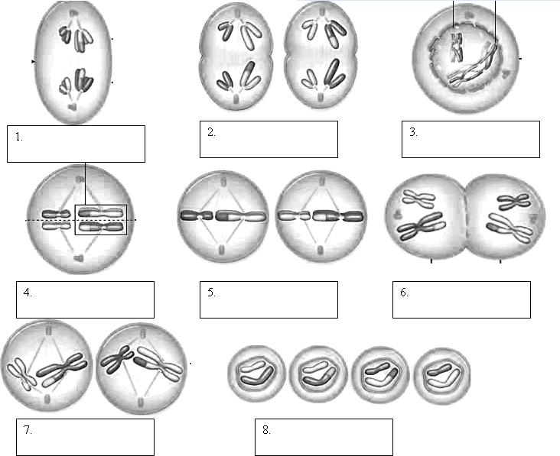
#8 Put the following phases of meiosis in order

Slide 9
#9 Linked genes
1) When genes are on the same chromosome they are called _______
2) Crossing over would occur most between genes _____ and ______.
3) Crossing over would occur least between genes _____ and _______.

Slide 10
#10 What is the chance of having three boys in a row?

Slide 11
#11 What is the probability that a child from the following cross would have a dominant phenotype? AaBbCcDd x AAbbCcDd

