Slide 1
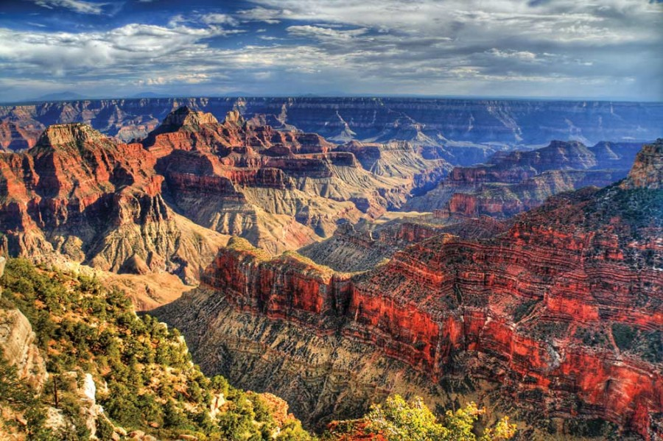
Geologic Time

Slide 2
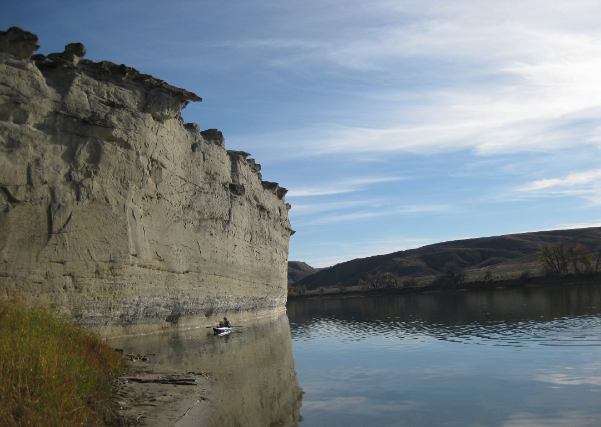
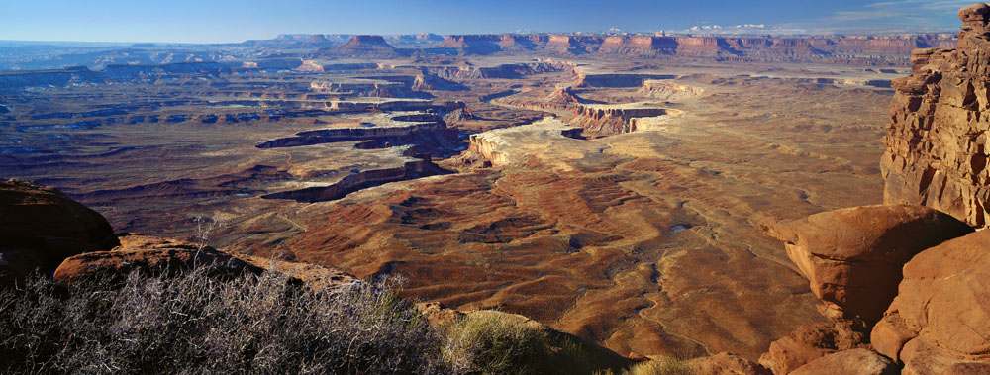
Sedimentary Rock Formation Favs.

Slide 3
Where do sediments come from?
- Weathering – breaking down rock into smaller pieces chemically and physically.
- Erosion- carrying away the particles and depositing them.
Glaciers
Wind
Running Water

Slide 4
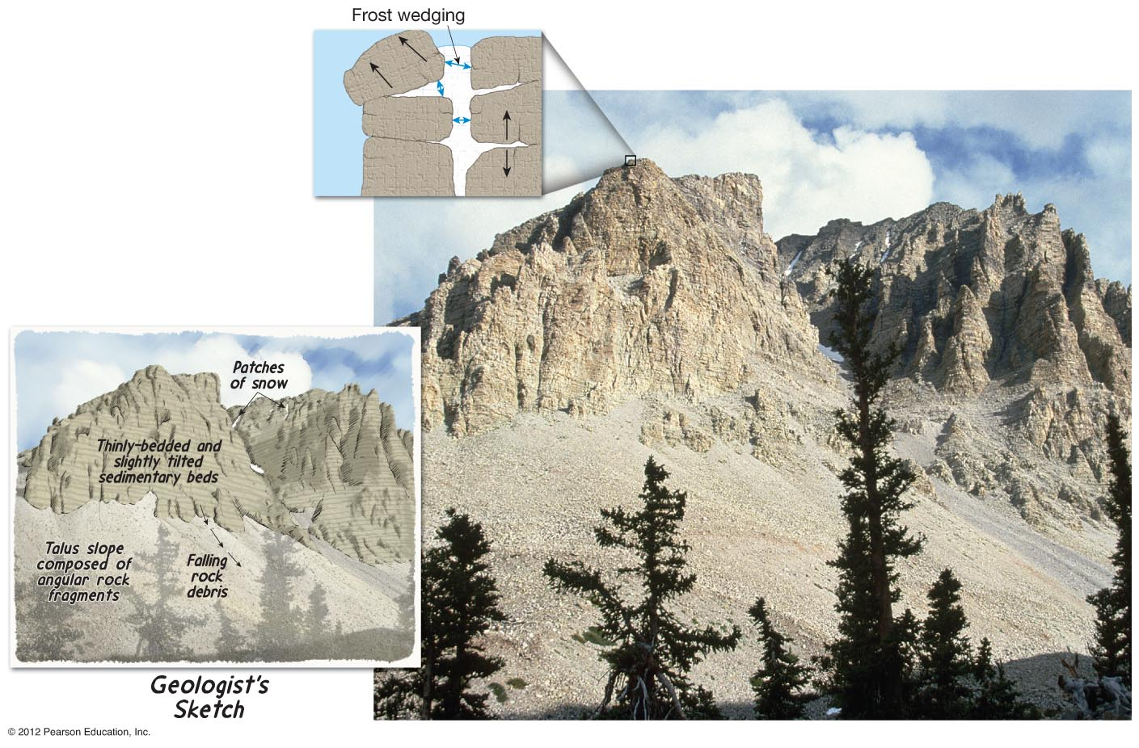
Physical Weathering Ex. Frost wedging
Talus slope . . . a.k.a.?
Notes:
a.k.a. skree or skree slope

Slide 5
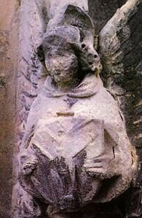
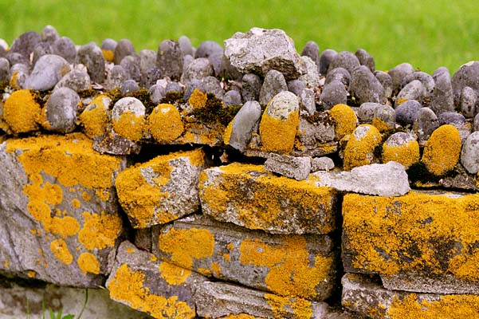
Chemical Weathering
Ex. Hydrolysis
Notes:
Caused by acid rain

Slide 6
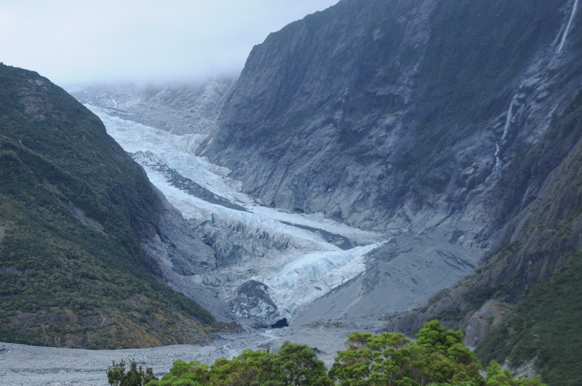
Glacier Erosion

Slide 7
Formation of Sedimentary Rocks
Sediment is deposited after erosion.
Compaction of particles by weight and compression.
Cementation (glueing) of particles by silicates or calcite.

Slide 8
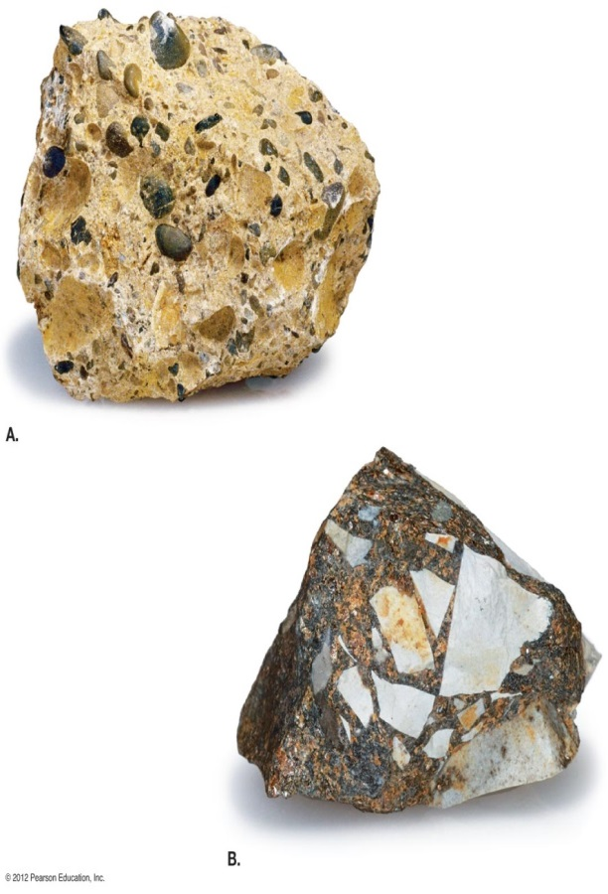
Three types of sedimentary rocks: 1. Clastic
Made of particles of other rocks.
Particle sizes
>2 mm = gravel/stones
0.06 – 2 mm = sand
0.004 – 0.06mm = silt
< 0.002 mm = clay
Examples: Breccia,
Conglomerate,
Sandstone and Shale (Tarbuck)

Slide 9
Work Cited
Tarbuck, E. Lutgens, Frederick. Earth Science. New Jersey: Pearson Education. 2012. Print

Slide 10
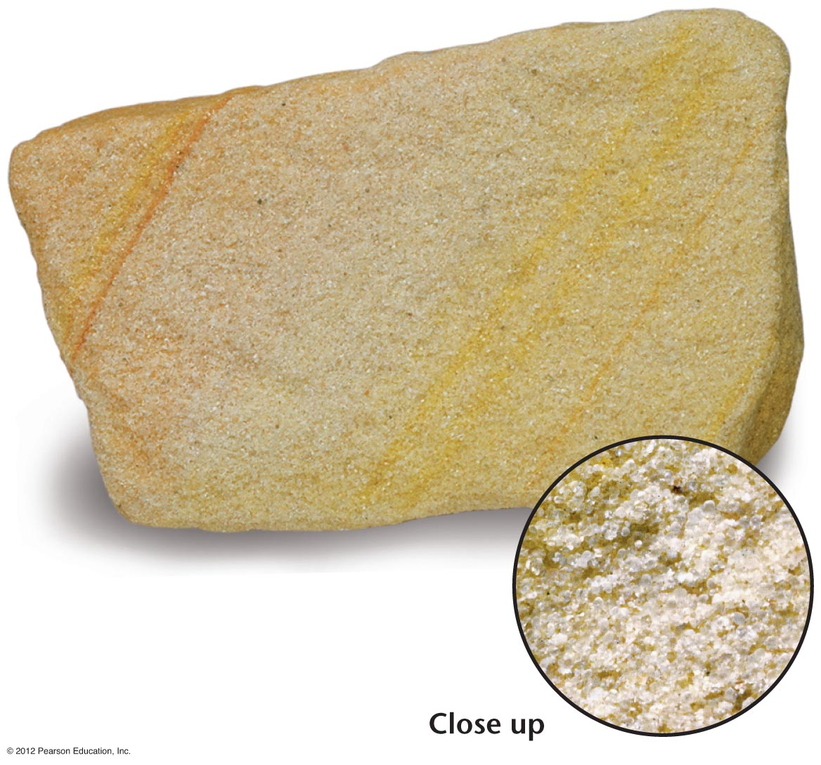

Slide 11
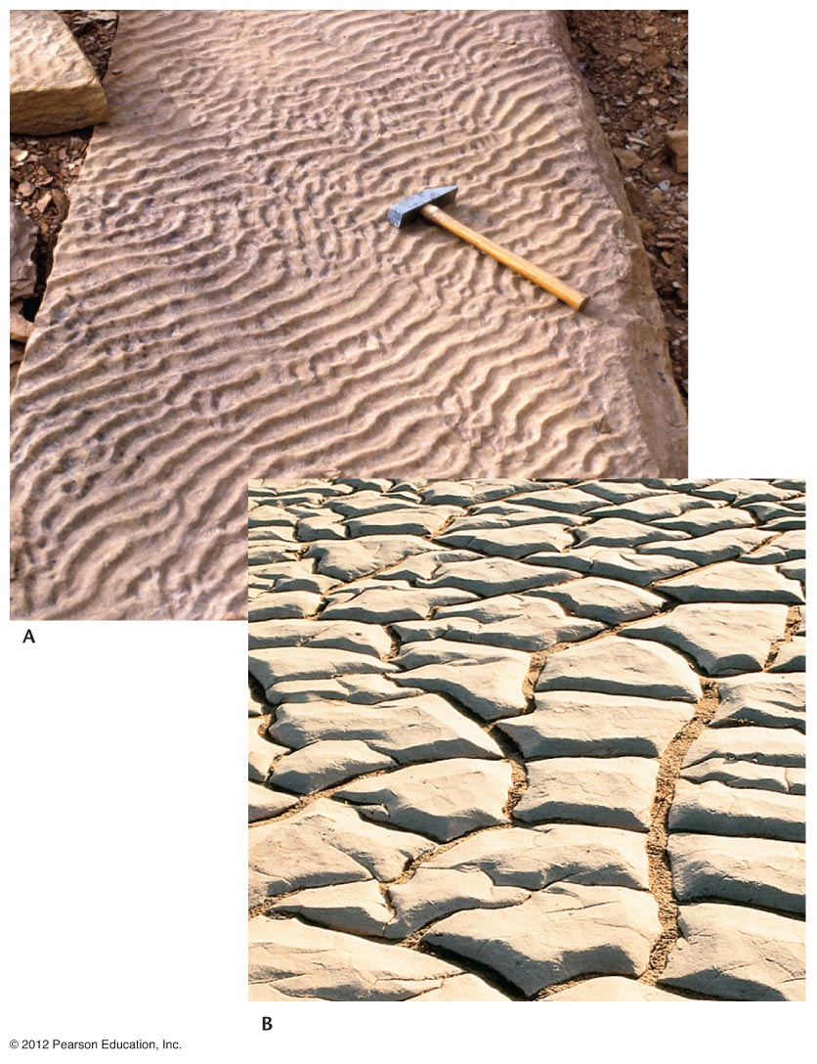

Slide 12
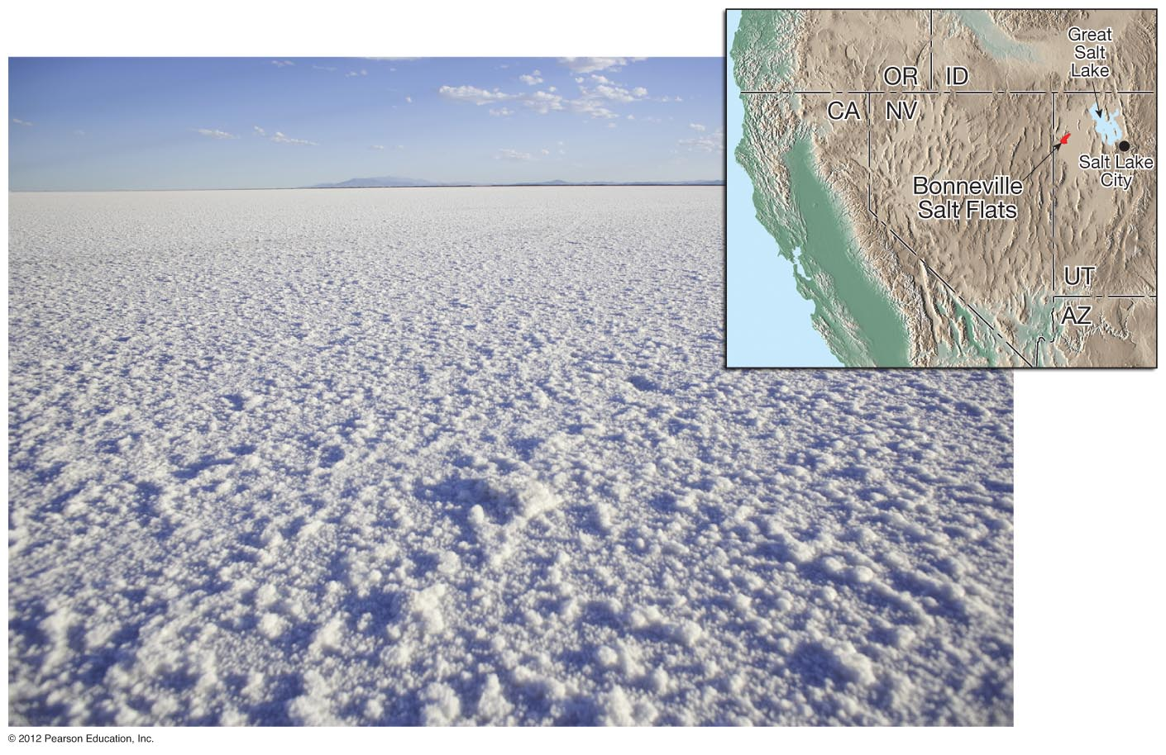
2. Chemical
Appear crystalline
Made by mineral precipitating out of water or by evaporation leaving mineral behind.
Examples: Rock Salt, Gypsum, Calcite, Limestone, Tufa

Slide 13
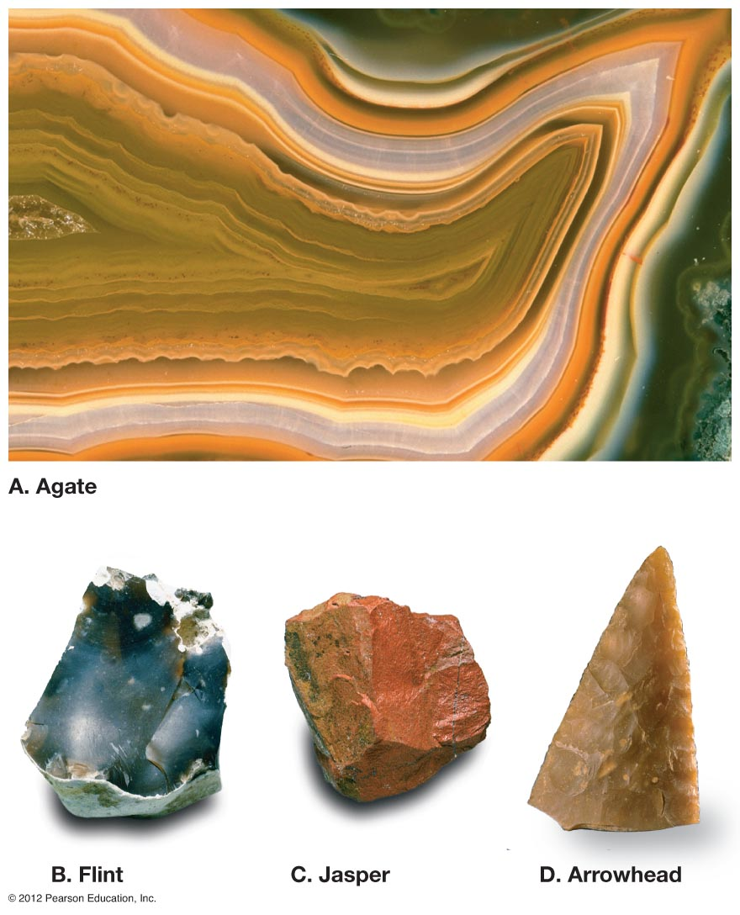

Slide 14
3. Organic
Formed from compaction and cementation of organic material plants, animals and shells.
Examples: Bituminous Coal, Fossiliferous Limestone, Chalk, Coquina

Slide 15
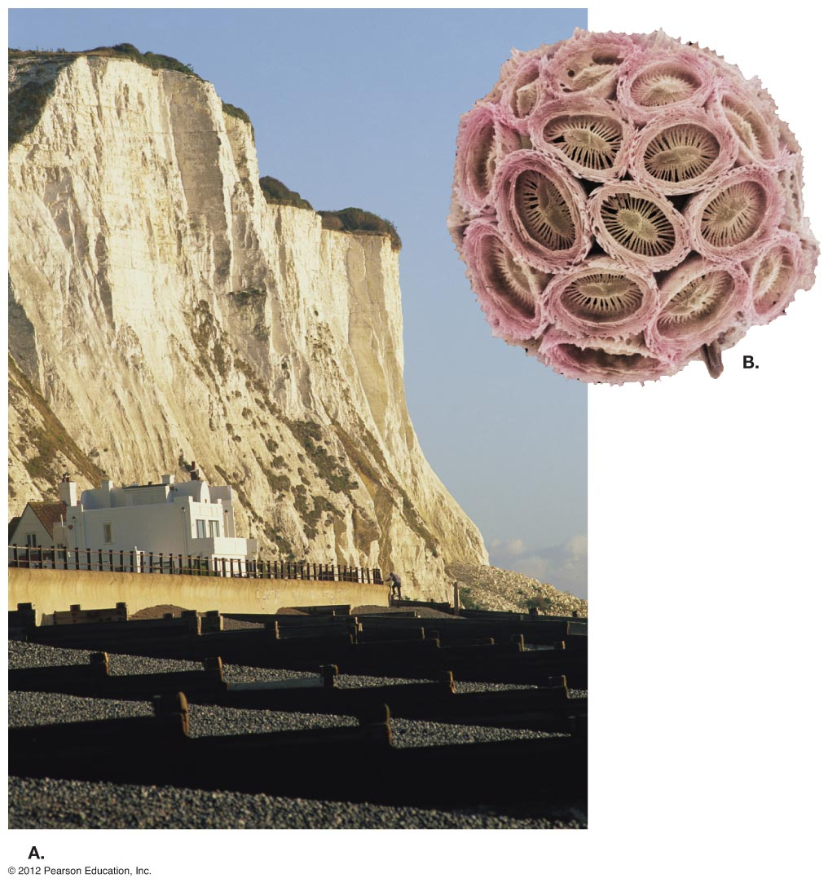

Slide 16
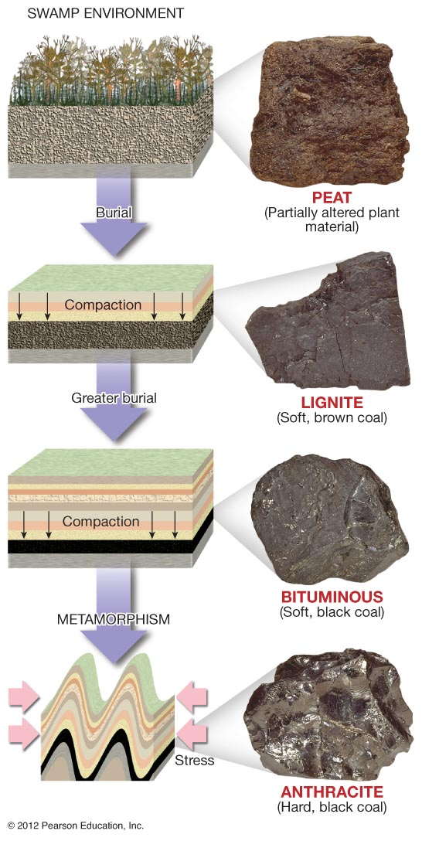

Slide 17
Metamorphic Rocks
Rock that has been changed due to heat and pressure.
Created by magma heating rock and stress from plate tectonics.

Slide 18
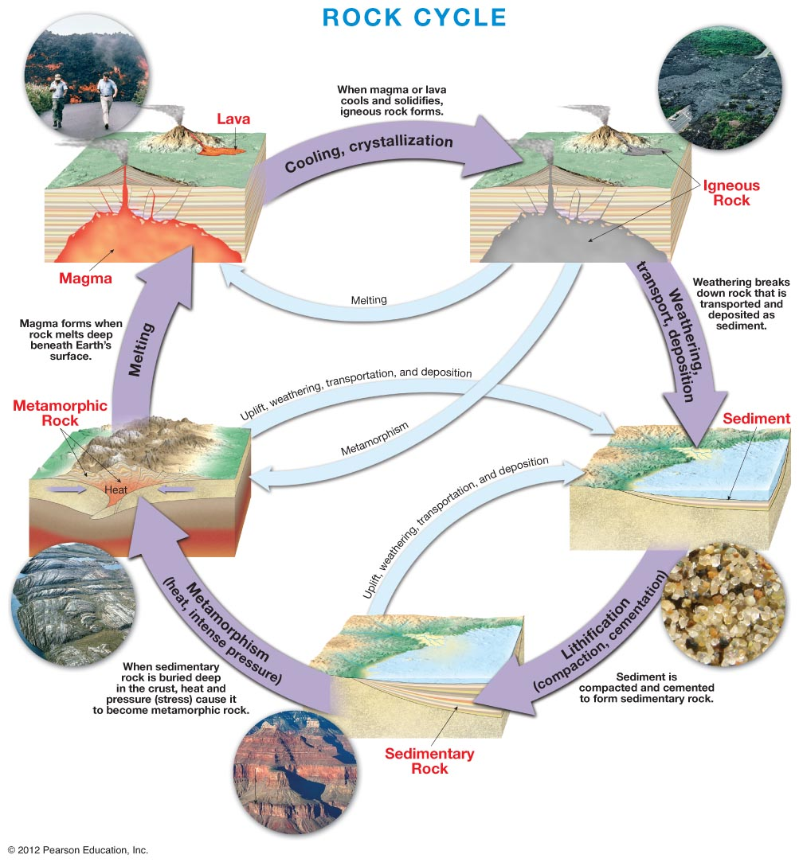

Slide 19
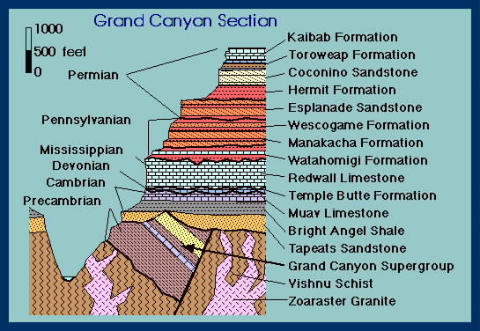
A Geologic Column is a model of the rock record from a particular location. It is made up of the rock layers arranged according to their relative ages & positions.

Slide 20
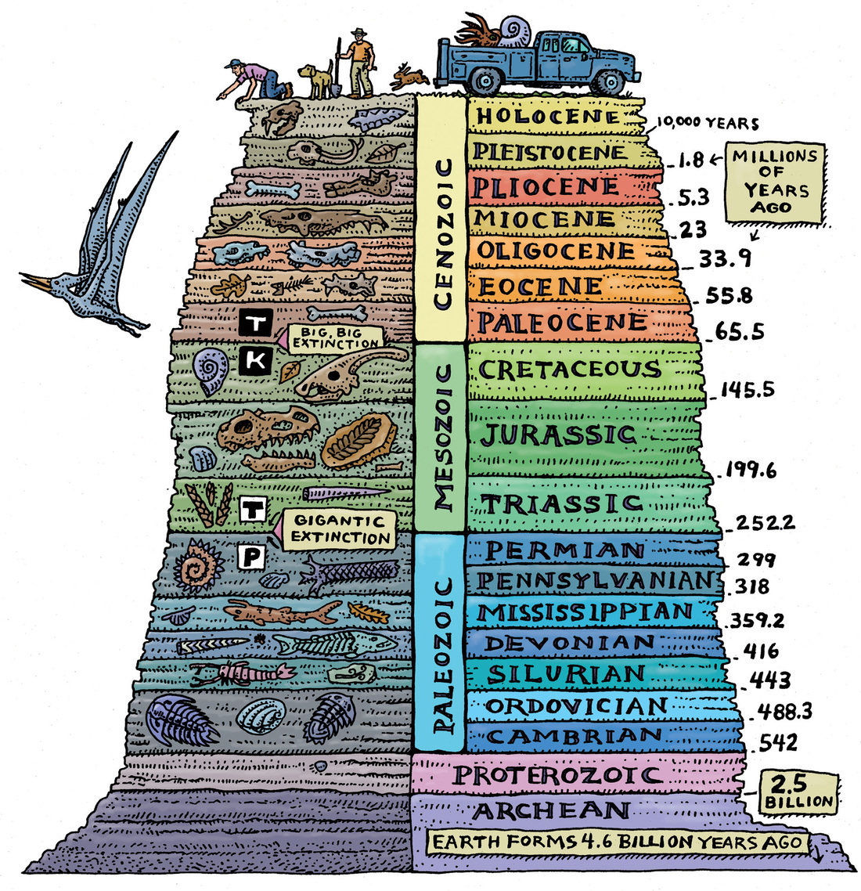

Slide 21
Before we start, understand uniformitarianism. The longest word you will learn in Earth Science.
*Uniformitarianism
- “The Past is key to the present.” (James Hutton)

Slide 22
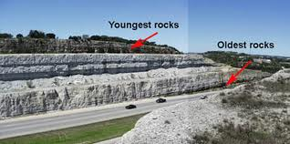
*Relative Time
- process where rocks are placed in the sequence that they formed.

Slide 23
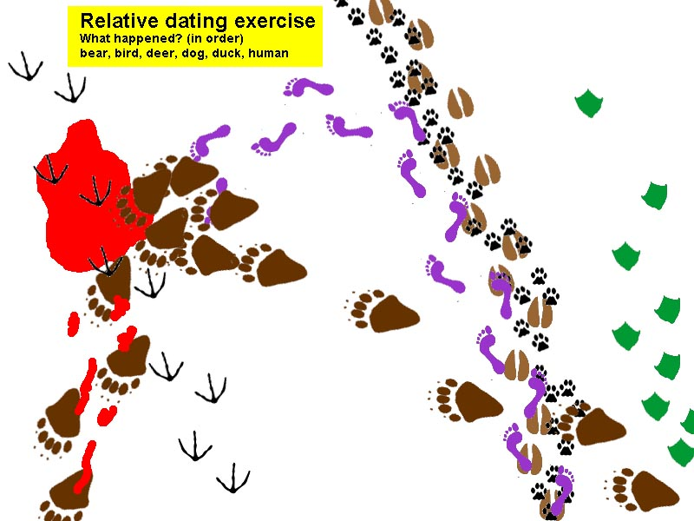

Slide 24
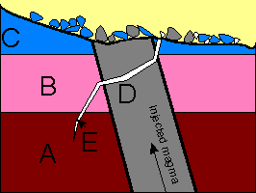
Write the numbers in the order that the geologic events occurred.

Slide 25
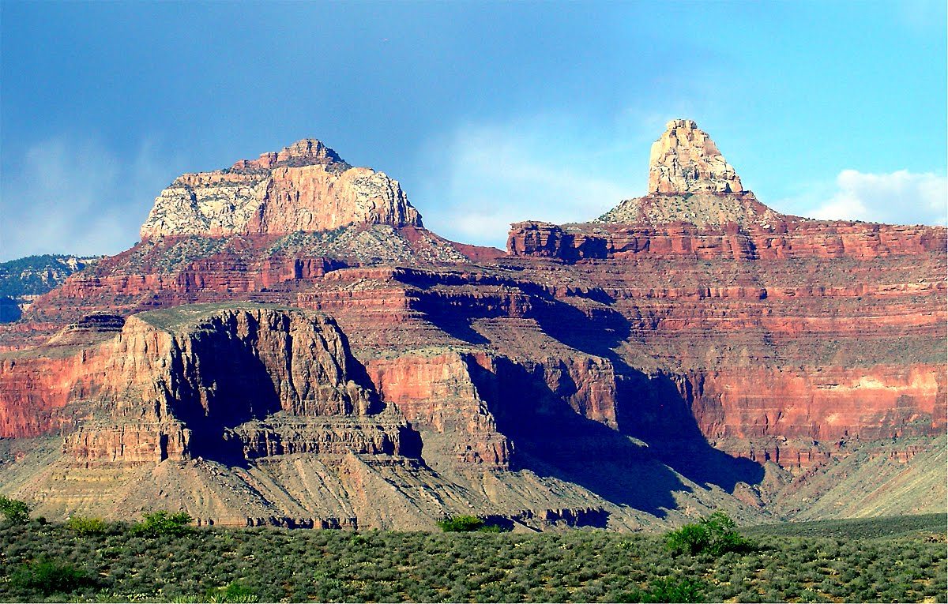
*Principals of Geology
Principle of Horizontality
Law of Superposition
Principle of Cross-Cutting Relationships
Inclusions
Unconformities

Slide 26
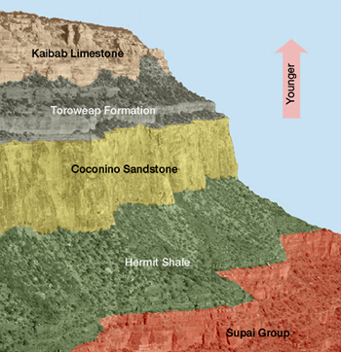
- Principle of Original Horizontality
• sedimentary rocks form as horizontal layers.

Slide 27
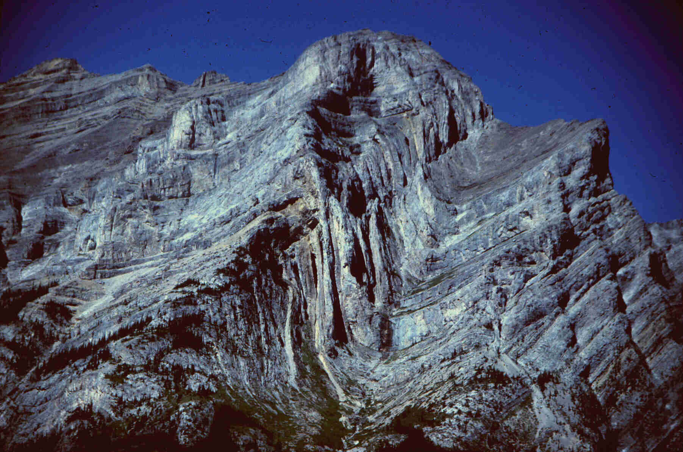
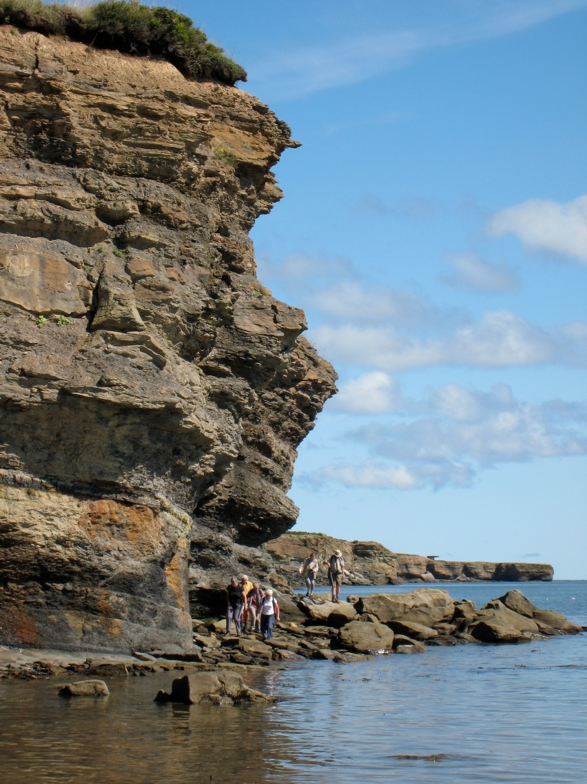

Slide 28
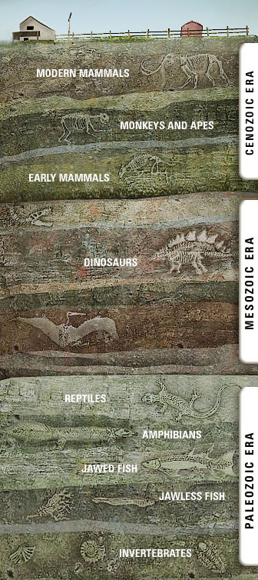
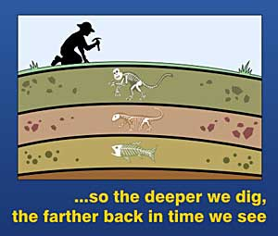
- Law of Superposition
• A sedimentary rock layer
is older than the layers above it, and younger than the layers below it.

Slide 29
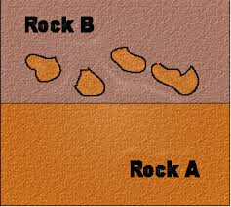
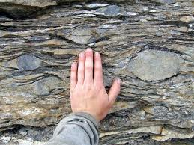
- Inclusions are pieces of one type of rock that are included into another rock when it forms.
• Therefore, the inclusions (rock pieces) must be older than the rock that formed around them.

Slide 30
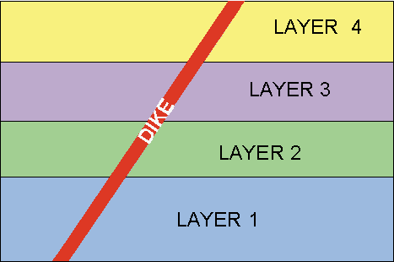
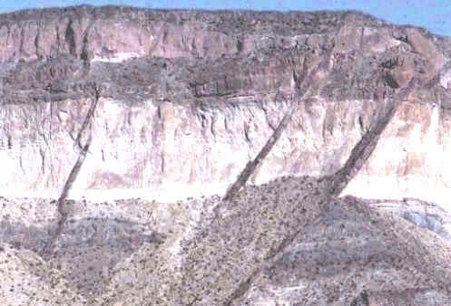
Principle of Crosscutting Relationships:
• a fault or intrusion is always younger than the rock it cuts through.

Slide 31
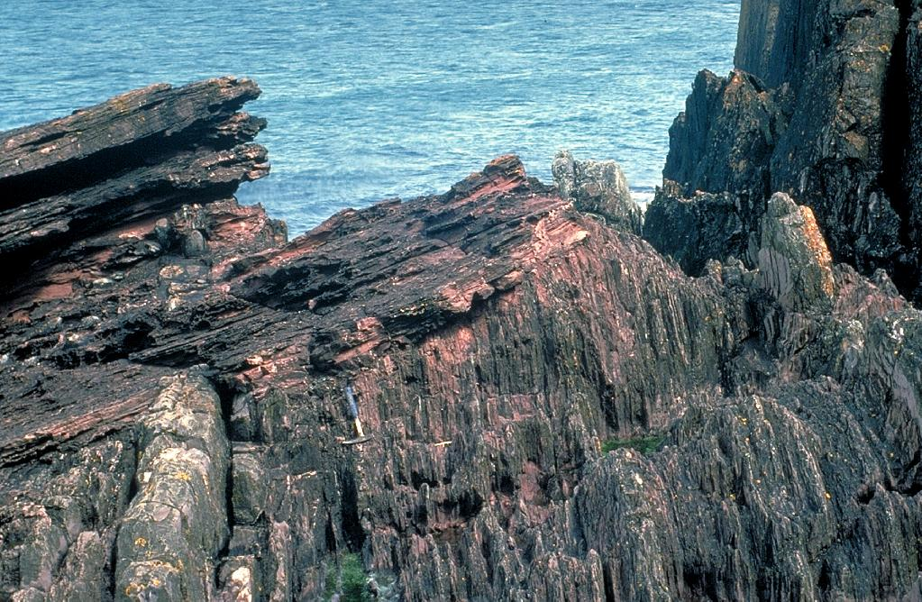
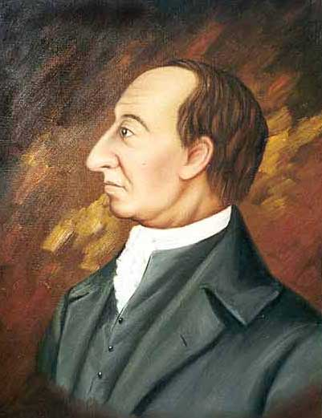
Geological History (3): Unconformities (Gaps)
Siccar Point, Scotland
Copyright © Marli Miller, University of Oregon
http://upload.wikimedia.org/wikipedia/
commons/c/c6/James_Hutton.jpg
unconformity
Hutton’s unconformity showed big gaps in the rock layers, which = movement over time
James Hutton
(1726-1797)
Notes:
31
Presenter notes: Hot on the heels of Werner came another influential geologist called James Hutton (1726-1797). In the late eighteenth century, Hutton realized that there were ‘big gaps’ in the geological record of time.
At several places like Siccar Point in Berwickshire, Scotland, Hutton’s noticed beds of layered rocks that stood on their end overlain by other layered rocks that dipped away at a shallow angle. Hutton was quick to realize what this meant. In the real world, sediment is not deposited continuously. Rather through convulsions of the Earth’s crust, sediments laid down as horizontal layers in the sea might be pushed up to form mountains. The layers might then be tilted at an angle and partly eroded away before new horizontal layers accumulated on top.
Hutton’s name for this kind of angular contact between two sets of sedimentary layers was an unconformity. In the time between the formation of the lower and upper layers of rocks, a mountain had been born and eroded down. This would have taken tens of millions of years. Therefore the unconformity represented a massive time gap in the geological record. Hutton referred to this phenomenon as ‘the abyss of time’.

Slide 32
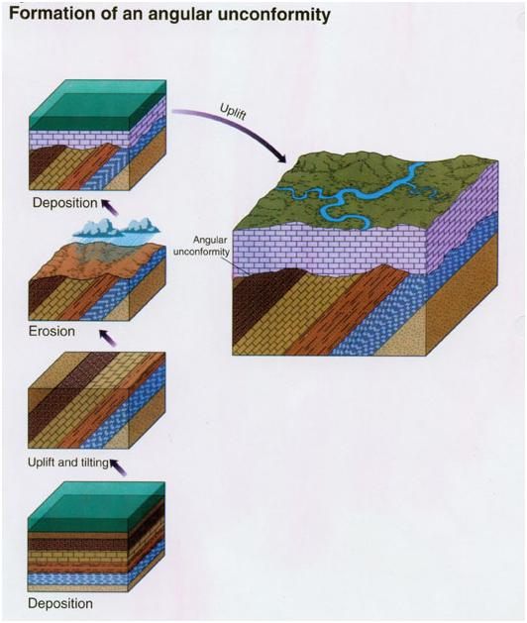
- unconformity.
• A break in the geologic record.
Ex. Deposition stopped for a period of time, and rock may have been removed by erosion before deposition resumed.

Slide 35
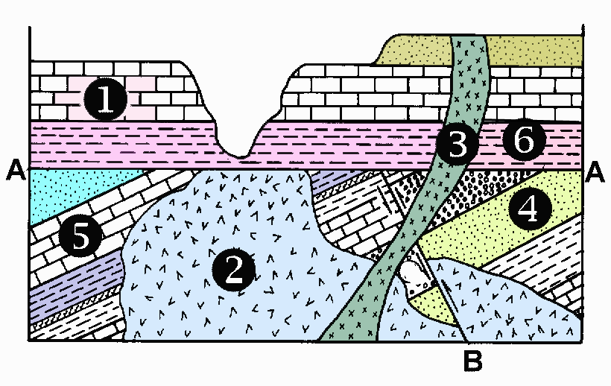
Write the numbers and letters in the order that the geologic events occurred.

Slide 36
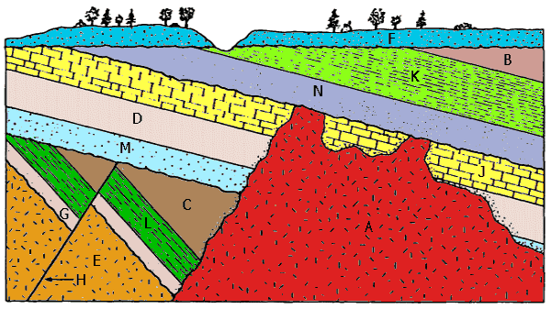
Write the letters in the order that the geologic events occurred.

Slide 37
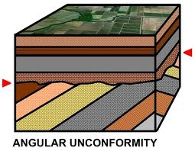
3 Types of Unconformities
Angular Unconformity: Sedimentary rock layers form over older sedimentary rock layers that have been tilted or folded.

Slide 38
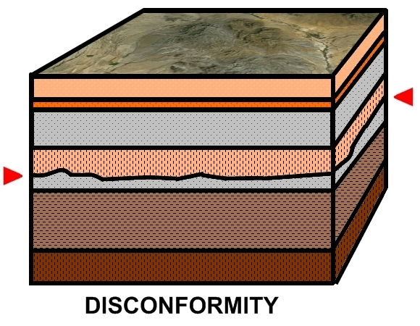
2. Disconformity: Two sedimentary layers are separated by an erosional surface.
Sometimes difficult to recognize because rocks on both sides of the unconformity are the same type!

Slide 39
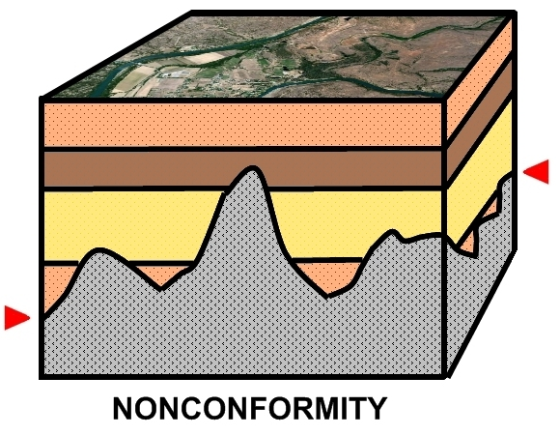
3. Nonconformity: New sandstone layers are separated by an erosional surface with older metamorphic or igneous rock beneath it.

Slide 40
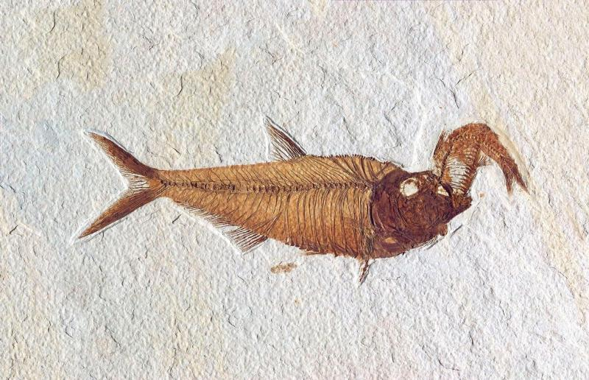
Fossil Examination

Slide 41
Fossil Butte National Monument ~Wyoming
Green River Formation Fossils
America's Aquarium in Stone
Some of the world's best preserved fossils are found in the flat-topped ridges of southwestern Wyoming's cold sagebrush desert. Fossilized fishes, insects, plants, reptiles, birds, and mammals are exceptional for their abundance, variety, and detail of preservation. Most remarkable is the story they tell of ancient life in a sub-tropical landscape

Slide 42
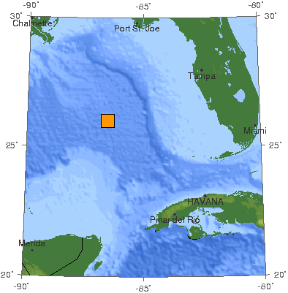
Question 4. When did the dinosaurs become extinct and how did it happen?
End of the Mesozoic
About 95 mya
Luis and Walter Alvarez
1980 found impact crater in Gulf of Mexico

Slide 43
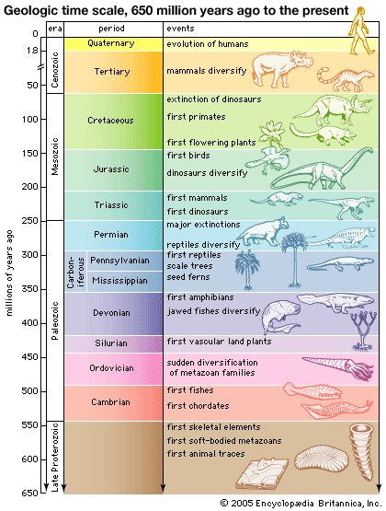

Slide 45
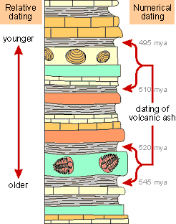
*Absolute Time (numerical dating) - process of determining an approximate age of rocks and/or fossils.

Slide 46
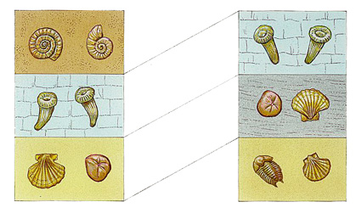
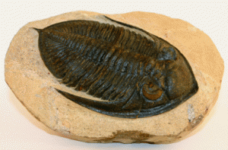
* Fossils
- Fossils can determine the relative ages of the rock layers in which they are located.

Slide 47
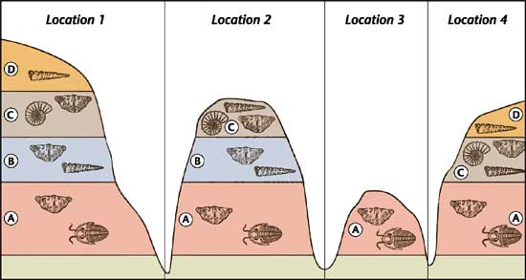
- Index fossil - must meet certain requirements:
1. Existed in large region.
2. Distinguishable figure.
3. Existed in large numbers within rock layers.

Slide 48
Correlation: When rock layers from different locations are compared.

Slide 49
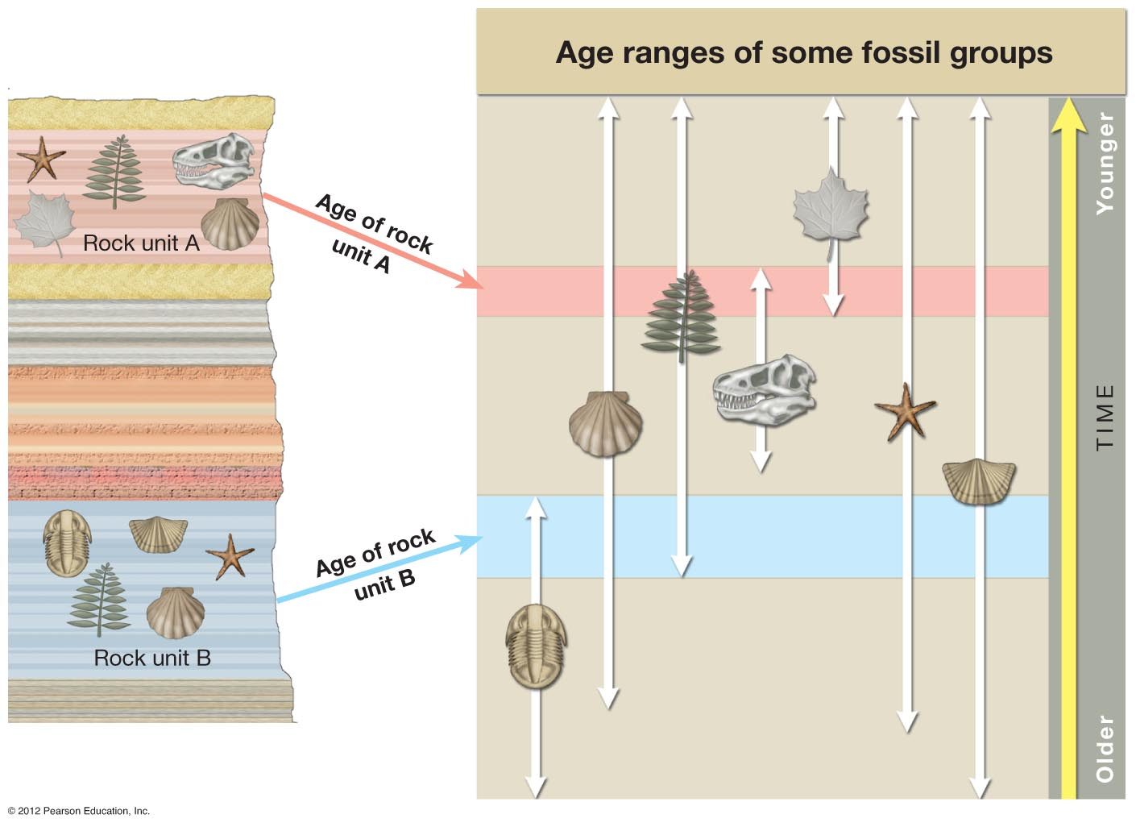

Slide 50
* What is an Isotope?
- Atoms have the same number of protons, but varying numbers of neutrons.
Carbon 14 (C-14)
Carbon 12 (C-12)

Slide 51
*Radiometric dating:
- Radioactive ‘parent isotopes’ emit protons and neutrons and decay into ‘daughter isotopes’
• C-14 decays into N-14
• Isotopes decay at a known rate, therefore can be used as “clocks” determining the absolute age of rocks and fossils.
Notes:
51
Presenter notes: Radioactivity refers to the way that some chemical isotopes are inherently unstable and slowly lose mass by emitting particles called protons and neutrons (radiation). In the diagram, the original isotope, or parent isotope, has decayed into a daughter isotope by emitting alpha radiation. An example of this phenomenon in nature is the way that Uranium-238 spontaneously decays into Lead-206.

Slide 52
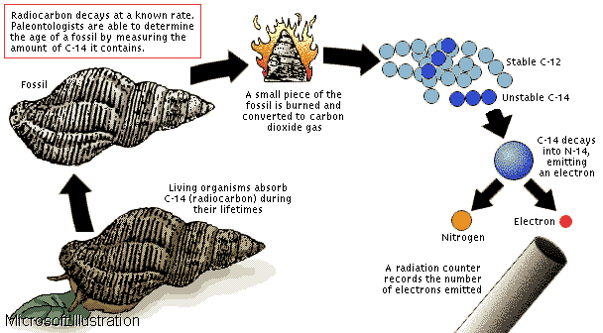

Slide 53
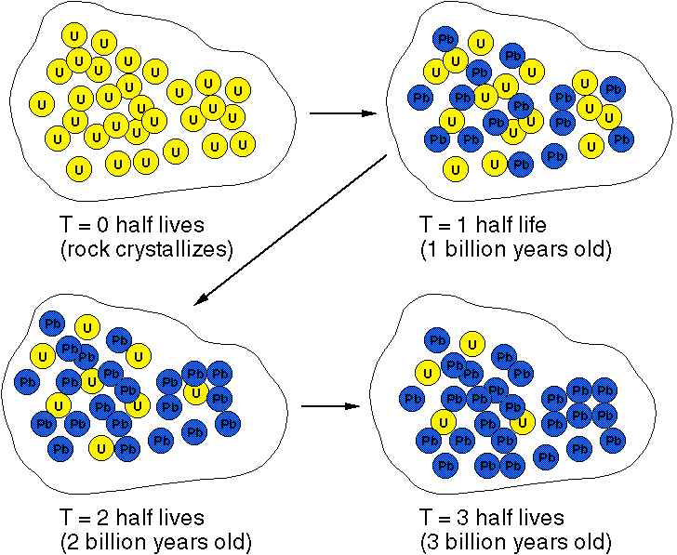
*Half Life
- The time it takes one half of the Parent radioactive atoms to decay into daughter atoms, is called

Slide 54
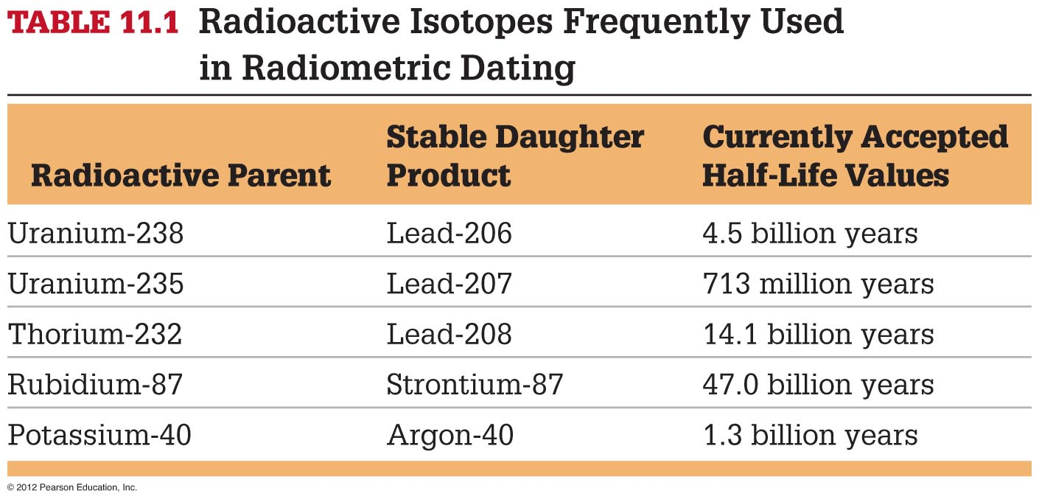
Radioactive Isotopes Half-lives

Slide 55
