Slide 1
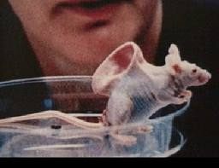
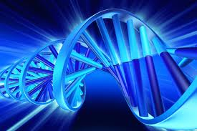
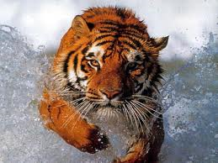
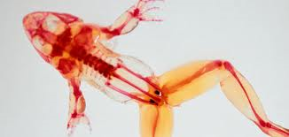
BIOLOGY – the study of life

Slide 2
What is Science?
Science -
an organized way of gathering and analyzing evidence about the natural world
Knowledge gained through experience
Accumulated body of knowledge through observation and or experimentation
Facts gained by systematic study
Science is more than a body of knowledge, it is a way of thinking
- Carl Sagan

Slide 3
Assumptions to do Science
There is order in the Universe
The human mind is capable of comprehending this order
If conditions are the same, the results of any study or experiment will be the same

Slide 4
Which of the following statements can be tested scientifically?
Most of the energy from the Sun is in the form of visible light
Marvel comics are better than DC comics
Earth is about 4 billion years old
Unicorns are real
A trophy elk is more important than a wolf
Natural Selection is the primary means by which populations of organisms change over time.

Slide 5
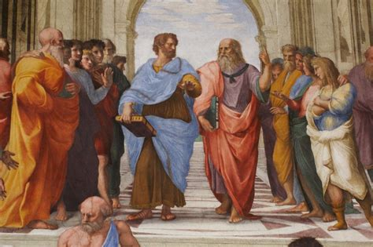
Good scientists exhibit certain traits
Curiosity
Honesty
An open mind
Willingness to be wrong and make mistakes
Ask good questions
Skepticism
The School of Athens - Raphael (1511)

Slide 6
The Scientific Method
Thinking scientifically involves the development of knowledge by observation and experimentation
Observations can lead to 2 ways to approach an experiment:
Inductive reasoning: specific to general
Deductive reasoning: general to specific

Slide 7
The Scientific Method
The scientific method is more like a cycle than a series of steps
Hypothesis – an educated guess based on observation.
– Can be tested by experimentation
Hypothesis
Prediction
Test Prediction

Slide 8
Case Study
Ignaz Semmelweis (1856)
Observations:
Childbirth deaths are 5 times higher from clinics staffed by doctors and medical students than clinics staffed by nurses and midwifes due to “childbirth fever”
Doctors often performed autopsies and nurses did not
Semmelweis

Slide 9
Case Study
Ignaz Semmelweis (1856)
Hypothesis:
Doctors transmit “cadaveric matter” to their patients
If a doctor performs an autopsy then their hands would be contaminated with “cadaveric material” which may kill a patient who is exposed to this material.
Prediction:
If Doctors washed their hands it would eliminate cadaveric matter from being transmitted to patients

Slide 10
Case Study
Correlation does not always mean causation
=

Slide 11
Case Study
Experimental Design – experiment designed to test the hypothesis
Control – nothing changes (no new variable added)
(doctors do not wash hands)
Independent variable – what changes
(doctors wash off “cadaveric material”)
Dependent variable – changes in response to independent variable – what you measure for results
(# patients getting “childbed fever”)

Slide 12
Case Study
Data Collection
Quantitative data = numbers obtained by counting or measuring
(# of patients affected, % concentration of soap used etc.…)
Qualitative data = descriptive observation
(severity of symptoms, age of patients, first birth? etc.…)

Slide 13
Case Study
Results and Analysis
Childbirth deaths reduced when doctors washed their hands
Conclusions
Did the experiment support the hypothesis?
What new hypotheses can be made and tested?
In biology, not all hypotheses can be tested in a controlled experiment (Does taking prenatal vitamins during pregnancy cause a higher IQ?)
Transmission of “cadaveric material” caused “childbirth fever”

Slide 14
Case Study
So what affect did this have on the scientific community?
Semmelweis's observations conflicted with the established scientific and medical opinions of the time.
His ideas were rejected by the medical community.
Semmelweis could offer no acceptable scientific explanation, and some doctors were offended at the suggestion that they should wash their hands.
Semmelweis's practice earned widespread acceptance only years after his death, when Louis Pateur confirmed the germ theory (1890s)

Slide 15
Scientific Theory
Theory = a well-tested explanation that unifies a broad range of observations and hypotheses
Theories have been tested and supported by many lines of evidence
They are the dominant view among scientists
Examples: Relativity (gravity), Cell, Germ, Natural Selection, Evolution

Slide 16
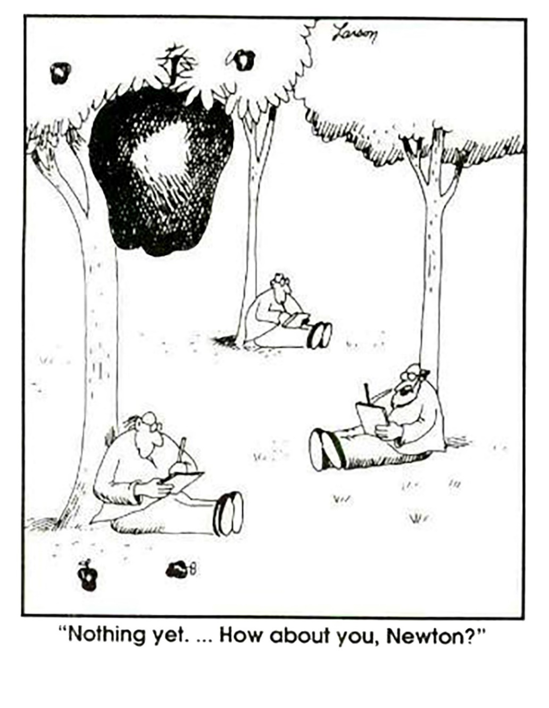
Scientific Law
Law = a statement based on repeated experimental observations that describes some aspect of the universe.
Example:
Newtons Law of Universal Gravitation

Slide 17
Review: The Scientific Method
The scientific method is a process of observing natural phenomena, which leads to asking questions, and offering explanations that can be scientifically tested.
Observation
Hypothesis
Prediction
Experiment
Analysis
Conclusion
Observation

Slide 19
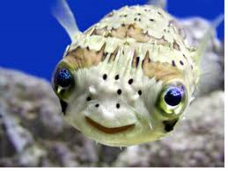
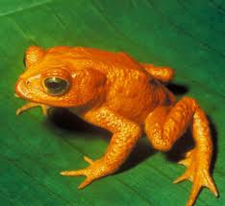
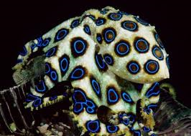
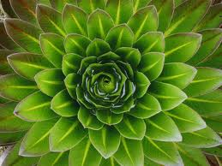
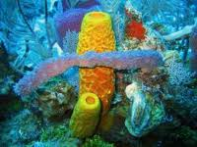
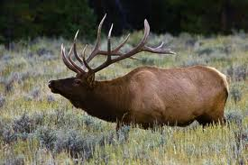
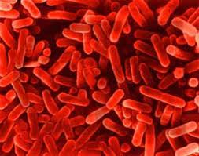
Characteristics of Living Things

Slide 20
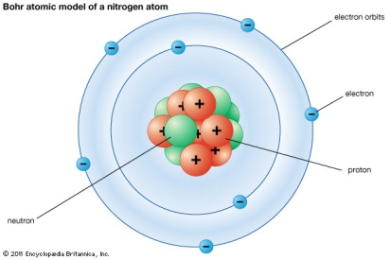
Levels of organization
Atom
Molecule
Cell
Tissue
Organ
Organ System

Slide 21
ATOMS – ORGAN SYSTEMS

Slide 22
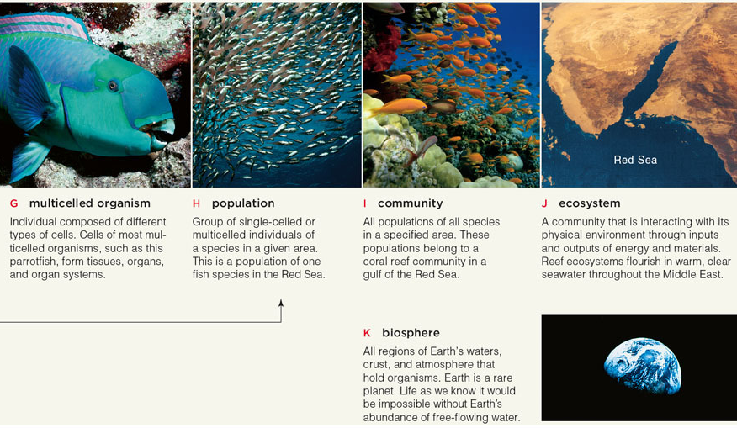
Organization - continued
Multicellular Organism
Population
Community
Ecosystem
Biosphere

Slide 23
Characteristics of Living Things
Universal genetic code – DNA
Grow and develop
Respond to their environment
Reproduce (sexually or asexually)
Maintain a stable internal environment = homeostasis
Obtain and use material and energy = metabolism
Made of cells
As a group – they evolve (change)

