Slide 1
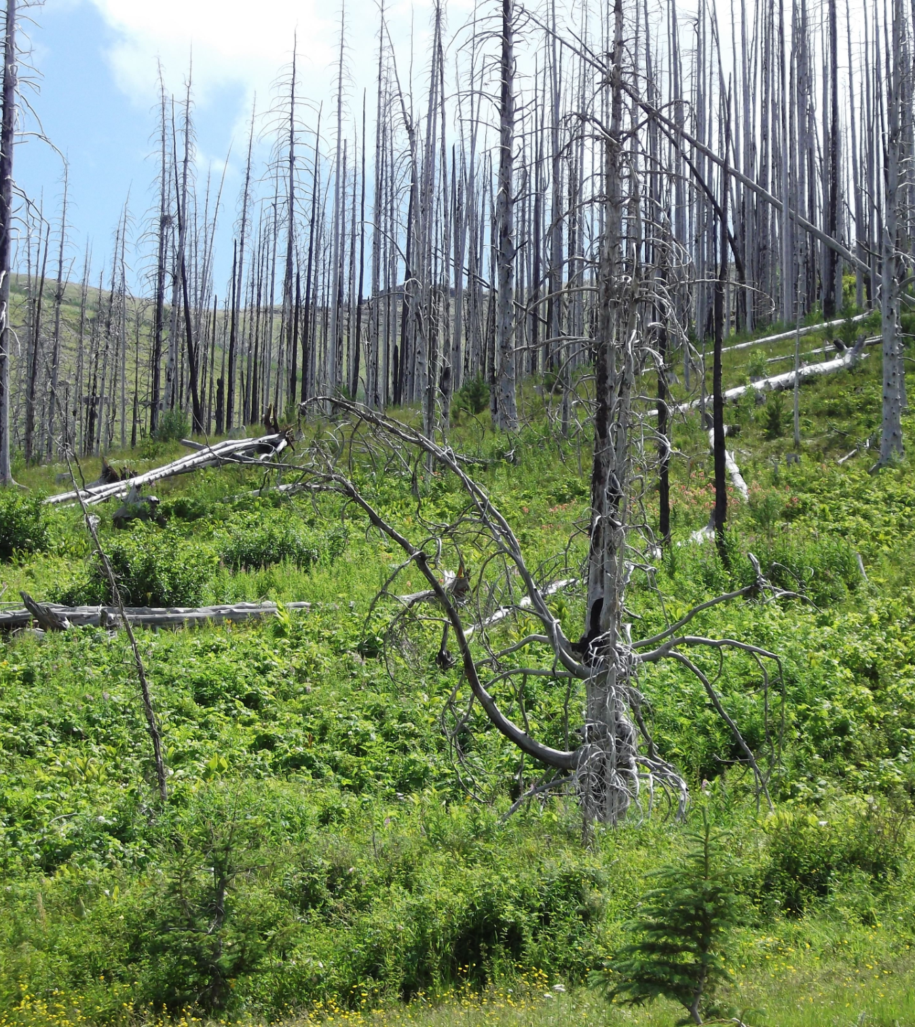
Bell Ringer
Get your notebook from the crate.
Turn to your Chapter 2 notes. Complete the 2 steps below on the left-hand page.
Observe the photo and make two observations. Record these observations.
Make a claim of what you think happened in this place to make it look this way.

Slide 2
Agenda
Bell Ringer
Video: After the Wildfires
Basic Facts of Forest Fires
Video: Forests Under Siege Video
The Earth System- 5 Questions

Slide 3
Learning Target
I can identify ways in which the fours spheres of the Earth system are affected by wildfires.

Slide 4
2011 Los Conchas fire in New Mexico burned over 150,000 acres.
Video: After the Wildfires

Slide 5
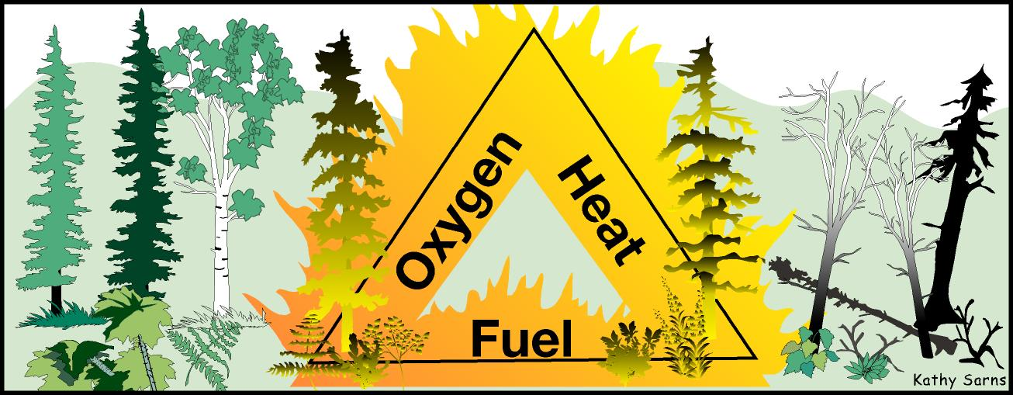
Components of Fire
Fuel- material being burned
Oxygen- needed for chemical reaction
Heat- can be from lightning or human activity

Slide 6
Causes of Forest Fires
Lightning
Human carelessness
Volcano eruptions and heat waves
Droughts and cyclical climate changes
Commonly occur during years of drought and on days of strong winds

Slide 7
Environments for Forest Fires
Forest fires are found in many various places
Moist areas allowing the growth of trees, but also feature extended dry, hot periods.
Temperature in summer and fall create dryer conditions, as well as during droughts when branches and leaves dry out and become highly flammable.

Slide 8
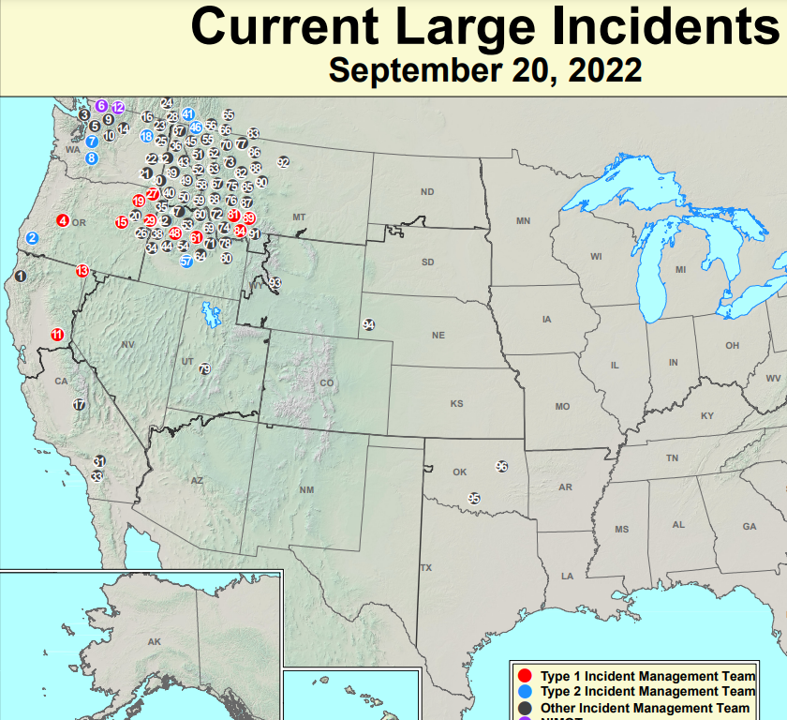
This map shows all current large forest fires in the US.

Slide 9
Benefits of Forest Fires
Forest fires are a natural part of Earth’s ecosystem and are mandatory
Fires allow for regeneration
Fires promote biological diversity and healthy ecosystems

Slide 10
Removes dead, weekend trees, and plants
Creates a more open forest floor which allows sunlight in for more growth
Ash left behind puts nutrients into the soil
Kills off invasive species allowing native species to regain territory

Slide 11
Disadvantages of Forest Fires
Loss of habitat for animals
Soil damage which can result in erosion (rare)
Uncontrolled burns can result in millions of dollars worth of property damage to homes or timber

Slide 12
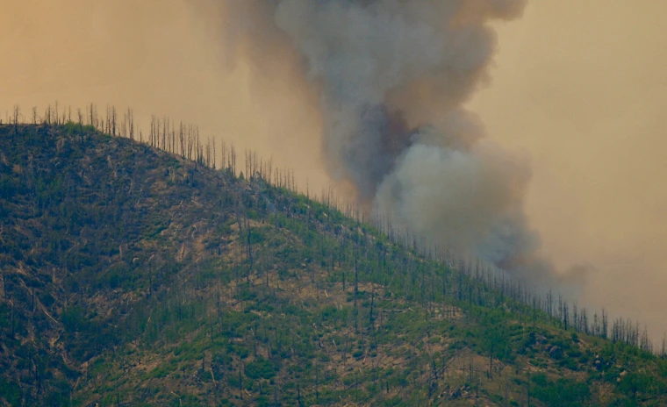
Forest Fires, the Land and the People
Video: Forests Under Siege
Notes:
https://youtu.be/F8OrmGAIqI4
https://montana.pbslearningmedia.org/resource/the-impact-of-wildfires-on-forests/our-land-video-gallery/

Slide 13
The Earth System - 4 Questions
Go back to the page in your notebook where you completed your Bell Ringer.
Use the text we read to answer the 5 questions about the Yellowstone Fire of 1988.
Your answers need to be written in complete sentences.
We will go over the answers in about 15 minutes.

