Slide 1
Lighting Systems
Data and power systems

Slide 2
All lighting systems have two main electrical systems or networks:
1. Power:
the network that supplies the power to run the equipment
2. Data :
the network that sends instruction sets to tell the powered
equipment telling it what to do!

Slide 3
A.C Power Distribution
Starts with generation
Is stepped up with transformers
Goes to overhead or underground transmission lines
Is stepped down with a transformer to use at building level
Is distributed by branch circuits thorough a building.

Slide 4
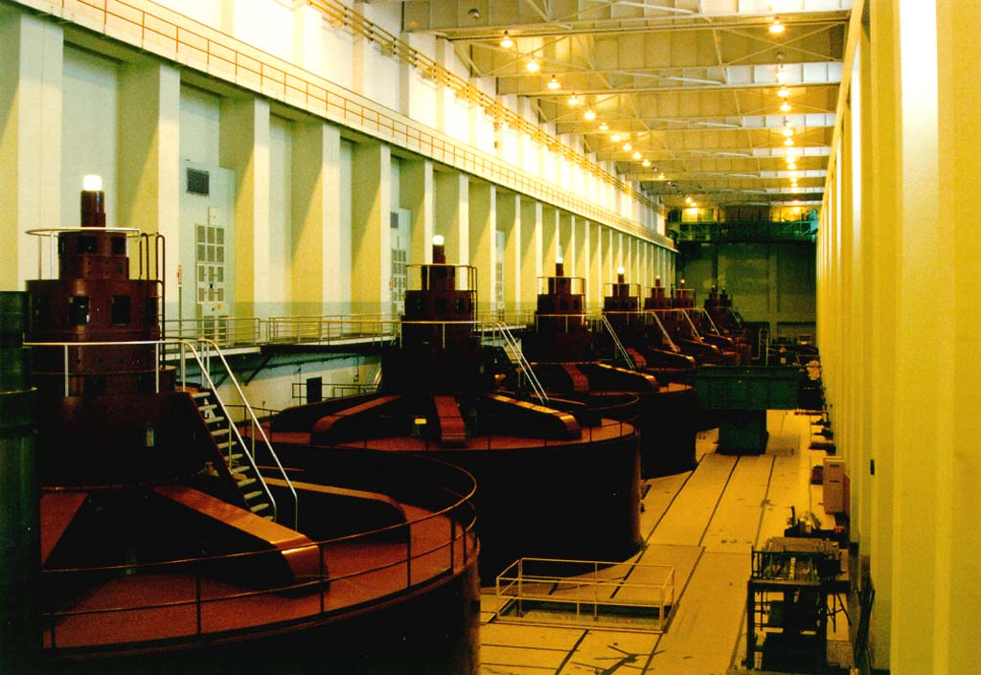
Generation

Slide 5
3 phase system
In a three-phase system, three circuit conductors carry three alternating currents (of the same frequency) which reach their instantaneous peak values at different times. Taking one conductor as the reference, the other two currents are delayed in time by one-third and two-thirds of one cycle of the electrical current. This delay between "phases" has the effect of giving constant power transfer over each cycle of the current, and also makes it possible to produce a rotating magnetic field in an electric motor.

Slide 6
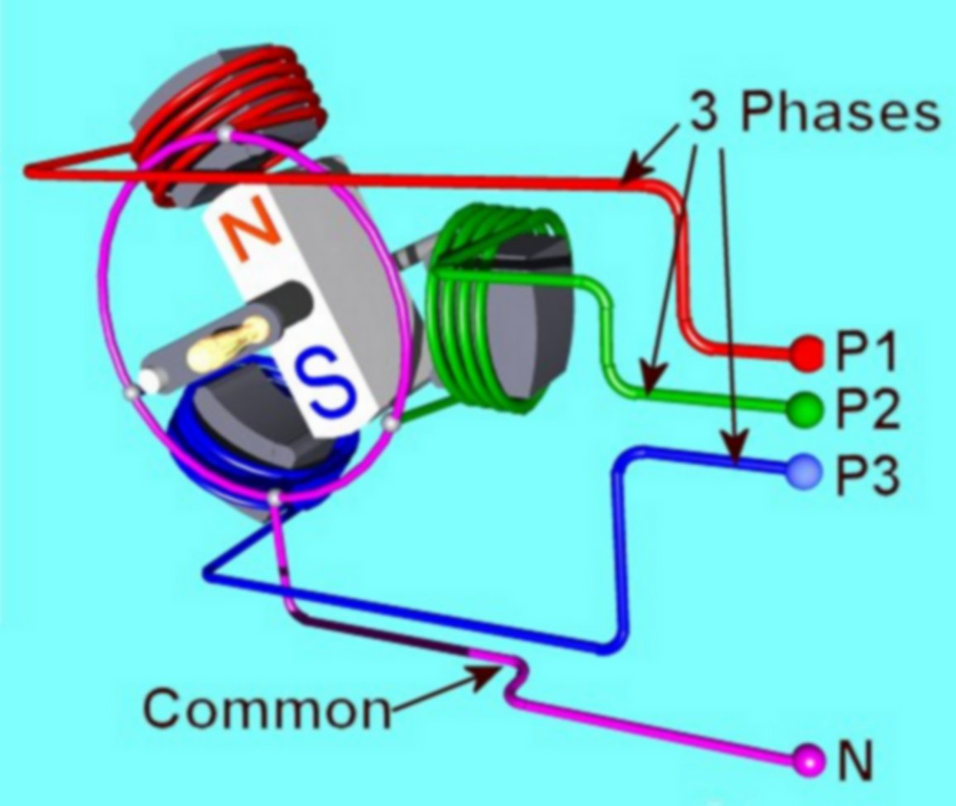
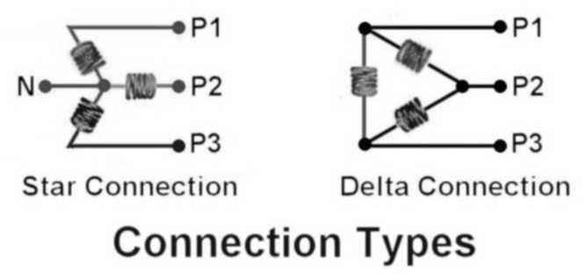
3 Phase Generator

