Slide 1
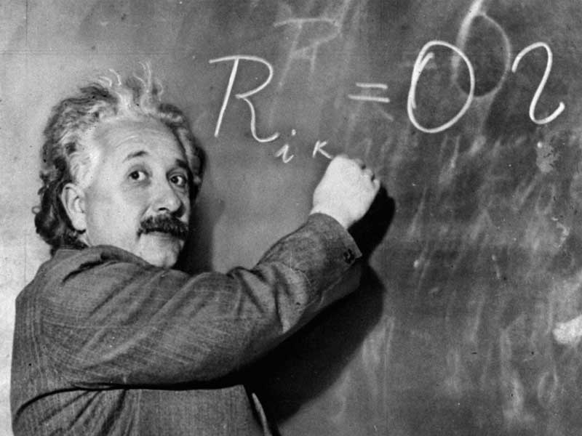
Nature of Science:
Metric System (A.K.A. International System of Units)

Slide 2
Why use the Metric System? - Base of 10, making it easy to use - Consistent with other scientists around the world.

Slide 3
Explosion of Mars Climate Orbiter in 1999 was due to unit confusion( $125 million dollars) .

Slide 4
Metric system’s base units
-Length: meter (m)
-Volume: liter (l)
-Mass: kilogram (Kg)
-Time: seconds (sec)
-Temperature: Kelvin (K), but we will use Celsius.

Slide 5
Tools used to measure in Metric System?
-Length: meter stick.
-Volume: Graduated cylinder
-Mass: Triple-beam balance
-Temperature: Thermometer

Slide 6
Prefixes
Prefix Symbol x factor
Mega M 1,000,000
Kilo K 1000
deka da 10
deci d 0.1
centi c 0.01
milli m 0.001
micro u 0.000 001

Slide 7
Standard of volume=liter
Kiloliter (kl)=1000 liter
Dekaliter (dal)=10 liter
Liter (l)
Deciliter (dl)=0.1 liter
Centiliter (cl)=0.01 liter
milliliter (ml)=0.001 liter
Microliter (ul)=0.000 001 liter

Slide 8
Standard of mass=grams
Kilogram(kg)=1000 gram
Dekagram (dag)=10 gram
Gram (g)
Decigram(dg)=0.1 gram
Centigram (cg)=0.01 gram
Milligram (mg)=0.001 gram
Microgram (ug)=0.000 001 gram

Slide 9
Standard of length=meter
Kilometer (km)=1000 meters
Dekameter (dam)=10 meters
Meter (m)
Decimeter (dm)=0.1 meter
Centimeter (cm)=0.01 meter
millimeter (mm)=0.001 meter
Micrometer (um)=0.000 001 meter

Slide 10
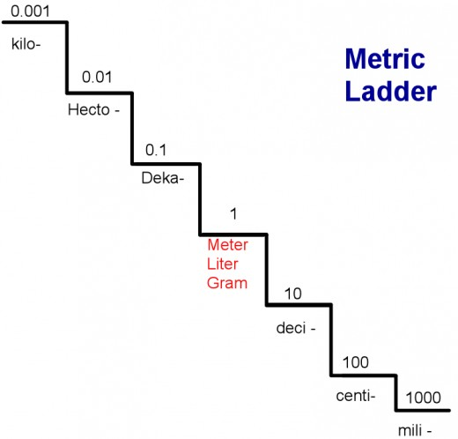
For each step you go down the staircase multiply the original number by 10.
For each step you go up the staircase divide the original number by 10.
Base Units
Practice conversions. 382 milliliter = _____________ liters
2.2 decimeters = __________millimeters
4.5 meters = _____________ centimeters
0.67 liters = ______________milliliters
303 grams = _____________ kilograms

Slide 11
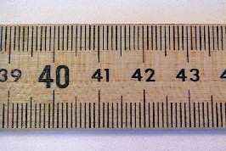
How-to use a meter stick.
-The smallest marks on a meter stick are millimeters(mm).
•It takes 1,000 millimeters to equal one meter(m). 1000 mm = 1 m
-The longer lines numbered are centimeters (cm).
• It takes 100 centimeters to equal one meter
100cm = 1 m
The pictures in this exercise were used from Jerry Hester at Clemson U. Physics - http://phoenix.phys.clemson.edu/tutorials/measure/index.html

Slide 12
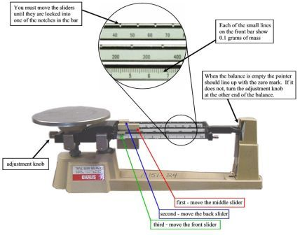
How-to use a triple-beam balance.

Slide 13
What is the mass if the following beams read as below?
Image was found at http://www.sir-ray.com/Problem%20Solving%20in%20Earth%20Science.htm

Slide 14
How-to use a graduated cylinder.
-Read the meniscus for accuracy. The meniscus is the bottom of the curve created by water ability to adhere to material.
Image was found at http://www.mrbigler.com/Chem1-C1/topics/measurement/significant-figures.html

