Slide 1
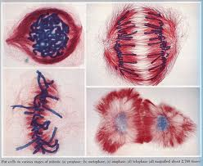
Cell Growth and Division
Chapter 10

Slide 2

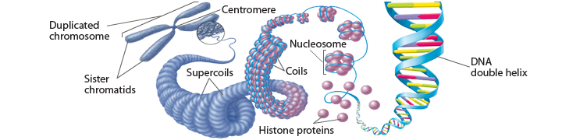
10.2 The process of Cell Division
Chromosomes – threadlike structures of DNA and protein that contains genetic information
  Prokaryotes – chromosomes are in cytoplasm
  Eukaryotes – chromosomes (chromatin) are in nucleus
    Many eukaryotes have multiple chromosomes which make it possible to separate DNA in cell division

Slide 3
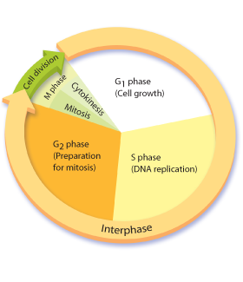
The Cell Cycle - Interphase
Interphase
  G1 Phase
  S Phase
  G2 Phase
Cell Division
  Mitosis
    Prophase
    Metaphase
    Anaphase
    Telophase
  Cytokinesis
Steps of the Cell Cycle
Cell Cycle Diagram

Slide 4
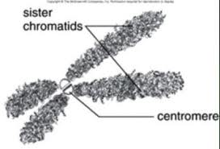
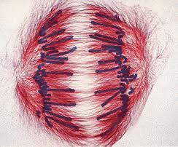
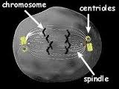
Important Cell Structures Involved in Mitosis
Chromatid – each strand of a duplicated chromosome
Centromere – the area where each pair of chromatids is joined
Centrioles – tiny structures located in the cytoplasm of animal cells that help organize the spindle
Spindle – a fanlike microtubule structure that helps separate the chromatids

Slide 5
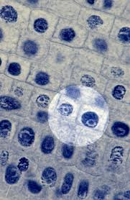
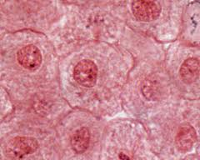
Interphase
Interphase = period of the cell cycle between divisions
  G1 Phase = cell growth, make new proteins and organelles
  S Phase = New DNA is made (doubles)
  G2 Phase = Organelles needed for cell division are made

Slide 6
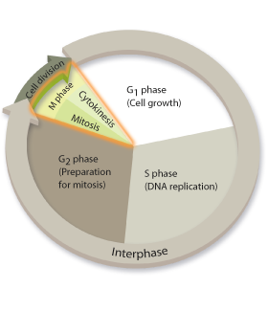
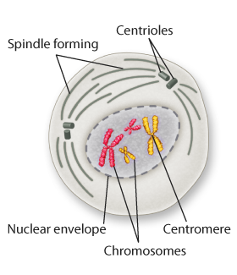
CELL DIVISION - Mitosis
Mitosis = the part of cell division where the nucleus divides
Prophase
  Chromatin condenses (Chromosomes become visible)
  Centrioles separate
  Spindle starts to form

Slide 7
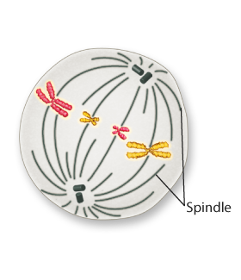
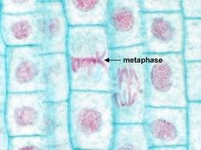
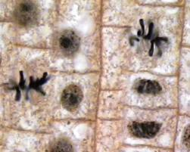
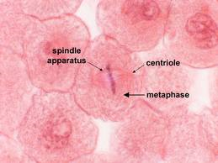
Mitosis - Metaphase
Metaphase
  Chromosomes line up across the center of the cell.
  Spindle fibers connect the centromere of each chromosome to the two poles of the spindle.

Slide 8
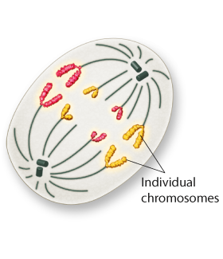
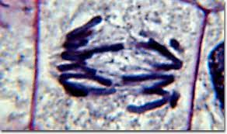
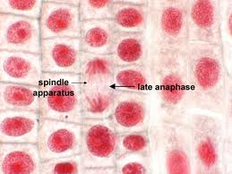
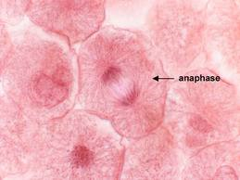
Mitosis - Anaphase
Anaphase
  Sister chromatids separate
  Individual chromosomes are pulled apart on spindle fibers

Slide 9
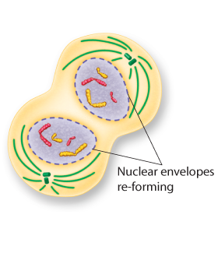
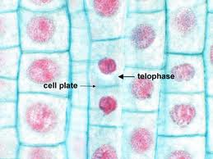
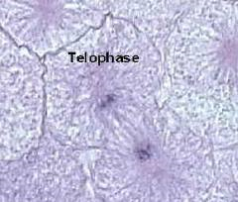
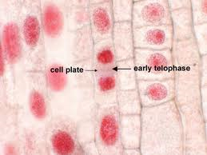
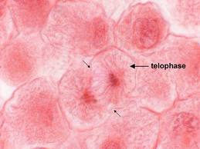
Mitosis - Telophase
Telophase
  Chromosomes are at opposite ends of the cell
  Chromosomes spread out into chromatin
  Nuclear envelope reforms
  Spindle breaks apart

Slide 10
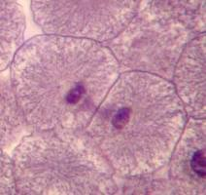
Cytokinesis
Cytokinesis = division of the cytoplasm to make two daughter cells
  The cytoplasm pinches in half
  Each of the two daughter cells has an identical set of chromosomes

Slide 11
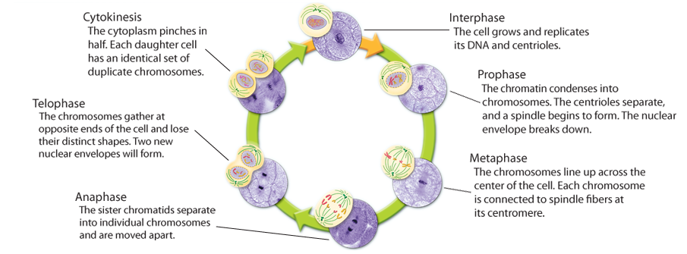
The Cell Cycle

Slide 12
Cell Cycle Diagram
Label the sections with the following terms
Then add this information in the correct place!
Chromosomes condense
Cytoplasm divides
Chromosomes align at the “equator”
Microtubules assemble into a spindle
Nuclear membrane breaks up
Sister chromatids move toward opposite poles
Centrosomes (with centrioles in animal cells) move to opposite poles
New nuclear membranes form
DNA replication occurs/chromosomes duplicate
Cells undergo normal metabolic processes
Spindle/microtubules attach to sister chromatids
Chromosomes reach the poles
Cell makes proteins for mitosis
Interphase
Prophase
Telophase
G1
G2
Metaphase
S
Cytokinesis
Cell Division
Anaphase
Mitosis

Slide 13
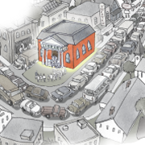
10.1 Cell Growth and Division
Limits to Cell Size
  1) Information Overload – as size increases, DNA is not able to provide information for all the needs of the cell. (Library analogy)

Slide 14
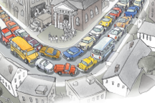
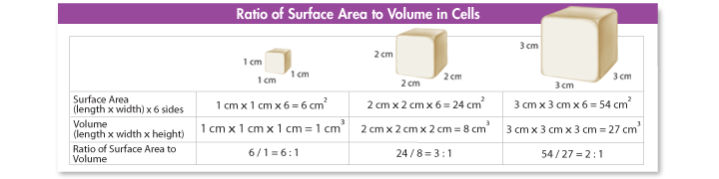
Limit to Cell Size (Cont.)
  2) Material exchange - If a cell gets too large, the surface area of the cell is not large enough to get oxygen and nutrients in and waste out
  -surface area to volume ratio
  -traffic analogy

Slide 15
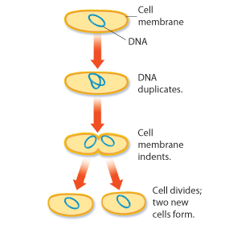
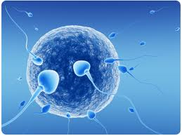
Cell Division
Cell Division = the process in which a cell divides into two new daughter cells
Asexual Reproduction = the production of genetically identical offspring from a single parent
Sexual Reproduction = offspring inherit some of their genetic information from each parent

Slide 16
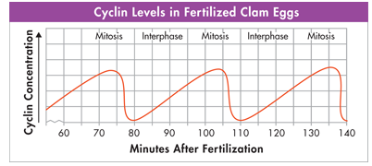

10.3 Regulating the cell cycle
How do cells know when to divide?????
  Some cells don’t divide once they are formed (muscle and nerve)
  Cells in the bone marrow that make blood cells and digestive tract divide as fast as every few hours
Cyclins = a family of proteins that regulates the cell cycle in eukaryotes

Slide 17
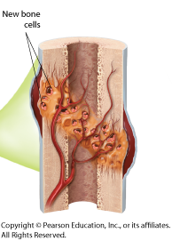
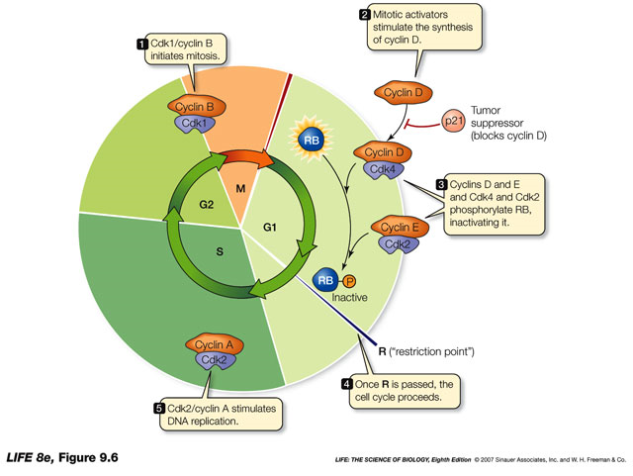
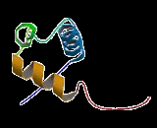
How do cells know when to divide?
Regulatory proteins instruct the cells when to divide
  Internal regulatory proteins make sure that steps in the cell cycle are completed before the next step occurs
  External regulatory proteins direct the cell to speed up or slow down the cycle
    Ex. Growth factors – stimulate the division of the cell (embryonic development and wound healing)

Slide 18
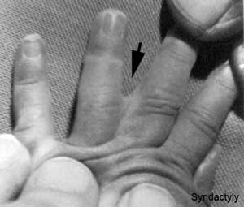
Apoptosis
Apoptosis = programmed cell death
  Cells either are damaged and die or they have programmed cell death
  In apoptosis the cell and chromatin shrink, cell membrane breaks and other cells recycle it
  Ex – mouse foot, human hand

Slide 19
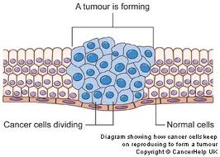
Cancer
Cancer = occurs when some of the body’s cells lose the ability to control growth
  Cancer cells do not respond to the signals that regulate growth and divide uncontrollably
  Cancer cells absorb nutrients needed by other cells, block nerve connections, and prevent organs from functioning.

Slide 20
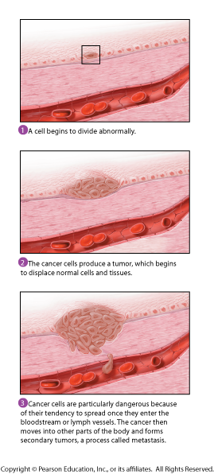
Cancer Cont.
Tumor = a mass of cancer cells
  Benign tumors = noncancerous tumors that do not spread to other tissue
  Malignant tumor = cancerous tumor that invade and destroy surrounding tissue
  Metastasis = the spread of cancer cells

Slide 21
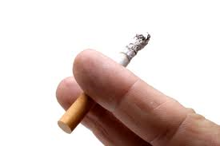
Causes of cancer
  Caused by defects in the genes that regulate cell growth and development
    Sources of gene defects include
      tobacco
      radiation exposure
      defective genes
      viral infection
    Many cancers have a defective p53 gene which halts the cell cycle until chromosomes have been replicated

Slide 22
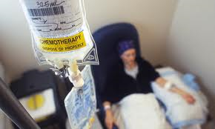
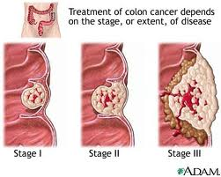
Treatment of cancer
Surgery
Radiation
Chemotherapy – chemical compounds that kill cancer
  Targets rapidly dividing cells and also interferes with cell division in normal cells (side effects)

Slide 23
10.4 Cell Differentiation
  The human body contains hundreds of different cell types, and every one of them develops from the single cell that starts the process. How do the cells get to be so different from each other?

Slide 24
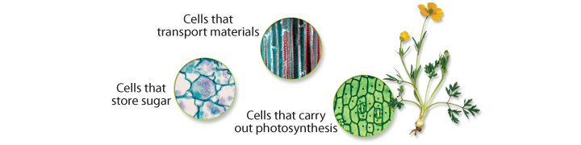
Differentiation
During the development of an organism, cells differentiate into many types of cells.

Slide 25
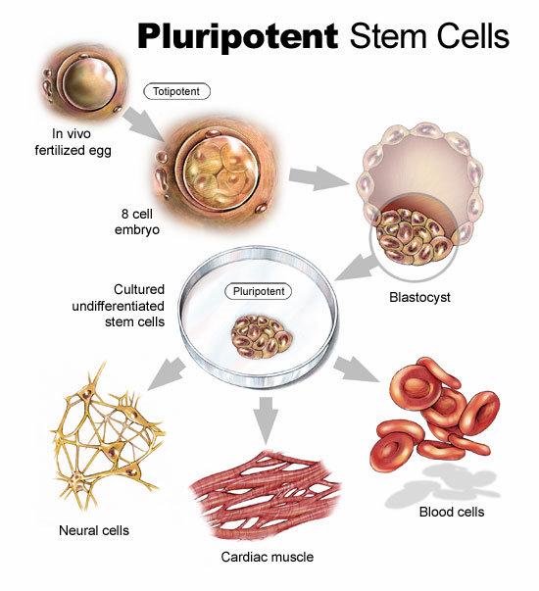
Stem Cells
Stem cells = the unspecialized cells from which differentiated cells develop
Totipotent cells= can develop into any type of cell in the body
Pluripotent = can develop into most (but not all) of the body’s cell types
  Inner cells in the early embryo
  (a hollow ball called a blastocyst)

Slide 26
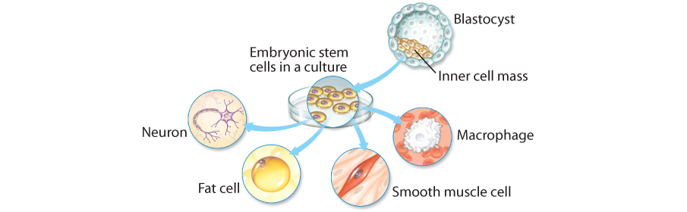
Embryonic Stem Cells
  Found in the inner cells mass of the early embryo.
  Embryonic stem cells are pluripotent. (cells have the capacity to produce most cell types in the human body)

Slide 27
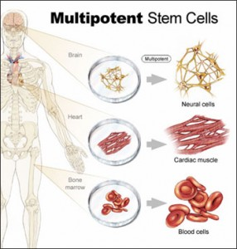
Adult Stem Cells
Adult stem cells are multipotent. They can produce many types of differentiated cells
Adult stem cells of a given organ or tissue typically produce only the types of cells that are unique to that tissue.
Peyton Manning Stem Cells?????
Skin Cell Spray

Slide 28
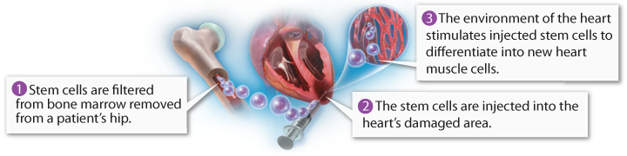
Stem Cell Research
Repair or replace badly damaged cells and tissues.
  heart attack
  stroke
  spinal cord injuries.

Slide 29
Stem Cells – the ethical concerns
Embryonic stem cells are harvested from early embryos
  Most methods destroy the embryo
  In the past, US limited funding for the embryonic cell lines used for research - NIH has136 embryonic stem lines in the US that are currently being used for research
  Research is being done to
    harvest embryonic stem cells without destroying the embryo
    turning adult stem cells into pluripotent cells
    Embryonic stem cells out of umbilical cord blood
      Cord Blood Banking News Clips
      Cord Blood Registry Video

Slide 30
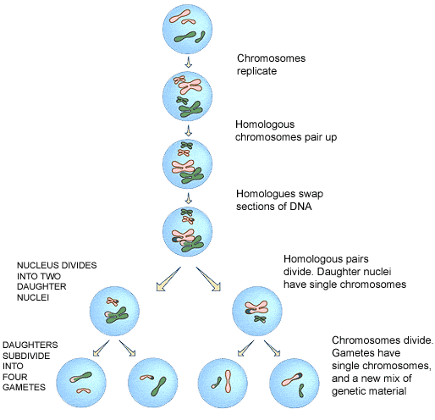
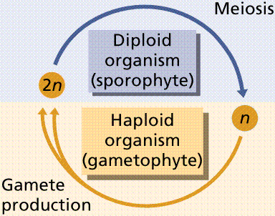
Meiosis
Meiosis
  A cell divides to form 4 haploid sex cells.
Diploid
  2n = 46 chromosomes
Haploid
  N = 23 chromosomes

Slide 31
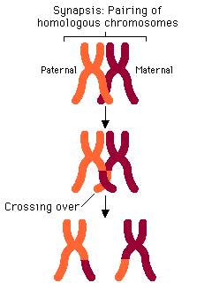
Meiosis Vocabulary
Tetrads
  2 Homologous chromosomes

Slide 32
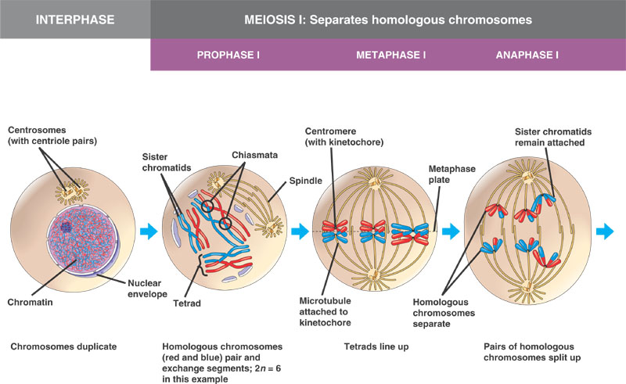
Meiosis I
Prophase 1
  Tetrad Forms
    Chromosomes pair up with
    corresponding chromosomes
Metaphase 1
  Tetrads line up in middle of cell
  Spindle fibers attach
Anaphase 1
  Homologous chromosomes are pulled to opposite ends of the cell
Telophase 1 & Cytokinesis
  Nuclear membrane forms
  Cell Separates into 2 cells
Result: 2 haploid daughter cells

Slide 33
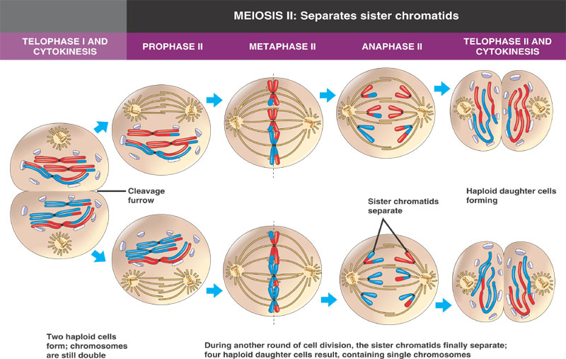
Meiosis 2
Prophase II
  Spindle fibers form
  Nuclear Membrane disappears
Metaphase II
  Chromosomes line up & attach to fibers
Anaphase II
  Sister chromatids separate & move towards opposite ends of cell
Telophase II & Cytokinesis
  Results in 4 haploid daughter cells

Slide 34
Comparing Mitosis & Meiosis
RESULTS:
  Mitosis
    2 diploid daughter cells
      46 chromosomes in each cell
  Meiosis
    4 haploid daughter cells
      23 chromosomes in each cell

Slide 35


Slide 36
Comparing Mitosis and Meiosis
Draw out the phases of mitosis on one half of your paper and the phases of meiosis on the other half. Or model both using the modeling supplies.
Compare and contrast the two processes.
Explain the differences in the number of chromosomes for humans at the start and end of each process.

