Slide 1

Multiplying Rational Numbers
Lesson 3.5
Find products of positive and negative
fractions and decimals.

Slide 2
Multiplying Positive and Negative Rational Numbers
1. Determine the sign of the product.
  • The product of two numbers with the same sign is positive.
  • The product of two numbers with different signs is negative.
2. Find the product. If working with fractions, put any
negative signs in the numerator while finding the
product.

Slide 3
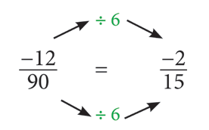
Example 1
Find the value of . Write in simplest form.
The numbers have different signs so the answer will be negative.
Multiply.
Simplify.

Slide 4
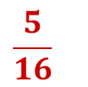
Extra Example 1
Find the value of .

Slide 5
Example 2
Find the value of . Write in simplest form.
Write each mixed number as an
improper fraction. Write negative
signs in the numerators.
Multiply.
Simplify.

Slide 6
Example 3
The water level of Renee’s swimming pool was dropping
3.4 centimeters every hour. What number represents the
change in the water’s depth after 0.25 hours?
Write the expression to represent –3.4(0.25)
the situation
The numbers have different signs
so the answer will be negative. Ignore
the signs while multiplying. Make the
final answer negative.
It is easiest to put the number with the most digits on the top.
0.25
× 3.4
0100
075__
0850

Slide 7
Example 3 Continued
The water level of Renee’s swimming pool was dropping
3.4 centimeters every hour. What number represents the
change in the water’s depth after 0.25 hours?
Count the number of places
after the decimal point in the
two factors. Move the decimal 0.850
this many places in the product.
Start at the right, and move left.
Write with the sign determined −0.85
above.
The pool’s change in depth in 0.25
hours was −0.85 centimeters.
Zeros at the end of a decimal do not need to be written

Slide 8
Extra Example 3
Find the value of −0.4(6.1).
−2.44

Slide 9
Assignment Time
Get out your spiral
Put a heading on your paper
Pg. 94 (2-8 all, 11-17 all)
Show all work – NO USE OF CALCULATORS!

