Slide 1
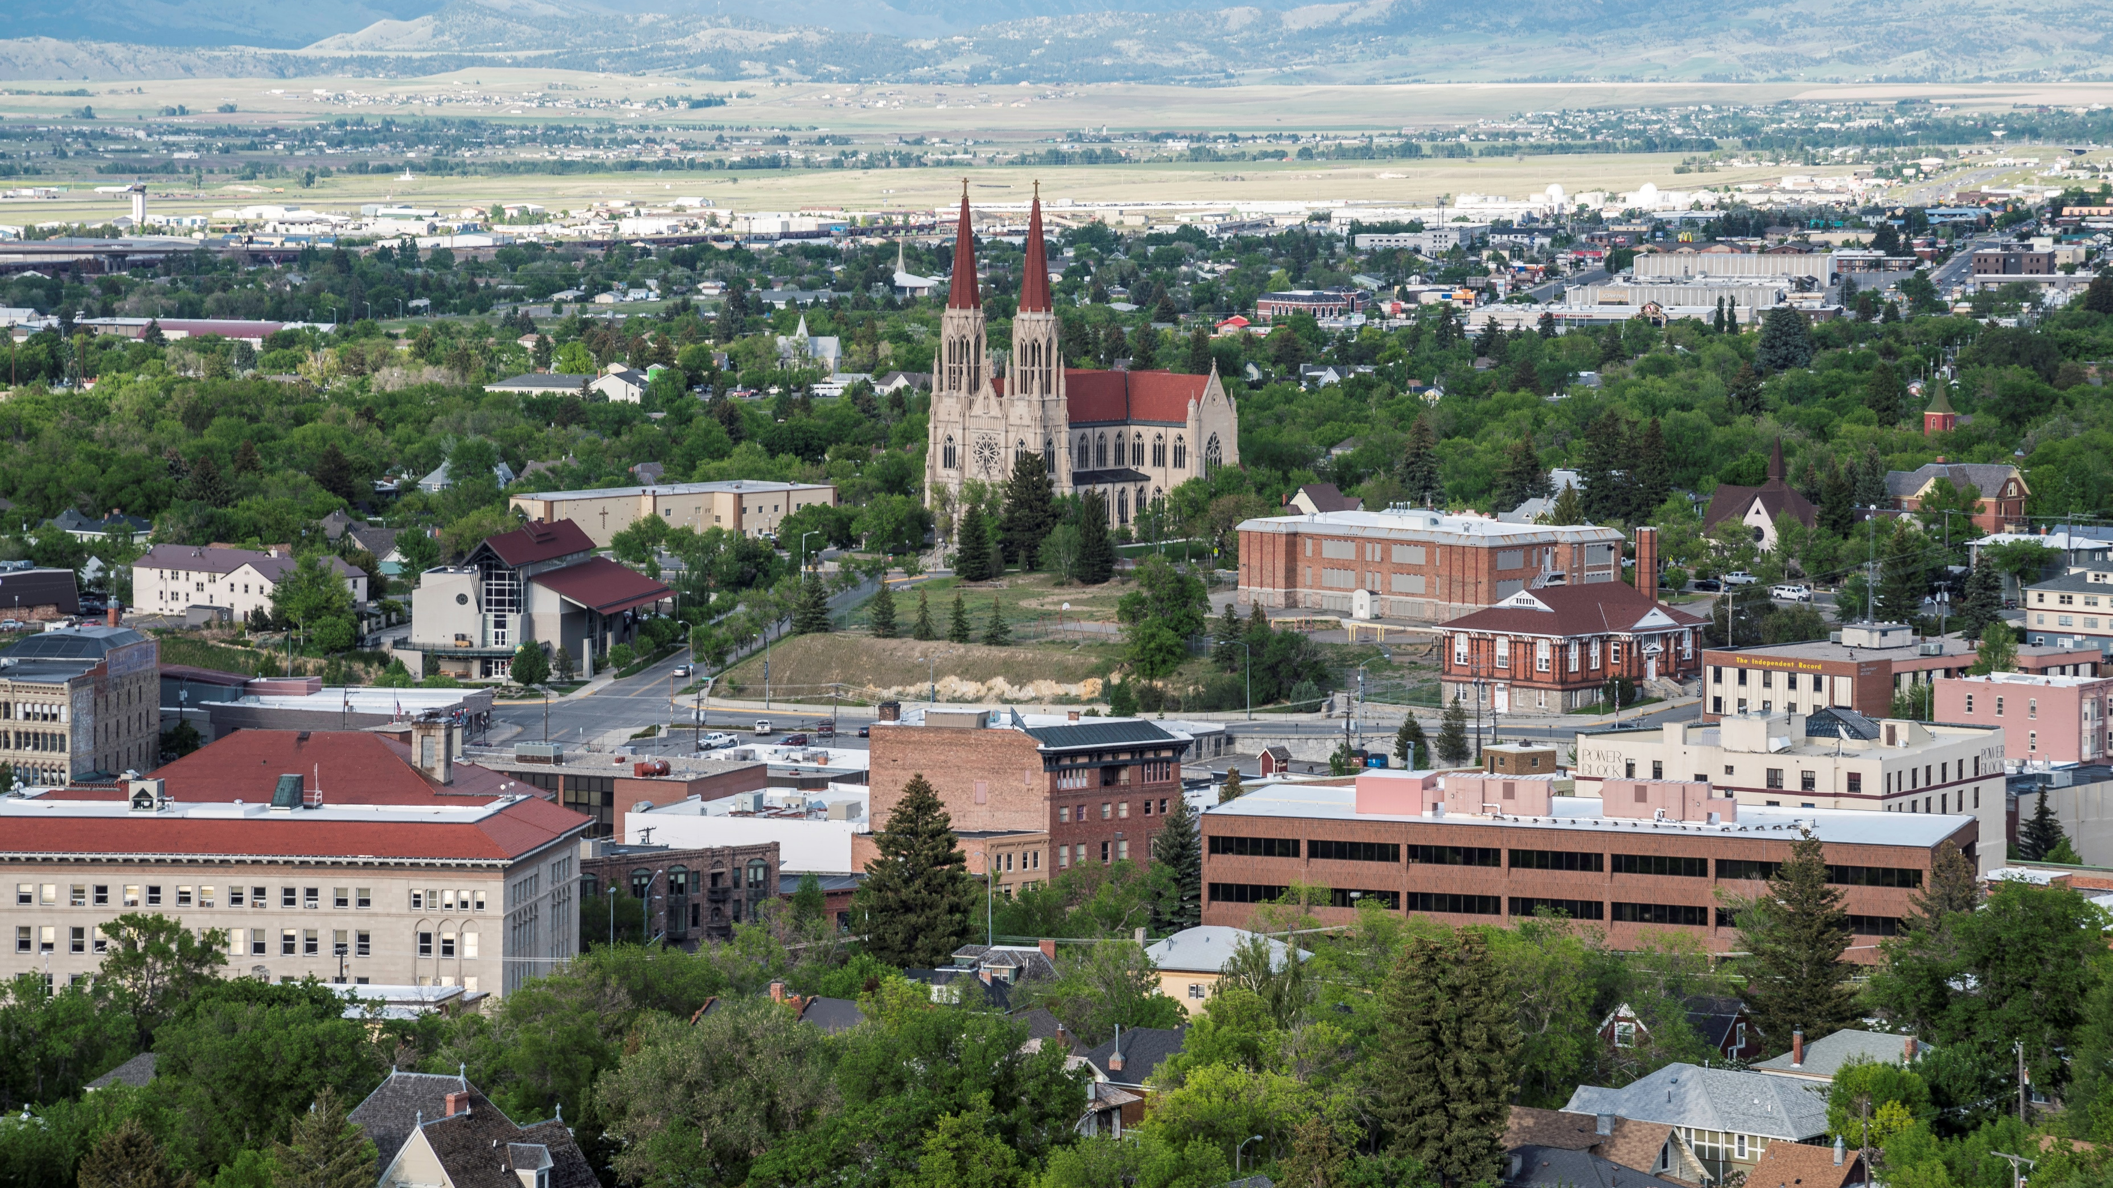
OAC Extension
Our Local Climate

Slide 2
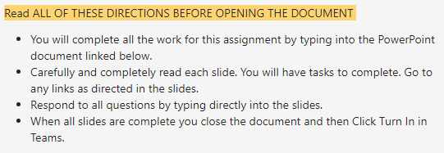
Bell Ringer
Go to Teams and find the assignment "Our Local Climate.
Open the assignment and read the instructions in the Teams assignment.

Slide 3
Agenda
Bell Ringer: Assignment Directions
Complete PowerPoint slides in Teams assignment

Slide 4
Learning Target
I can interpret data to explain the factors that determine the climate of Helena, Montana.​

Slide 5
Warm Up – OAC Extension
Visit the Weather Mapping website Ventusky linked HERE (You have to hold down the CRTL key to click the link)
Search for Location → Helena, MT
Play around with the site, find as many details as you can about our current weather conditions in Helena, MT.
Zoom in and out to get perspective on the whole world.
What does this make you think or wonder?
Answer:
Notes:
https://www.ventusky.com/

Slide 6
Stop and Jot
What factors do you think most affect Helena’s climate? Explain why
Answer:

Slide 7
Factors That Affect Climate
Read this!
Latitude (distance from the equator)
Proximity (closeness) to water
Elevation (how high above sea level)

Slide 8
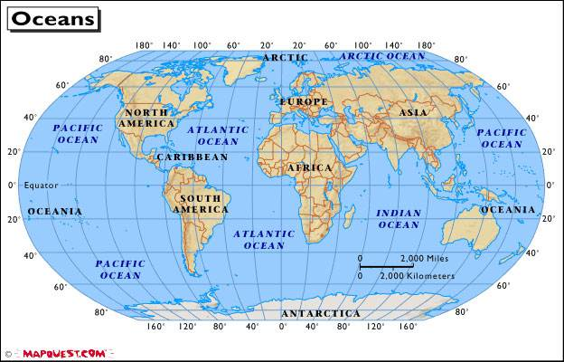
Climate – Latitude
Helena’s latitude is 46.58 degrees North of the equator.
How do you think Helena’s latitude affects its temperature?
Answer:

Slide 9
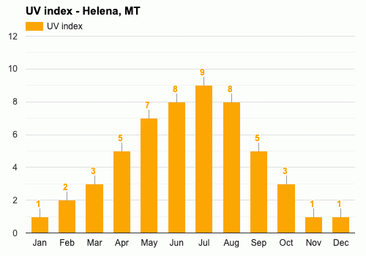
Climate – Energy from the Sun
UV Index is a measurement of ultraviolet radiation energy from the Sun
1) What do you observe about UV index in Helena?
Answer:
2) What do you think causes the UV index to change in this pattern?
Answer:

Slide 10
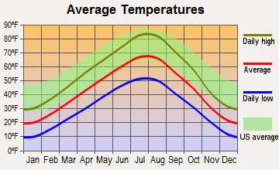
Climate - Temperature
1) Describe the trend of temperature throughout the year in Helena?
Answer:
2) How does the average temperature of Helena compare to the US average?
Answer:

Slide 11
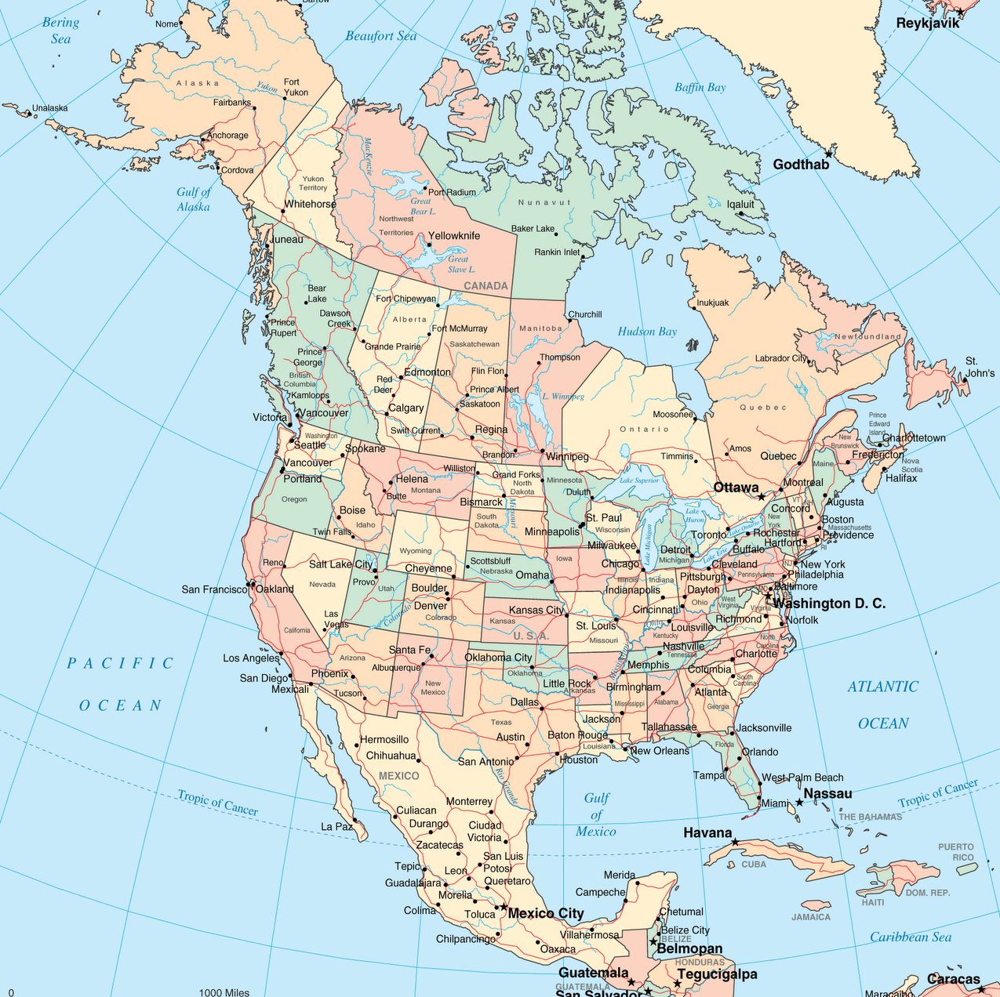
Climate – Distance from Water
Being close to an ocean makes a location have higher precipitation and more moderate (not extreme) temperatures.
How do you think Helena’s distance from an ocean affects our climate?
Answer:

Slide 12
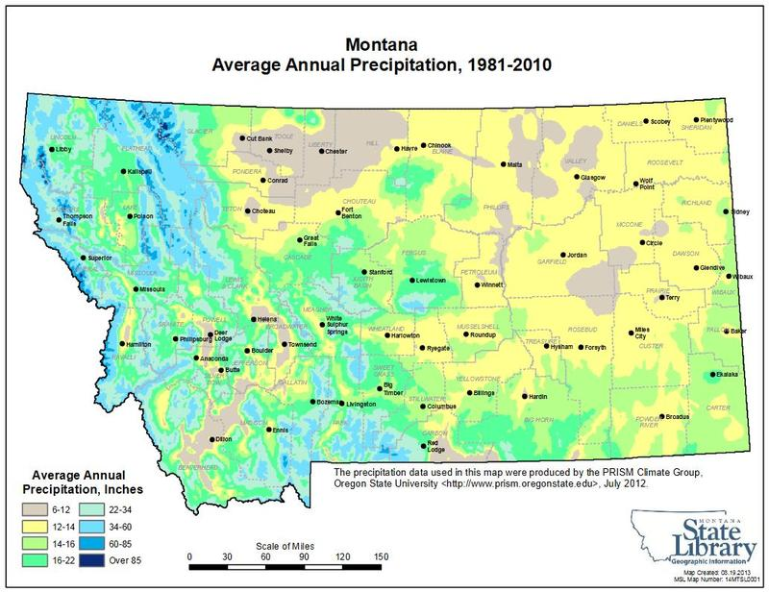
Climate -Precipitation
What do you notice about average annual precipitation in Montana? In Helena?
Answer:

Slide 13
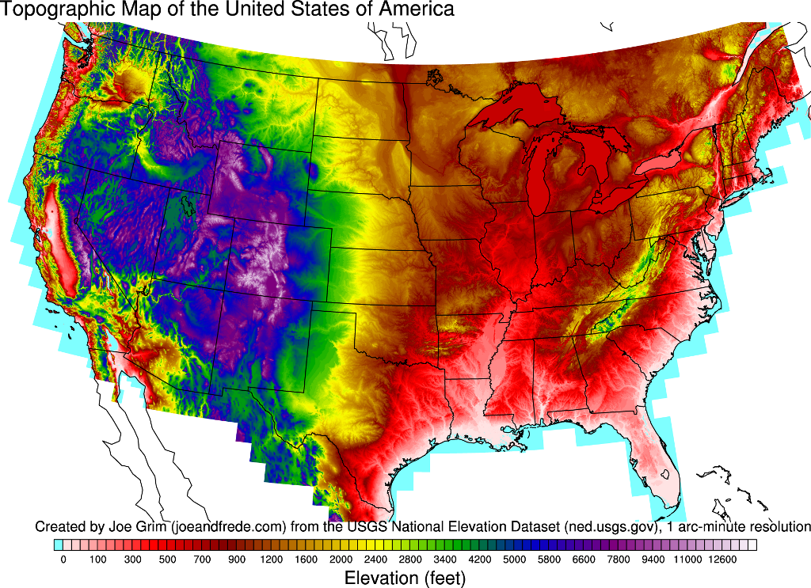
Climate - Elevation
1. How does the elevation of Montana compare to other parts of the United States?
Answer:
2. How do you think elevation affects climate? Are higher places hotter or warmer than cooler places?
Answer:

Slide 14
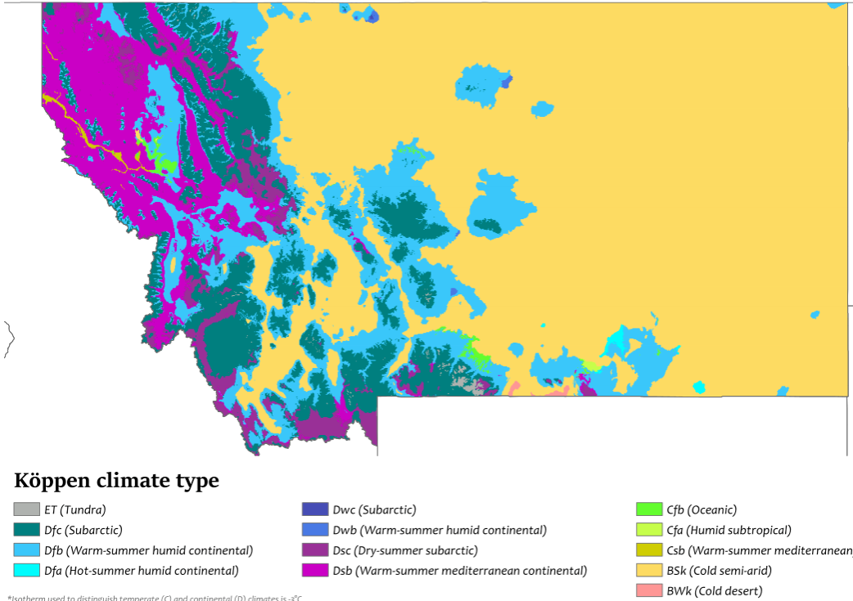
Climate Zone – Cold Semi-Arid
Read this!
Most of Helena is classified in the “Bsk” Cold semi-arid climate zone (yellow on the map), as it is on the “dry” side of the continental divide.
Other nearby areas are “Dfb” (warm-summer humid continental), which is blue on the map.

Slide 15
Climate Zone – Cold Semi-Arid
Read this!
Cold Semi-Arid is the second driest climate type, after deserts. They tend to be in elevated portions of temperate zones. They are typically found in continental interiors some distance from large bodies of water like oceans. Cold semi-arid climates usually feature warm to hot dry summers and cold winters. These areas usually see some snowfall during the winter, though snowfall is much lower than at locations at similar latitudes with more humid climates.
Areas featuring cold semi-arid climates tend to have higher elevations and tend to have major temperature swings between day and night, sometimes by as much as 20°C (36°F) or more in that time frame. Cold semi-arid climates at higher latitudes tend to have dry winters and wetter summers.

Slide 16
Explain: Why is our local climate the way it is?
Describe in detail what is Helena, Montana’s climate? Hint: cold semi-arid
Answer:
2) Why does Helena have this climate? (What factors affect it?) Explain in complete sentences and use evidence from the graphs and maps.
Answer:

Slide 17
Exit Ticket: Further Climate Exploration
Building construction in different climate zones
More detailed climate zones around the world
Climate affects agriculture: When to Plant Vegetables in Helena, MT
How Montana Tribes Rely on Tradition to Fight Climate Change
Choose one (or more) links to explore.
What does it make you think or wonder about climate? (here or around the world, and in the past, present or future.)
Answer:

