Slide 1
OAC Lesson 2.5
Critical Juncture

Slide 2
Bell Ringer Lesson 2.5
Get your science notebook.
Read through your key concepts and vocabulary.
Think: What affects air temperature of a location?

Slide 3
Learning Target
I can use the key concepts and vocabulary to answer multiple choice questions about the ocean, atmosphere and climate.

Slide 4
Agenda
Bell Ringer
Exit Ticket - Missing Work and/or Chapter 1 Assessment Revisions
Review Assessment Strategies
Critical Juncture

Slide 5
Review Assessment Strategies
How can I be more successful?

Slide 6
Ocean, Atmosphere, and Climate: Lesson 2.5
Activity 1
Next, you’ll complete an assessment that will show what you’ve learned so far in the Ocean, Atmosphere, and Climate unit.
Some of the questions will be about things you haven’t learned yet, so just try your best by using the following strategies:

Slide 7
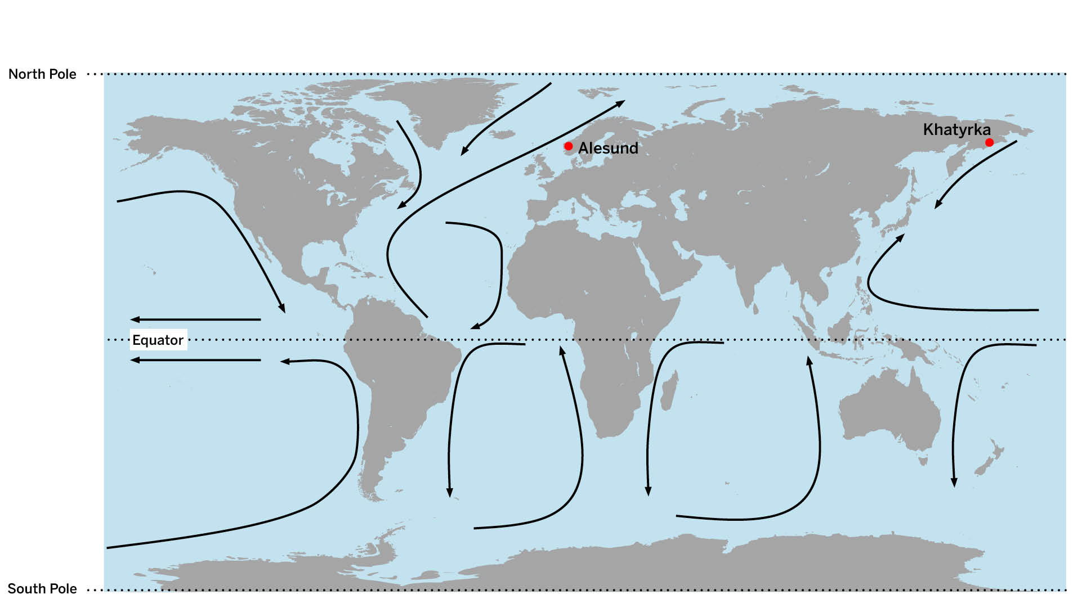
Analyze the image with each question.
What do you notice about the latitude of these two cities?
What do you notice about the ocean current going by each city?

Slide 8
Carefully read the text of the question
What are the two parts to this question?
Alesund and Khatyrka are the same distance from the equator and they are both near the ocean. Use the information on the map to answer these questions: How does the air temperature of Alesund compare to the air temperature of Khatyrka? Why? The air at Alesund is

Slide 9
Identify differences in each answer choice
A | the same as Khatyrka. Even though the ocean water at each location is a different temperature, the same amount of energy is transferred to the air at both locations.
B | the same as Khatyrka. They are both near moving ocean water, so the same amount of energy is transferred to the air at both locations.
C | warmer than Khatyrka. At Alesund, energy is transferred from the ocean to the air. At Khatyrka, energy is transferred from the air to the ocean.
D | warmer than Khatyrka. At Alesund, a lot of energy is transferred from the ocean to the air. At Khatyrka, only a little energy is transferred from the ocean to the air.

Slide 10
Draw a picture of what the answer choice is saying. (Energy transfer diagram like SIM and modeling tools)
Check your notes. Can you find a key concept that confirms your answer choice?
SLOW DOWN. This is not a race, and you have to think and read carefully.

Slide 11
Critical Juncture- Lesson 2.5
Activity 1: 12 multiple choice questions (20 min.)
Pick to complete Activity 2 or 3. DO NOT DO BOTH.
Resources you can use:
Science Notebook
Unit Wall
Key Concepts
Vocabulary
Have narrator in Amplify read the questions to you!
Make sure to take your time.
Go to your notes to confirm choices. There may be some Chapter 3 questions so those may not be familiar yet.
Remember: click “hand in” after the last multiple-choice question.

Slide 12
Exit Ticket
Check your current science grade and assignment list for quarter 3.
Do you have any missing OAC assignments? If so, you need to work on them and send Mrs. Burke a chat message when you finish.
All missing OAC work is due by Friday, March 22nd. NO EXCEPTIONS!
Read quietly if you have extra time.

