Slide 1
PMEI Day 7
Composing Proposal Outlines
Notes:
Lesson purpose: for interns to create proposal outlines—listing multiple pieces of evidence for their optimal designs—which act as scaffolds as they write their Final Proposal in the following days
Please refer to this lesson’s Materials & Preparation section in the digital Teacher’s Guide or the print Teacher’s Guide for information about preparing to teach this lesson, including any applicable safety notes. Copy and paste the below URLs into your browser to access the resources used in this lesson.
Futura Workspace https://apps.learning.amplify.com/futuraworkspace
Futura Geohazards Engineer's Dossier https://ereader.learning.amplify.com/#/reader/865363e8-c5ac-49dd-ae44-d85914aff1ee
Printable Futura Geohazards Engineer’s Dossier https://assets-prdd.learning.amplify.com/damAssets/e33ace98-cb89-4c06-9ca8-371a284f43f4/477180fd-169c-43a4-8a56-d5b26107368f/Futura_Geohazards_Engineers_Dossier.pdf
Printable Proposal Rubric https://assets-prdd.learning.amplify.com/damAssets/d12212fb-55fa-4217-919f-21f9eff84e76/71e1e27c-4820-4030-8ac5-90d6d374ece1/SCI_Proposal_Rubric.pdf
Printable Proposal Outline form https://assets-prdd.learning.amplify.com/damAssets/9e800745-a4e1-4818-b985-086280080425/e538e637-8af3-4a52-8142-6ff1a51f191f/PMEI_Printable_Proposal_Outline_Form.pdf
Proposal Outline Feedback Reference https://assets-prdd.learning.amplify.com/damAssets/04943ef9-104b-4d58-a00d-14cedafef3c2/6585af27-1553-4c8c-b879-34ad1cfcfb8e/PMEI_Proposal_Outline_Feedback_Reference.pdf
Plate Motion Engineering Internship Engineering Notebook, pages 22–24 https://assets-prdd.learning.amplify.com/damAssets/f5ce865d-36cc-4552-97d3-cb0a1631dea6/c7a3d8b9-a7f1-4f76-9cc6-97f24e9db064/PMEI_Investigation_Notebook_Pages_22%E2%80%9324_NA18.pdf
Plate Motion Engineering Internship Multi-Language Glossary https://ereader.learning.amplify.com/#/reader/06c4a735-5a96-498c-95c6-61318222b014
Note: These materials are made available exclusively for use by students and teachers for whom the corresponding materials have been purchased or licensed from Amplify. Any alterations you make should only be shared within your own school or district. Any other distribution or reproduction of these materials is forbidden without written permission from Amplify.

Slide 2
Bell Ringer – Day 7
Read the Day 7 Daily Message on p. 22
Write Daily Message Notes

Slide 3
Learning Target
I can write a proposal outline that includes multiple pieces of evidence to support my design decisions.

Slide 4
Agenda
Daily Message
Proposal Outlines
Resources
Strategies
Writing
Exit Ticket

Slide 5
Plate Motion Engineering Internship: Day 7
Activity T
As Hana mentioned in her message, today you’ll begin working on proposals.
Proposals are similar in some ways to scientific arguments. Both use evidence and reasoning to support a claim. In an engineer’s proposal, the claim describes why a particular design is optimal.
Notes:
💬Suggested teacher talk:
You have written scientific arguments before, and your science experience may help you write an effective proposal. Engineering proposals use evidence to support the claim, just as in scientific arguments. To support your design choices and explain how the design addresses each of the criteria, you have several sources of evidence that show how your design is optimal.

Slide 6
Plate Motion Engineering Internship: Day 7
Activity T
The proposal is for a specific audience: your project director (Hana), and the World Ocean Administration.
As you write, keep your audience in mind.
Notes:
💬Suggested teacher talk:
Whenever you are trying to communicate scientific ideas, it is important to remember whom you are trying to convey this information to. The audience reading this proposal most likely understands less about tsunamis and warning systems than you do, and you are trying to convince them that your design is optimal. You’ll need to consider which types of evidence will be the most important to include.

Slide 7
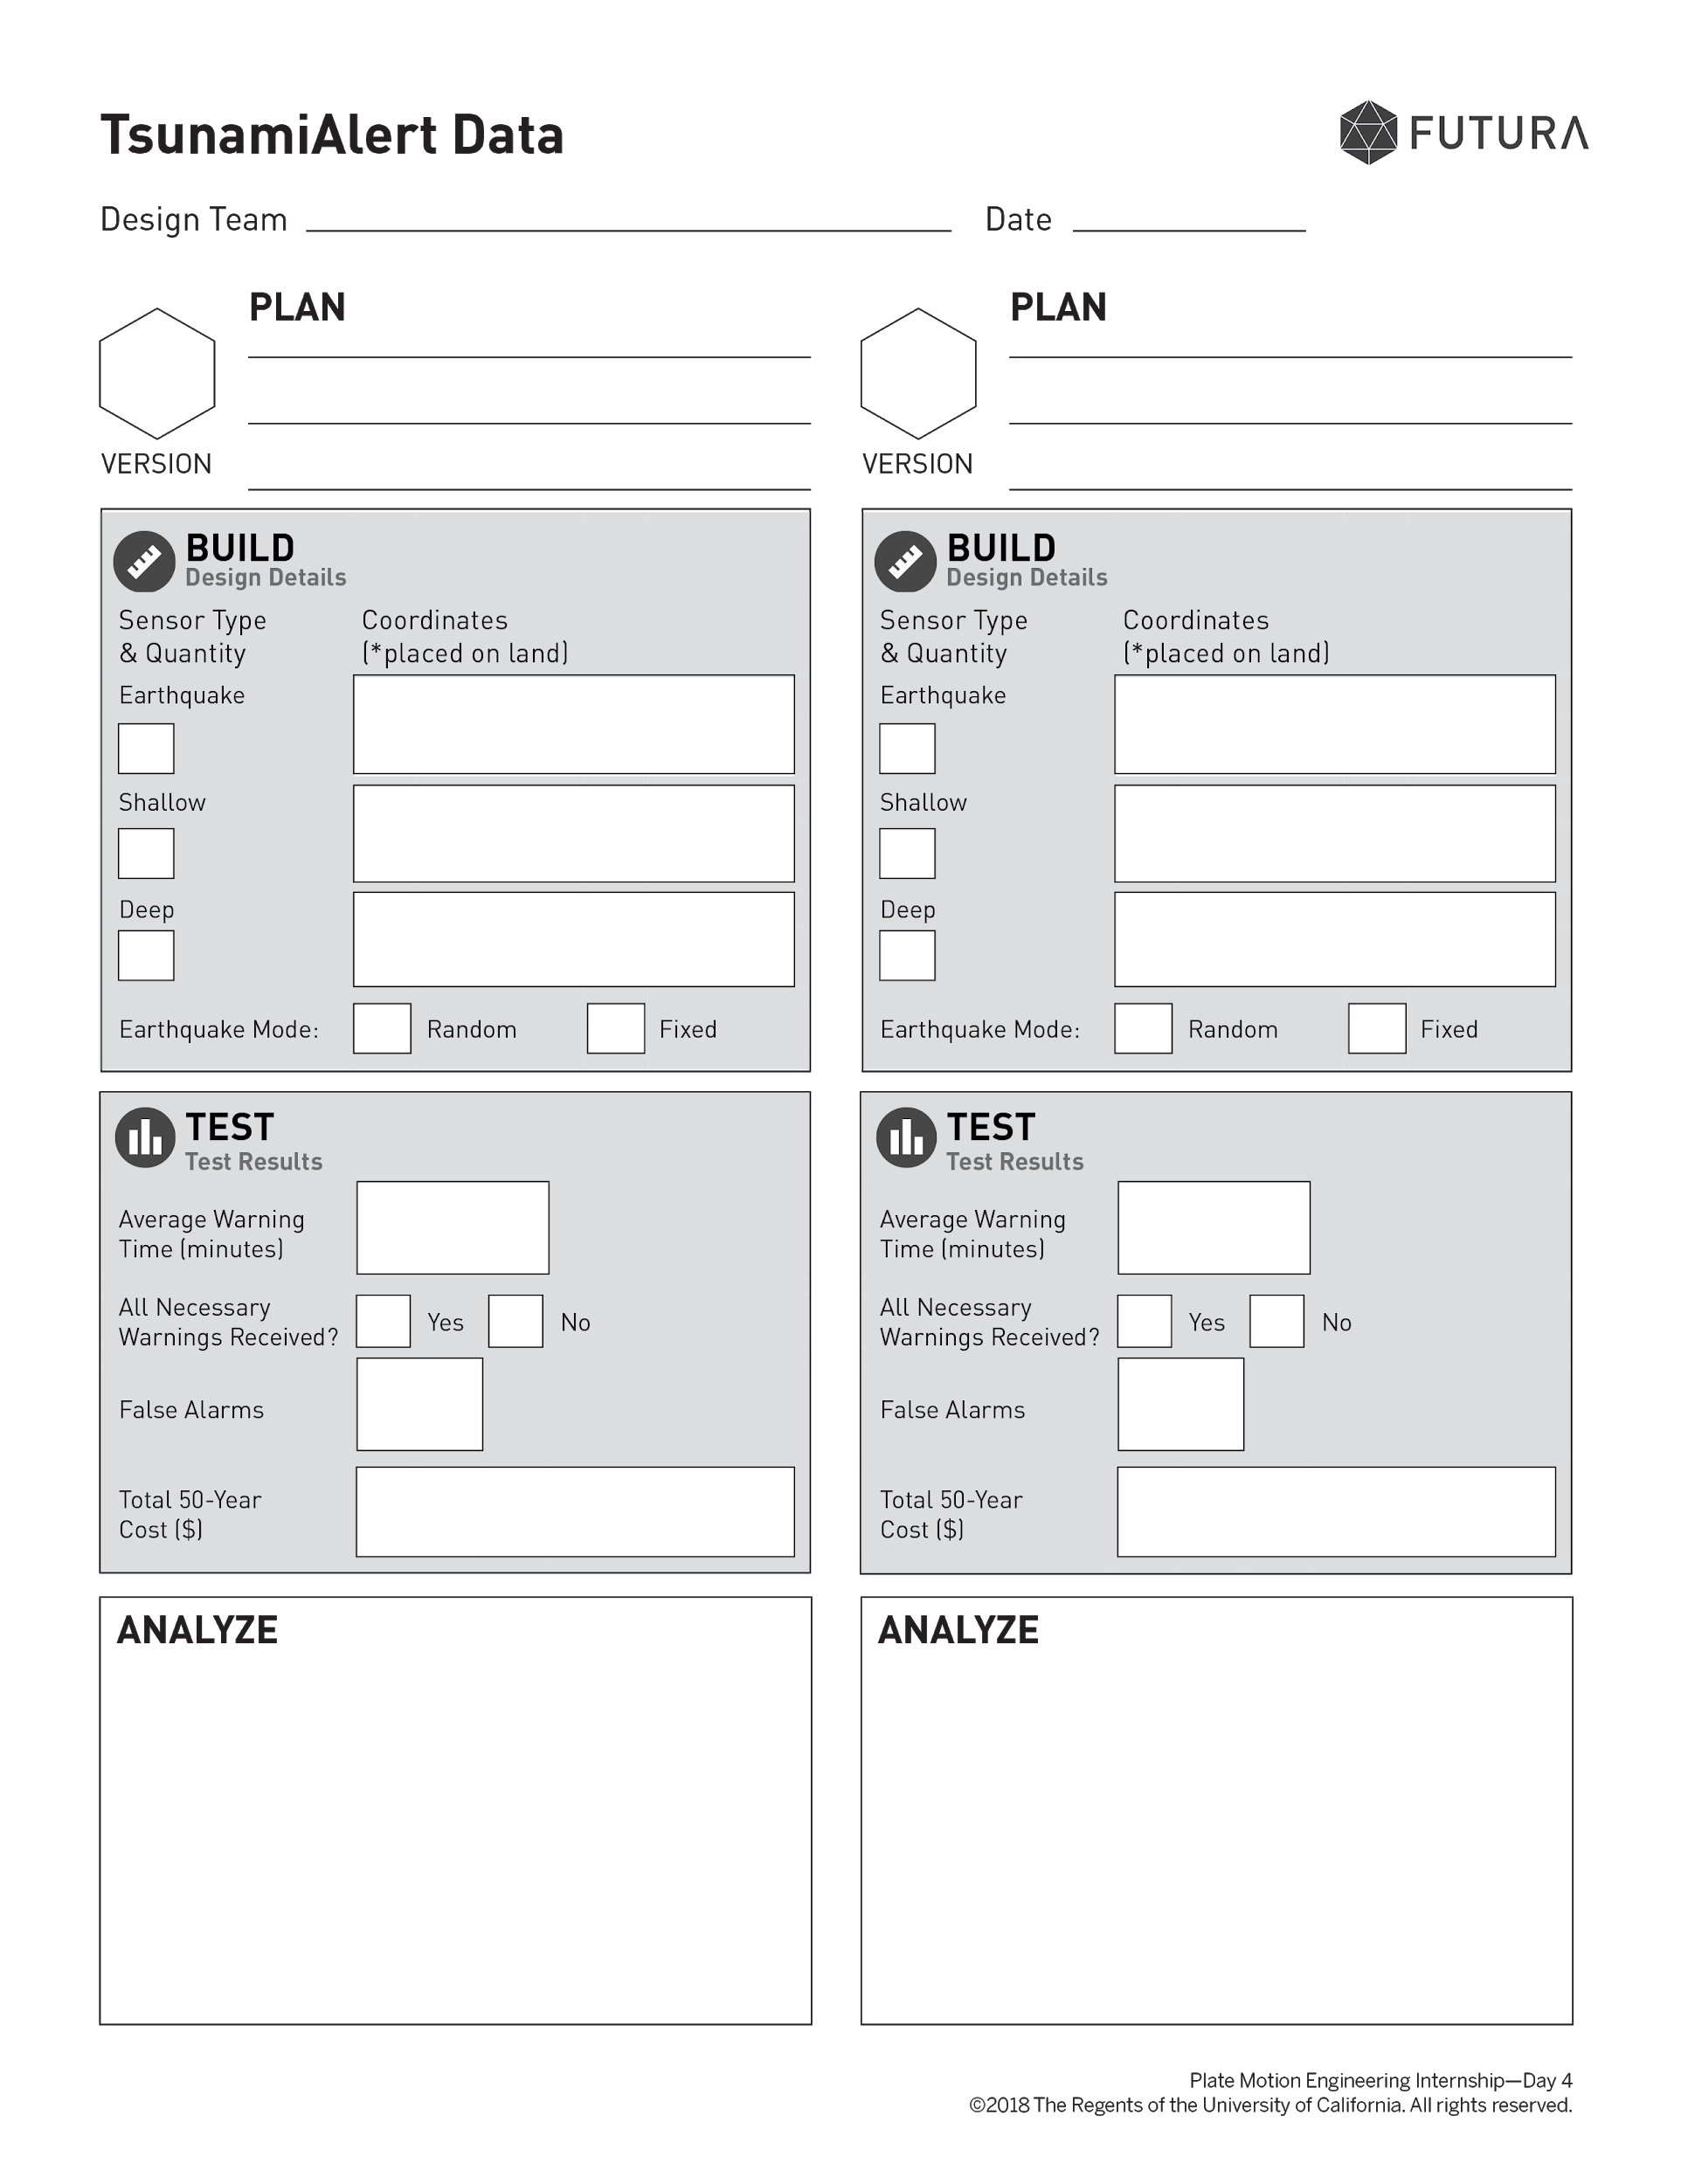
Plate Motion Engineering Internship: Day 7
Activity T
You’ll write your proposal using the final design you chose earlier.
Optimal
Locate the version you marked as “final” or “optimal” on your TsunamiAlert data sheets.
Notes:
👉Teacher action:
If necessary, assist interns in finding their optimal designs.
💬Suggested teacher talk:
This proposal is the argument where you will use your strongest evidence to support why the design is optimal.

Slide 8
Build – Design Details
Use the form on p. 23 to make your outline.
First, you’ll describe your optimal design, including the quantity of each type of sensor you used and the coordinates where you placed them.

Slide 9
Plate Motion Engineering Internship: Day 7
Activity T
The Design Decisions section is the most important part of the proposal. Today, we’ll focus on the design decisions and how they affect each of the project criteria.
Let’s look at a large version of the rubric for the Design Decisions section so we can review it together.

Slide 10
Notes:
👉Teacher action:
Briefly review what the "Excels" quality in the rubric means for the Design Decision sections.
💬Suggested teacher talk:
Today, you will gather multiple pieces of evidence to make a strong proposal.

Slide 11
Plate Motion Engineering Internship: Day 7
Activity T
The Proposal Rubric says that excellent proposals use multiple pieces of evidence to support the design decisions.
Let’s review some of the different types of evidence you can use to make a strong argument about why your design is optimal.

Slide 12
Design Decisions – Average Warning Time

Slide 13
Notes:
👉Teacher action:
Point out and review the different types of evidence described in the table as follows.
Final results: Say, “List the final test result of the optimal design for this criterion.”
Design goal: Say, “The design goal is the value that you set after the feedback on your first submitted designs, and may be specific or a range. You should refer to your Design Feedback Summary. Your optimal design may or may not meet the goals you set, as demonstrated in this example.”
Comparison to another design: Say, “You’ll analyze your data to identify another design that was stronger or weaker for this criterion. This is also an opportunity to mention trade-offs or give clues to why that design was strong for this criterion but rejected due to a different criterion.”
Background research: Say, “This is where you’ll show Hana that you understand how and why your design features address this criterion, using information from the Dossier or results from the isolated tests during the Research phase. We’ll go over background research in more detail in a few moments.”

Slide 14
Plate Motion Engineering Internship: Day 7
Activity T
Background Research is the part of the outline that Hana cares about most.
She’ll be looking for multiple pieces of strong evidence that are directly related to the criterion. For example, if you are writing about average warning time, make sure NOT to include evidence about false alarms or cost.

Slide 15
Plate Motion Engineering Internship: Day 7
Activity T
Let’s discuss what kind of information to include in the Background Research for average warning time.
Notes:
👉Teacher action:
If you are projecting onto a board, you can write notes in the Background Research section of the table as you discuss the following questions. Refer to the example Proposal Outline in Possible Responses for additional sample answers to the following questions.
💬Ask students:
What do you know about the earthquakes that cause tsunamis that reach Sri Lanka?
What does the Dossier tell you about how each sensor type affected warning time?
What did you learn about how sensor placement affected warning time when using TsunamiAlert?
🙋Students may respond:
Strong earthquakes of magnitude 8.0 or greater that come from convergent boundaries are most likely to cause ocean-wide tsunamis; Earthquakes along transform and divergent boundaries don’t usually cause tsunamis.
Earthquake and deep sensors can have a long warning time because they don’t have much delay; Shallow sensors give the shortest warning time because they have a long delay.
If sensors are not placed close to the earthquake that caused an ocean-wide tsunami, they won’t send a very long warning; You need to have enough sensors sending data for a warning, like 2 shallow, or 1 deep and 1 earthquake.

Slide 16
Plate Motion Engineering Internship: Day 7
Activity T
Your outline does not need to include everything you have learned, but it should have multiple pieces of evidence from the Dossier and TsunamiAlert research to demonstrate that you understand why the sensors you chose and the locations you selected produced these optimal results.
Notes:
👉Teacher action:
Address any questions about the Proposal Outline.

Slide 17
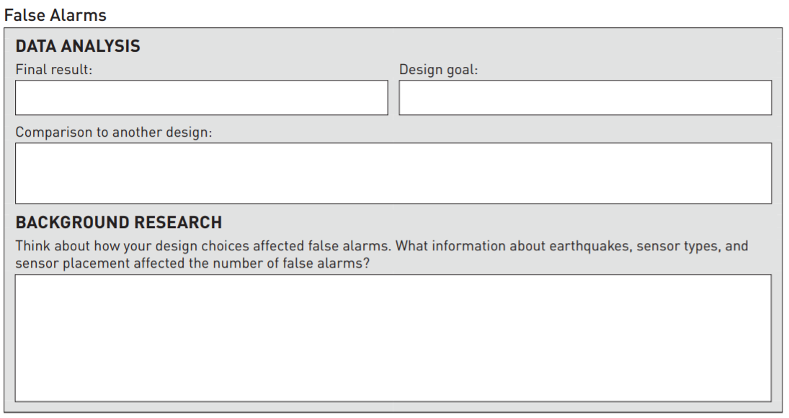
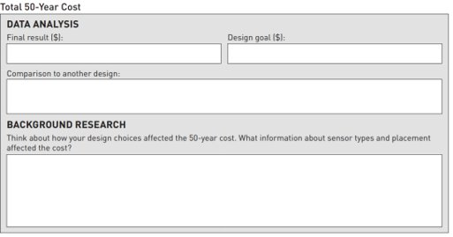
Finish Proposal Outline
Complete the sections for False Alarms and Total 50 Year Cost
Evidence Sources:
Dossier (chapters in the back of your booklet)
Data Sheet
Map on pg. 10
Sensor Analysis pg. 12
Design Feedback Summary pg. 19

Slide 18
Exit Ticket – Proposal Outline
The outline is due at the end of class on Monday, Dec 9.
What do you have left to complete?

Slide 19
Plate Motion Engineering Internship: Day 7

