Slide 1
Photosynthesis and Respiration
Log in to your CHS OneDrive account.
Create a new folder and name the folder Biology 1.
Create a new Word document and save it in your OneDrive account.
Name the file “Your Last Name”-Photosynthesis-Respiration
1. Answer both questions as stated. Highlight words or statements you agree with in you explanation write-up.
2. (5-6 complete, substantive, sentences for each topic)
3. Share this file with Mr. Tuss dtuss@helenaschools.org
Example:
Is it Food for Plants
Things plants use as food:
Plant food from a garden store
sugar
carbon dioxide
Fertilizer
Plants use a variety of things for food. Sugar is something that plants use as food because sugar is a carbohydrate and carbohydrates are made by plants. Another thing plants use as food is carbon dioxide …

Slide 2
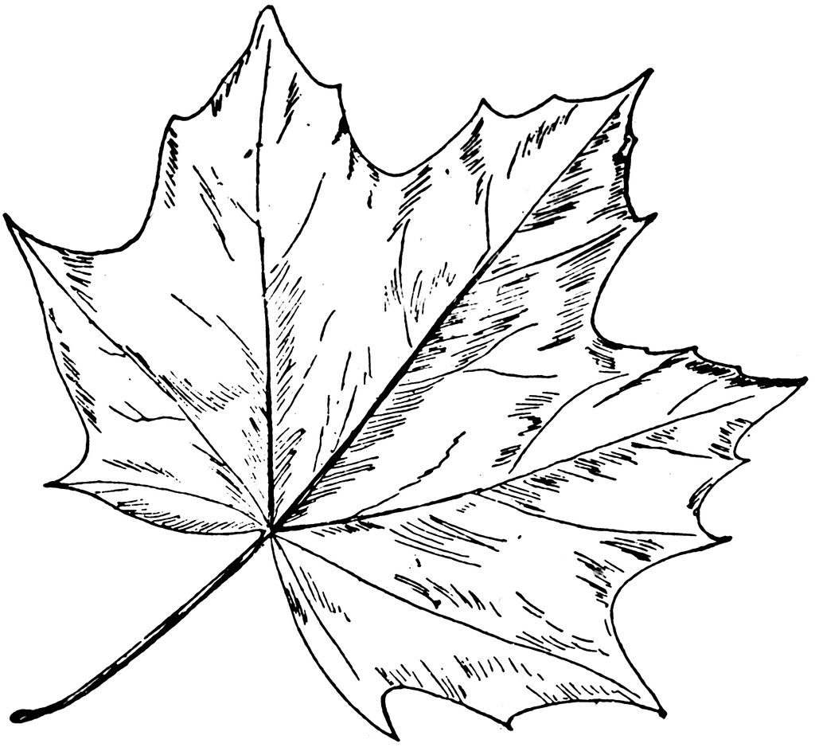
Is it food for Plants?
Organisms including plants need food to survive.
Write down the things you think plants use as food.
sunlight
plant food from a garden store
sugar
carbon dioxide
minerals
fertilizer
soil
water
leaves
oxygen
chlorophyll
Vitamins
Explain your thinking. How did you decide if something on the list is food for plants?
Cite at least two examples you picked and use complete sentences.

Slide 3
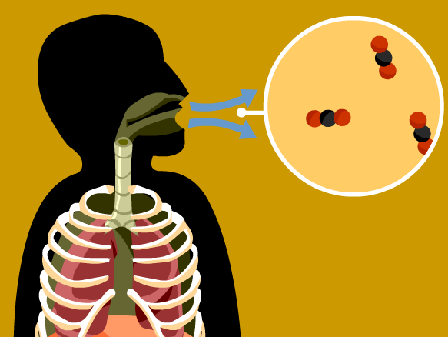
Respiration: Why does your body need oxygen?
Write down the statement or statements that you agree with.
Your body needs oxygen so that your heart can beat.
You need oxygen because it is a product of cell respiration.
You need oxygen because your body uses it in the combustion reaction of sugars.
Your tissues begin to die after they lose oxygen for a prolonged period.
It is better to breathe through your nose than your mouth.
Oxygen is needed in your bloodstream, so it (oxygen) can circulate through your body.
Some people do not need as much oxygen as others.
Explain your thinking. What rationale or knowledge are you using to agree with any of the statements?
Cite at least two examples you picked and use complete sentences.

