Slide 1
Plant Organ Lab

Slide 2
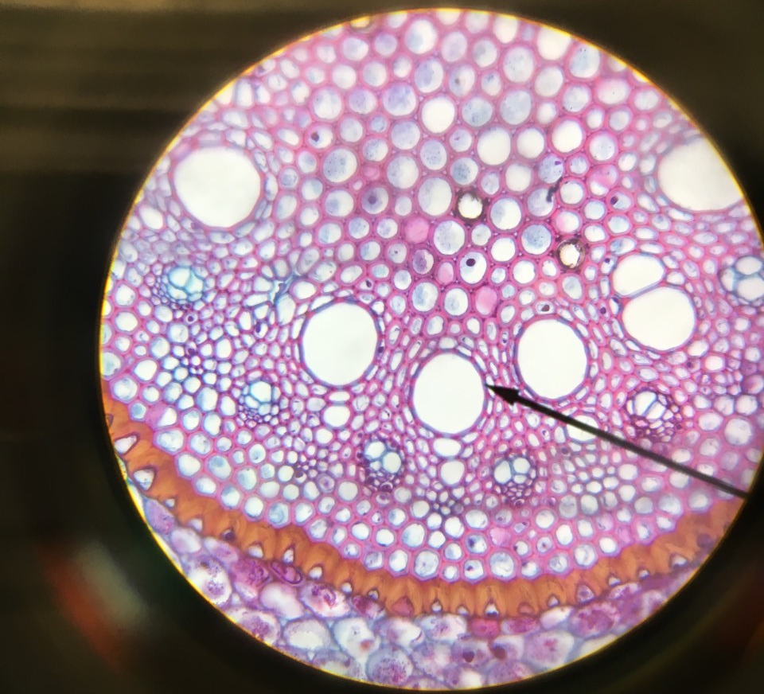
Monocot root Zoomed in

Slide 3
Dicot Root

Slide 4
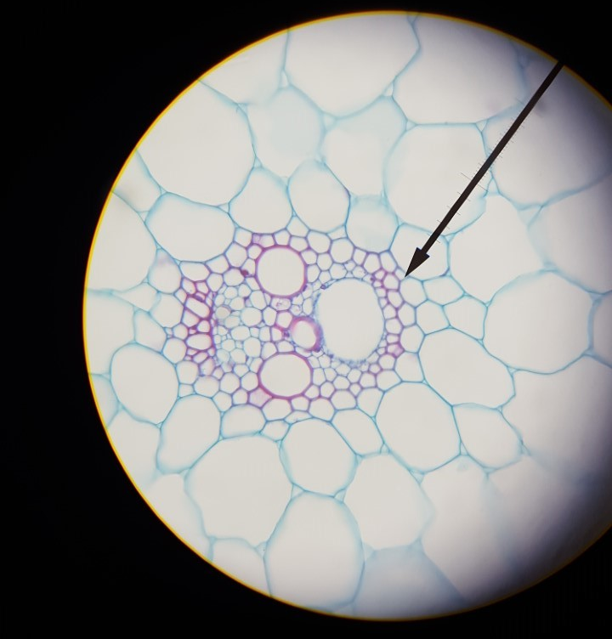
Monocot stem

Slide 5
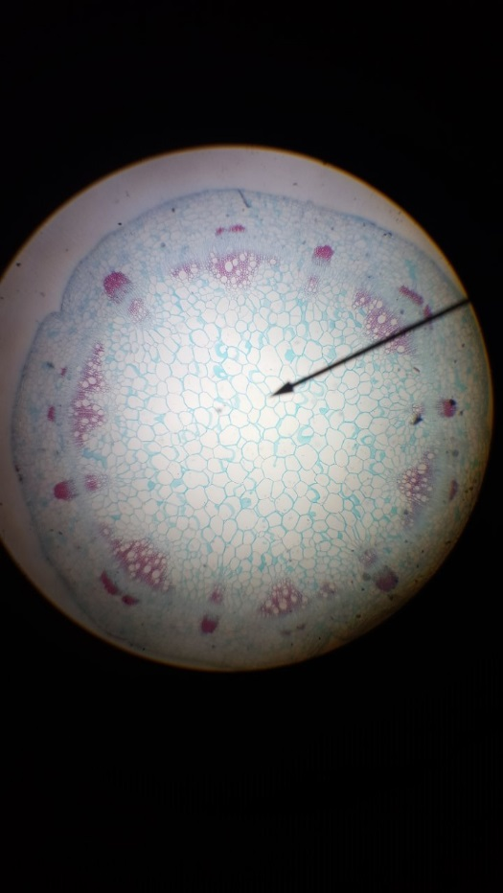
Dicot stem

Slide 6
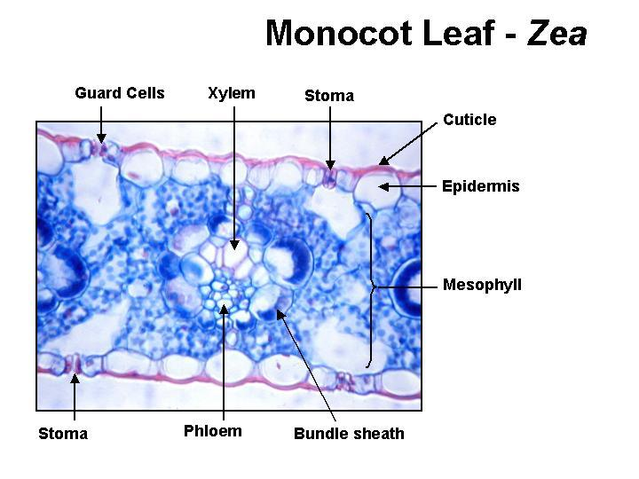
Monocot Leaf

Slide 7
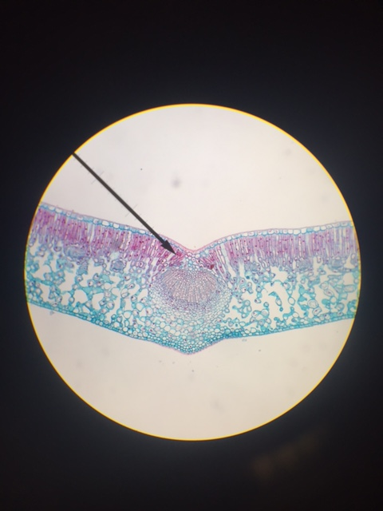
Dicot leaf

Slide 8
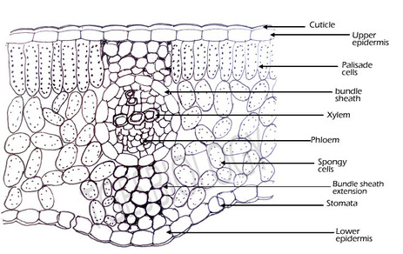
Dicot leaf

