Slide 1
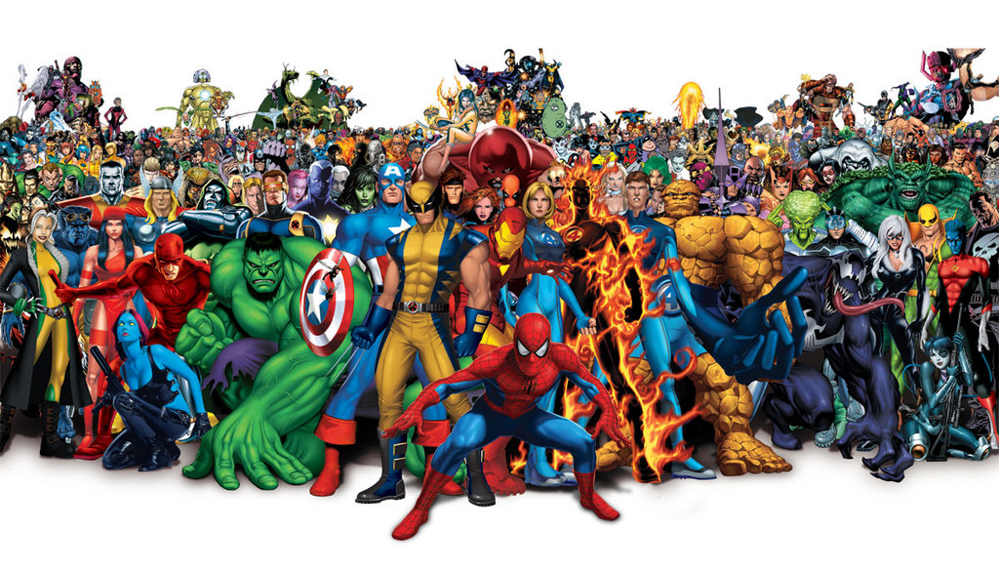
Proyecto de novela gráfica

Slide 2
Objetivo del proyecto: Tu objetivo es crear un superhéroe y un villano originales y contar su historia en una novela gráfica.

Slide 3
Pregunta esencial: ¿Cuáles son los rasgos de superhéroes y villanos?

Slide 4
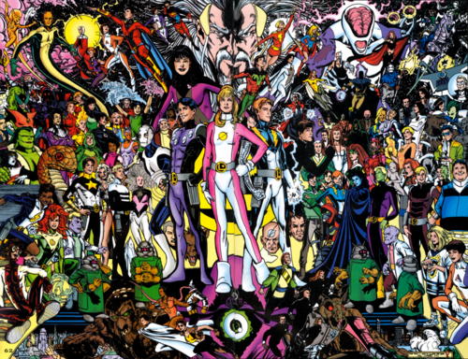
Think Pair Share
¿Qué es un superhéroe y qué características tienen muchos superhéroes?
¿Qué es un super villano y qué características tienen muchos Super villanos?
¿Cuáles son algunas pistas físicas que demuestran quién es el héroe y quién es el villano?
Nombra a algunos de tus superhéroes favoritos.

Slide 5
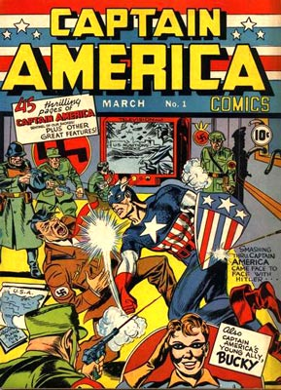
Pregunta esencial: ¿Por qué necesitamos superhéroes?
(Click link below)
http://abcnews.go.com/blogs/entertainment/2013/06/why-are-we-obsessed-with-superheroes/

Slide 6
Article Response Questions
Why do we enjoy super heroes? (3-5 lines)
What purpose did Superman serve?
How have super heroes changed over the years?
Identify a real world issue you want your super hero to address. Explain why you chose this issue.

Slide 7
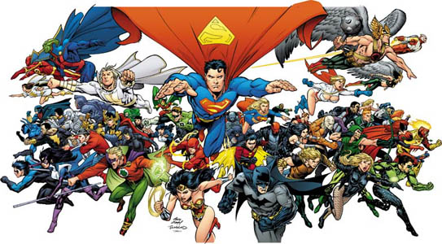
Crear un superhéroe
Escoge un problema del mundo real y crea un superhéroe motivado por ese tema. Una vez finalizado, ilustra tu personaje. ¡ Prepárate para compartir!

Slide 8
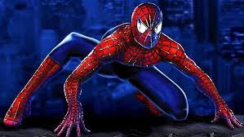
Pregunta esencial: ¿Quién es tu súper héroe? ¿y qué representa y defiende?
https://www.youtube.com/watch?v=4o29VoxtsFk

Slide 9
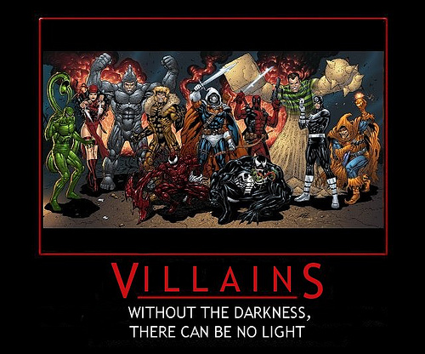
Crear un super villano
Crea un villano para tu héroe para combatir. Una vez terminado, ilustra este personaje.
¡ Prepárate para compartir!

Slide 10
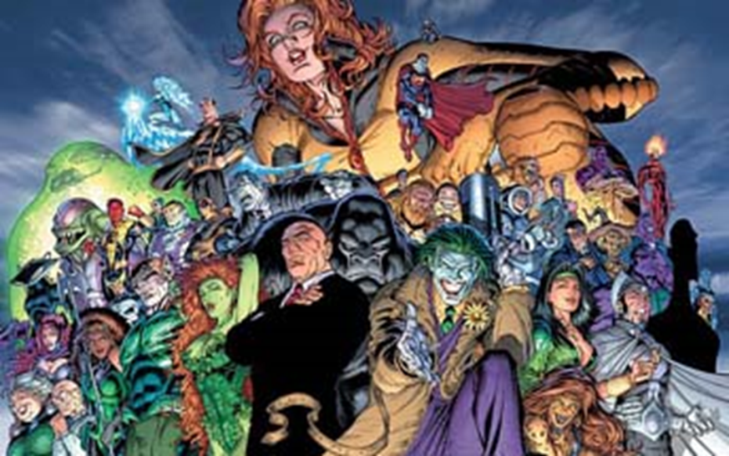
Pregunta esencial: ¿Quién es tu súper villano? ¿y qué representa y defiende?
Super-Villain Tribute:
https://www.youtube.com/watch?v=Oiq29WL_aSY
Super-Villain Origins: Killer Croc
http://www.youtube.com/watch?v=kqFc3oSVO00
Super-Villain Origins: Doctor Octopus
http://www.youtube.com/watch?v=7b896uTebGA

Slide 11
Pregunta esencial: ¿Cuáles son los eventos importantes en tu narrativa?
The first ever episode
of Superman:
http://www.youtube.com/watch?v=_frD6bGp63U

Slide 12
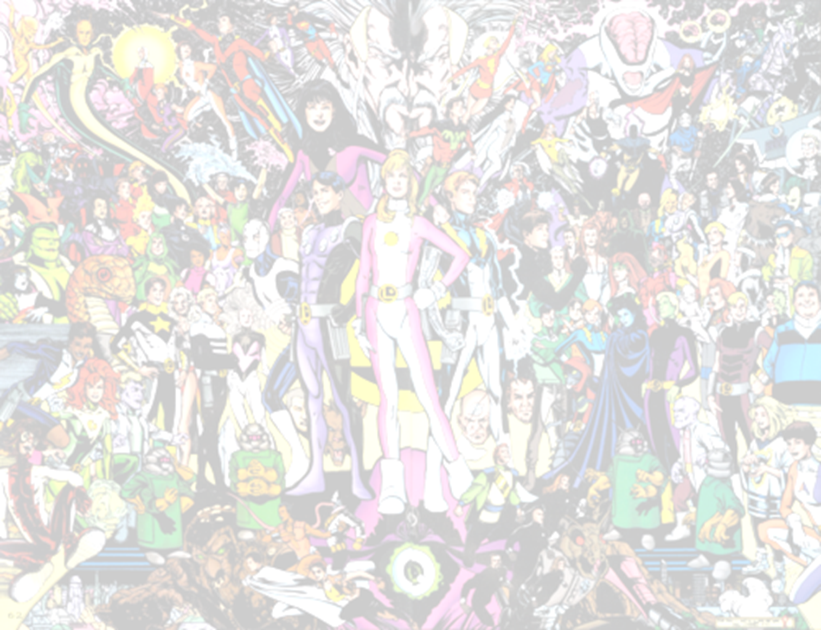
Storyboard
Origin: Where did the super hero come from and how did he acquire his powers?
Society: describe the society in which the super hero lives and the problems he combats.
Debut: give the super hero a chance to flex his or her super hero muscles.
Every super hero has a day job. Introduce the super hero’s alter ego.
Round 1: first encounter with super villain. Your hero may be tempted to kill the villain off, but he must either let the villain go or you can have the villain escape.
Super villain makes his evil plans which often include revenge. What are his plans for society and the super hero?
Round 2: villain’s attempt at revenge. What is your super hero’s vulnerability? How does he escape the clutches of the villain?
Round 3: climactic battle. How does the super hero thwart the villain’s evil plans and save the day?
Epilogue: What happens to the villain? What happens to society when the villain is neutralized? What happens to the super hero?

Slide 13
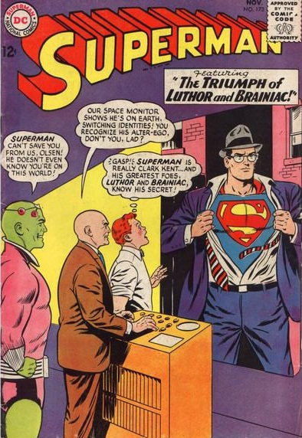
Use a combination of exposition and dialogue.

Slide 14
Elaboración!
Be sure to include a minimum of five well-developed sentences per page.

Slide 15
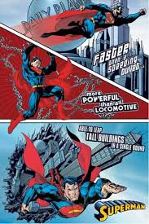
Use figurative language, especially onomatopoeia and hyperbole!

Slide 16
Daily Checklist: Completa con un amigo después de cada página.
Five well-developed sentences per page.
Word choice is varied and appropriate.
Event is clearly described through text and illustration.
Text and illustrations are neatly executed and creative.
Grammar, punctuation, and spelling are correct.

Slide 17
Tu novela Grafica
Page 1: Origin
Page 2: Society
Page 3: Super hero debut
Page 4: Super hero alter ego
Page 5: Round 1 with villain
Page 6: Villain’s evil plan
Page 7: Round 2
Page 8: Climactic battle
Page 9: Epilogue
Title Page: title, author, illustrator

