Slide 1

Introduction to Probability
Lesson 3.5
Recognize probabilities that are unlikely and likely.
Express probabilities as fractions, decimals and percents.

Slide 2

Vocabulary
Probability
The measure of how likely it is something will occur.
Good to Know!
The probability that something will occur can be written as a fraction, decimal or a percent.
⬥ When written as a percent, the probability something will occur is 0% to 100%.
⬥ When written as a fraction or a decimal, the probability something will occur is 0 to 1.
The more likely something will occur, the closer its probability is to 1. The less likely something will occur, the closer its probability is to 0.

Slide 3
Example 1
Determine whether each event is impossible, unlikely, equally
likely, likely or certain.
a. A card thrown on the floor lands face up.
  Equally likely. It can land face up or face down – one is not more likely than the other.
b. You roll a 2 on a regular number cube.
  Unlikely. There are 6 numbers on a number cube and 2 is only one of the numbers.
c. You are older now than when you were born.
  Certain. You are older now than when you were born.

Slide 4
Extra Example 1
Determine whether each event is impossible, unlikely, equally likely, likely or certain.
a. A card picked from a full deck is a king.
b. A coin lands on its side when it is flipped on a flat surface.
c. You roll a 3, 4 or 5 on a regular number cube.
unlikely
impossible
equally likely

Slide 5
Example 2
Dexter’s teacher said there was an 80% chance of getting
math homework this weekend. Write this probability as a
simplified fraction and a decimal.
As a fraction:
As a decimal:
An 80% chance of math homework is the same as a 0.8 chance of homework or a chance of homework.

Slide 6
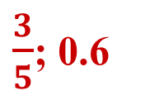
Extra Example 2
Simon’s coach said there was a 60% chance the team would run 3.5 miles at practice. Write this probability as a simplified fraction and a decimal.

Slide 7

Example 3
Felipe asked 50 students which type of movie they
most preferred. Forty percent chose action movies,
chose drama and 0.5 chose comedy. How many
of the students chose each type of movie?
Action movies: Find 40% of 50. 0.4 × 50 = 20 people
Drama movies: Find of 50.
Comedy movies: Find 0.5 of 50. 0.5 × 50 = 25 people
☑ 20 + 5 + 25 = 50. All 50 people are included.

Slide 8
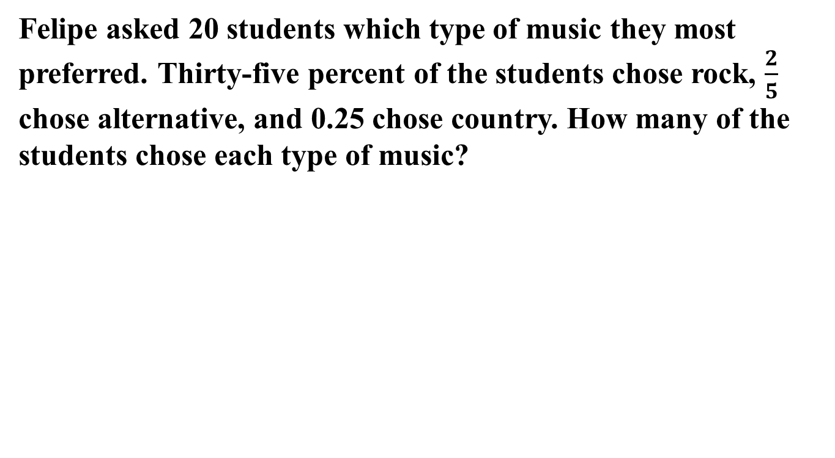
Extra Example 3
Rock: 7 students
Alternative: 8 students
Country: 5 students

Slide 9
Exit Problems
Determine whether each probability is impossible, unlikely, equally likely, likely or certain.
1. You roll a 1, 2, 3, 4 or 5 on a number cube.
2. You toss a coin and it lands “heads”.
3. You pick a blue sock out of a drawer
filled with white and black socks.
4. There is a 0.6 chance that Tabitha will choose the winning card. Write this probability as a percent and a simplified fraction.
likely
equally likely
impossible

