Slide 1

Geometric Probability
Lesson 3.8
Find the geometric probability of an event.

Slide 2
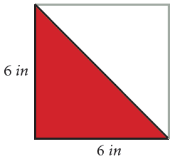
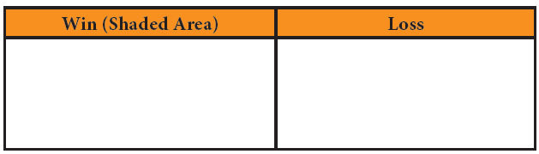
Explore! What Are My Chances of Winning?
Step 1 Draw a 6 inch by 6 inch square on a sheet of paper. Draw a diagonal line and shade one side as shown. This is the game board.
Step 2 What percent of the square is shaded? Write your answer as a fraction, decimal and a percent.
Step 3 Hold a bean above the center of the square game board. Drop the bean so it falls on the game board. If it does not fall on the game board, drop it again until it does. Only count trials when the bean lands on the square. Record whether or not it fell in the shaded area of the square. When the bean lands in the shaded area record a “win”. If it falls in the unshaded area record a “loss”. Drop the bean on the board at least 10 times.

Slide 3
Explore! What Are My Chances of Winning?
Step 4 Find the experimental probability that a bean will land in the shaded area.
Step 5 Find the theoretical probability a bean will land in the shaded area by answering these questions.
a. Find the area of the shaded region.
b. Find the area of the entire square.
c. Find the theoretical probability the bean lands in the shaded area. Write your answer as a fraction, decimal and percent.
Step 6 How do your answers in Step 2 and Step 5c compare? Explain your
reasoning.
Step 7 Create a game board that has a chance of winning. Explain how you know you have a 25% chance of winning.

Slide 4
Vocabulary
Geometric Probability
Ratios of lengths or areas used to find the likelihood of an event.

Slide 5
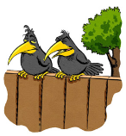

Example 1
William just finished painting 40 feet of fence along the side
of his house. He still has 50 feet left to paint. A bird landed
on the fence. What is the probability the bird landed on the
painted part of the fence?
Find the ratio of the painted length of fence to the total length of fence.
The painted length is 40 feet.
The unpainted length is 50 feet.
Find the entire length of the fence. 40 + 50 = 90 feet
Find the probability.
The probability the bird landed on the painted part of the fence is .

Slide 6

Extra Example 1
Mike just finished painting 20 feet of fence along the side of his house. He still has 40 feet left to paint. A bird landed on the fence. What is the probability the bird landed on the painted part of the fence?

Slide 7
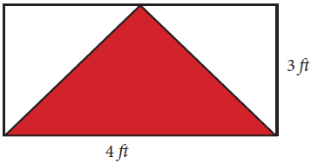
Example 2
What is the probability that a dart hitting the board below will land in the red triangle?
The base of the red triangle is 4 and its height is 3 (same as the rectangle).
Find the area of the red triangle. × 4 × 3 = 6 ft²
Find the area of the rectangle. 4 × 3 = 12 ft²

Slide 8
Example 2 Continued…
What is the probability that a dart hitting the board below will land in the red triangle?
Find the probability. P(dart lands in the red triangle)
The probability a dart will land in the red triangle is .

Slide 9
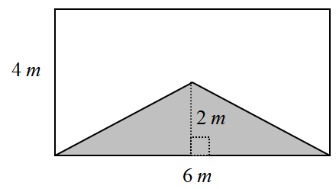
Exit Problems
Find the geometric probability a dart landing on the board will land in the shaded part.
Find the probability a dart landing on the board will not land in the shaded part.

