Slide 1

Three-Dimensional Figures
Lesson 3.1
Identify the names and qualities of three-dimensional figures.

Slide 2
Vocabulary
Solid
Three-dimensional figure that encloses a part of space.
Face
A flat surface or polygon that forms a solid. A polygon that is a side or base of a solid.
Polygon
A closed figure formed by three or more line segments.
Bases
A face of a solid usually located on the top or bottom of solid.

Slide 3
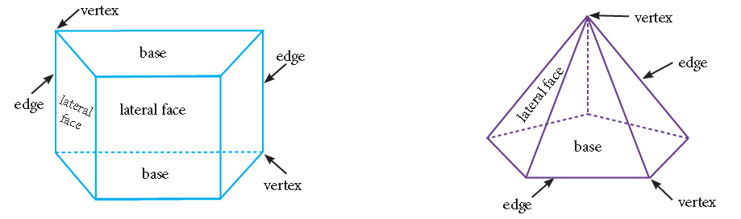
Vocabulary
Lateral Face
A side of a solid that is not a base.
Edge
A line segment where two faces meet.
Vertex
A point where three or more edges meet.

Slide 4
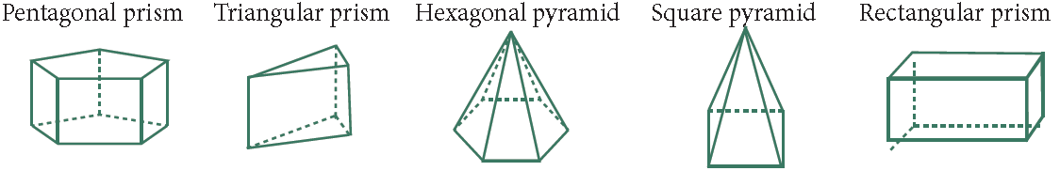
Naming a Prism or Pyramid
1. Describe the shape of the solid’s base(s).
♦ 3 sides = Triangular
♦ 4 sides = Square, Rectangular or Trapezoidal
♦ 5 sides = Pentagonal
♦ 6 sides = Hexagonal
♦ 7 sides = Heptagonal
♦ 8 sides = Octagonal
2. Describe the shape as either a prism or a pyramid.

Slide 5
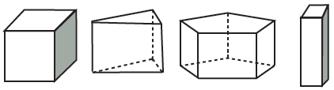
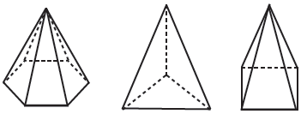
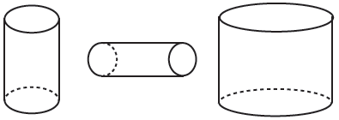
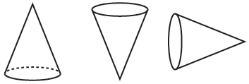
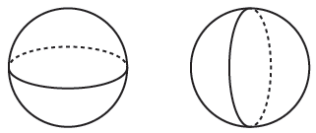
Name | Definition | Diagrams
Prism | A solid formed by two congruent, parallel bases and rectangular sides.
Pyramid | A solid with a polygonal base and triangular sides that meet at a vertex.
Cylinder | A solid formed by two congruent and parallel circular bases.
Cone | A solid formed by one circular base and a curved surface which connects the base and the vertex.
Sphere | A solid formed by a set of points in space that are the same distance from a center point.

Slide 6
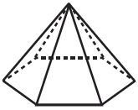



Example 1
Name the solid that best describes each picture.
a. b. c. d.
a. The bases are the polygons that are parallel to one another. The bases are triangles. The solid is called a triangular prism.
b. The solid has one base with six sides. It is a hexagonal pyramid.
c. The solid has parallel circular bases. It is a cylinder.
d. The prism has parallel bases that are squares or rectangles. It can be called a square prism or rectangular prism.

Slide 7
Extra Example 1
Name a solid that would represent each description.
a. A box for a pair of shoes
b. The Leaning Tower of Pisa
c. A funnel
d. A marble
rectangular prism
cylinder
cone
sphere

Slide 8
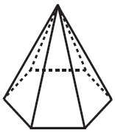
Example 2
Identify the number of faces, vertices, edges, bases
and lateral faces in the hexagonal pyramid.
Bases: The polygon at the bottom of the prism.
There is 1 base.
Lateral Faces: All polygonal sides that are not bases.
There are 6 lateral faces.
Edges: The line segments formed when two faces
meet. There are 12 edges.
Vertices: All corners where the edges meet.
There are 7 vertices.
Faces: All polygonal sides including the base
and all lateral faces. There are 7 faces.

Slide 9
Extra Example 2
Identify the number of faces, vertices, edges, bases and lateral faces in a triangular prism.
faces: 5
bases: 2
lateral faces: 3
edges: 9
vertices: 6

