Slide 1
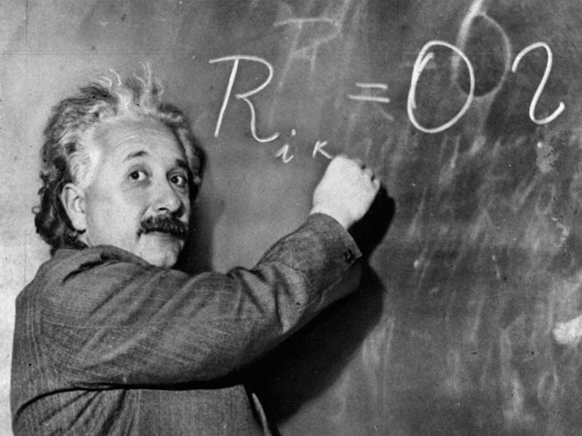
Nature of Science -
Scientific Thinking

Slide 2
Engaging in Argument from Evidence
- Observations are used to gather evidence ( factual data). Two types.
• Quantitative-descriptions that use numbers (ex. -2C, 200 ml)
• Qualitative – descriptions that do not use numbers (ex. color, odor, touch)
- Inference (Claim) is a conclusion made from evidence and reasoning.

Slide 3
Obtaining, Evaluating and Communicating Information
-Students need to
evaluate literature and properly cite using MLA.
write specific procedures and findings.
Present finding orally.

Slide 4
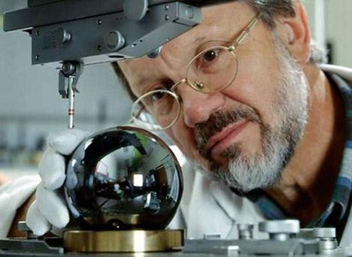
Asking question and Defining Problems
-What do you want to know or solve?

Slide 5
Constructing Explanation
- Form a hypothesis, which is a tentative explanation to solve the problem and can be tested.
• Written in If… then… format.
• Imagination and creativity

Slide 6
Planning and Carrying out Investigations
- Independent- variable that can be changed.
- Dependent- variable that changes in response to the independent variable.
- Controlled-all other variables kept consistent during experiment.

Slide 7
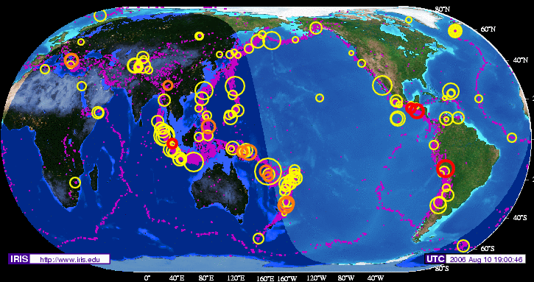
Analyzing and Interpreting Data -Data and observations are clearly recorded. Units/labels are included. Figure. Weekly Earthquake data, August 10, 2006.

Slide 8
Atmospheric carbon dioxide concentrations in Mauna Loa, Hawaii.
Year
Jan.
Feb.
March
April
May
June
July
Aug.
Sept.
Oct.
Nov.
Dec.
Annual
1958
-99.99
-99.99
315.71
317.45
317.5
-99.99
315.86
314.93
313.19
-99.99
313.34
314.67
-99.99
1959
315.58
316.47
316.65
317.71
318.29
318.16
316.55
314.8
313.84
313.34
314.81
315.59
315.98
1960
316.43
316.97
317.58
319.03
320.03
319.59
318.18
315.91
314.16
313.83
315
316.19
316.91
1961
316.89
317.7
318.54
319.48
320.58
319.78
318.58
316.79
314.99
315.31
316.1
317.01
317.65
1962
317.94
318.56
319.69
320.58
321.01
320.61
319.61
317.4
316.26
315.42
316.69
317.69
318.45
1963
318.74
319.08
319.86
321.39
322.24
321.47
319.74
317.77
316.21
315.99
317.07
318.36
318.99
1964
319.57
-99.99
-99.99
-99.99
322.23
321.89
320.44
318.7
316.7
316.87
317.68
318.71
-99.99
1965
319.44
320.44
320.89
322.13
322.16
321.87
321.21
318.87
317.81
317.3
318.87
319.42
320.03
1966
320.62
321.59
322.39
323.7
324.07
323.75
322.4
320.37
318.64
318.1
319.79
321.03
321.37

Slide 9
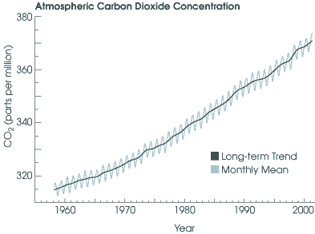
- Analysis/graph.
•Graphically display or use calculation to analyze data.

Slide 10
Constructing Explanations.
Conclusion
• Accept or reject your hypothesis? Why?
• Summarize essential data used to draw conclusions.
• Discuss possible experimental error.
• Questions are asked for next hypothesis.

