Slide 1
Stomata Lab Make-up

Slide 2
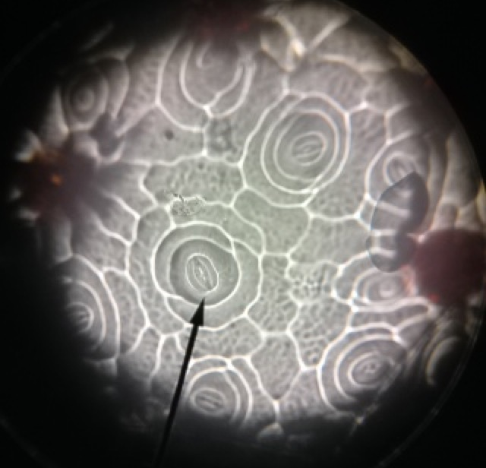
Lower epidermis (field one and two

Slide 3
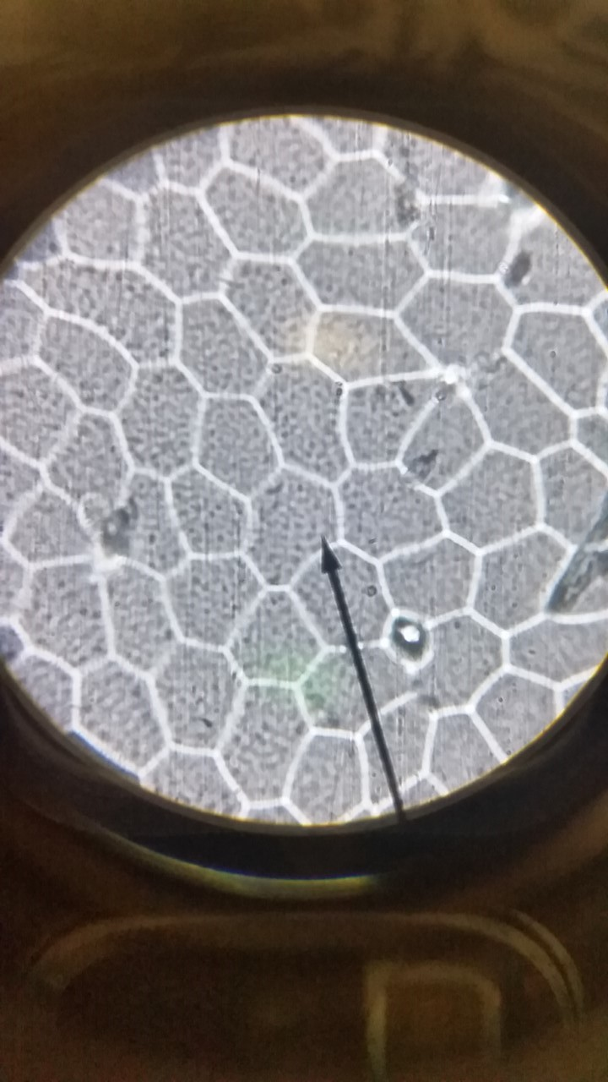
Upper epidermis

