Slide 1
Mrs. Grotbo
<
Physical Science
>
Welcome, science and engineering apprentices! I hope you are ready for a year filled with answering questions and solving problems in our world using the skills real scientists and engineers use every day! I am looking forward to mentoring you in all things STEM!
Room: 122 I Email: sgrotbo@helenaschools.org I Phone: 406-324-1042
Webpage: https://staff.helenaschools.org/staff_page/sgrotbo/
COURSE DESCRIPTION:
In this course, you will be studying energy, forces and motion, magnetism, electricity, gravity, phase changes, chemical reactions, light waves, and more. We use Amplify Science and other resources to guide our explorations and investigations into the wonders of the world. Our goal is that by the end of our time together you will be confident in investigating, designing, discussing, reading, writing, and visualizing like scientists and engineers.
GRADING:
Your work will be self-, peer-, and teacher-assessed to reflect your achievement of the MT State Science Standards. Your grade will be weighted as follows and utilize the district’s letter-grade scale as set in PowerSchool. Grades will be updated in PowerSchool weekly.
70% - End-of-Chapter and Unit Tests, Tasks, Explanations,
Arguments, Quizzes, and Proposals
30% - Classwork/Homework, Self-Assessment Surveys,
Critical Juncture (Mid-Unit) Assessments
CLASS RULES:
We follow the HMS BOB Universals: Be Safe, Be Responsible, Be Respectful, Be a Learner! (See Student Handbook) Due to the nature of our class, we also abide by safety expectations as set in our Science Safety Contract.
REWARDS & CONSEQUENCES:
Students will be honored for exemplary behavior and cooperation through whole class and whole team prizes - Ex. BOB Pawsitives, candy, homework passes, activity choice, etc.

Slide 2
Consequences: Violations of our school universals will require verbal warnings, lunch recess discussions of behavior and planning, phone calls to caregivers, full-lunch detentions (student may eat in my classroom), after-school detentions, and office referrals as needed.
Chrome Book Violations: Chromebooks are to be used as an educational tool only. No games, YouTube videos, etc., will be tolerated. Student will lose access to the Chromebook for the day and be required to work on paper ONLY. This may continue indefinitely if the student is struggling to use technology properly.
SUPPLIES NEEDED: ITEMS NOT ALLOWED:
Required Daily:
1” Three-Ring Binder
#2 Pencil
Optional (Great idea!):
Water Bottle
Colored Pencils
Highlighters – Pink, Green, Yellow
Food, gum, candy, and drinks are NOT allowed outside of the appropriate snack period in the morning. Medical accommodations will be followed.
TARDIES:
You need to be in your seat, working on the Bell Ringer, when the school bell rings. If you need to get something, use the restroom, etc., during passing time but are afraid you will be tardy, please visit with me at the door of the classroom, and we will figure something out! If you receive more than 2 tardies, a detention will be issued.
LEAVING THE CLASSROOM:
You need to gather appropriate supplies, fill water bottles/get a drink, go to the restroom during passing time. We abide by the 20/10 Rule in my class. There are no passes out of the classroom for the first 20 minutes of class and the last 10 minutes. BE HERE! BE A LEARNER!
HOMEWORK: ABSENT/LATE WORK:
This is a highly collaborative class. Therefore, most of the work we do is completed during the class period. If you are unable, to finish something in class, you are expected to finish it during Advisor time or at home.
Absent? You need to access our class agenda on TEAMS to see what you missed. You have two days to complete your work and turn it in. Oops? If you did not finish something on time, you have until the end of the unit (test day) to complete the assignment. Please complete the form on TEAMS to alert me you have finished. I grade Absent/Late work on Wednesdays ONLY.
NEED HELP?:
Please see me before school (7:45-8:00), after school (until 3:15 T-F), or during Advisor. You must get a pass from me ahead of time to come during Advisor period.

Slide 3
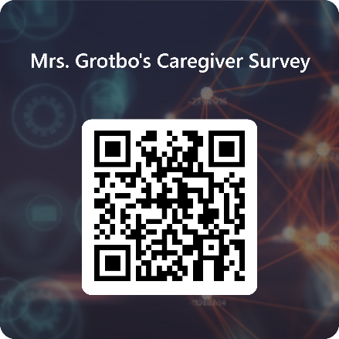
Mrs. Grotbo
Physical Science
<
>
Caregiver/Student Acknowledgement
Directions:
Read and discuss this document with your caregiver.
You and your caregiver need to each sign in the designated spot below, letting me know you completed the task in Step 1.
Detach and return THIS PAGE ONLY! Please have your caregiver keep the first two pages for reference.
Have your caregiver follow the QR Code below to complete a brief Caregiver Survey. Please let me know if a paper copy is needed instead of digital.
STUDENT:
Class Period: _______
Printed Name (first AND last): __________________________________________________________
Signature:_____________________________________________________________________________
CAREGIVER:
Printed Name (first AND last): __________________________________________________________
Signature:_____________________________________________________________________________

