Slide 1
AP Biology Biology in Focus
Chapter 1: Evolution and the Foundations of Biology
Chapter 2: Chemical Context of Life

Slide 2
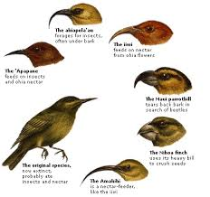
Unifying Themes in Biology
Evolution~ biology’s core theme; differential reproductive success
Emergent Properties~ biological organization, hierarchy of life
The Cell~ all organism’s basic structure
Heritable Information~ DNA
Structure & Function~ form and function
Environmental Interaction~ organisms are open systems
Regulation~ feedback mechanisms
Unity & Diversity~ universal genetic code
Scientific Inquiry~ observation; testing; repeatability
Science, Technology & Society~ functions of our world

Slide 3
Emergent Properties
Property that emerges from interactions that occur due to increasing organization.
With each step upward in the biological hierarchy, new properties emerge that were not present at the simpler organizational levels.
Life is difficult to define because it is associated with numerous emergent properties that reflect a hierarchy of structural organization.
But, with more emergent
properties organisms become
more complex. Like chlorophyll
and photosynthesis.

Slide 4
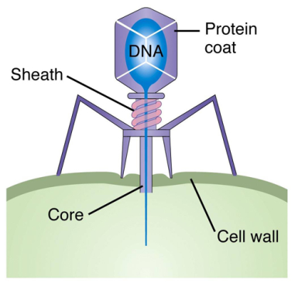
What is considered living?

Slide 5
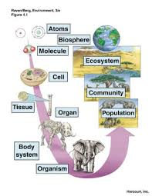
Levels of Organization
Reductionism-The approach of
reducing complex systems to
simpler components that are
more manageable to study.
Helpful in biology-Watson
and Crick inferred the chemical
basis of biological inheritance
with the study of DNA.
1

Slide 6
Systems Biology!!!
https://www.youtube.com/watch?v=jFBCBmK9E3U

Slide 7
The Three Domains of Life
Bacteria
Archaea
Eukarya
LUCA-Last Universal Common Ancestor

Slide 8
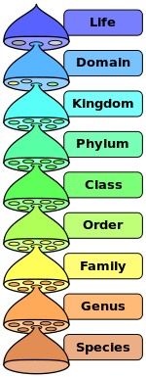
Taxonomy
Classification has changed from appearance to DNA
“Dumb King Phil Came Over From German Soil”

Slide 9
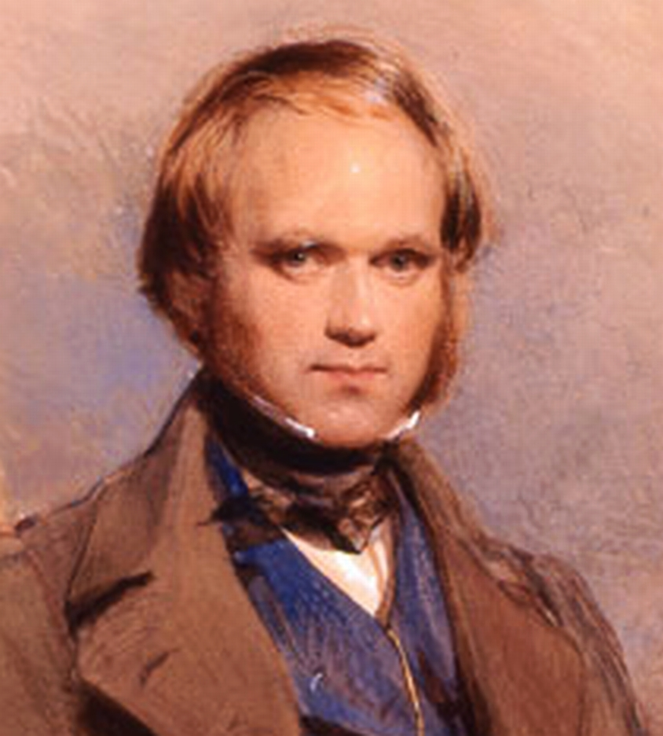
Charles Darwin
Natural Selection-Darwin inferred that individuals with inherited traits that are better suited to the local environment are more likely to survive and reproduce.
On the Origin of Species by Means of Natural Selection

Slide 10
Two Main Points
Species have arisen from a succession of ancestors that differed from them.
“Descent with modification”
Natural selection

Slide 11
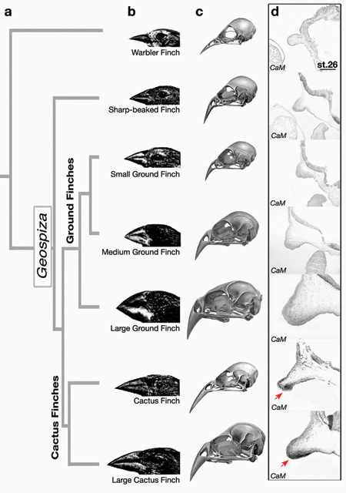
Tree Diagram

Slide 12
Any questions?
Now you finish the rest of the notes with what you already know! Good luck!!!

