Slide 1
CR Anderson Middle School
7th Grade Math
CONTACT INFO
Dr. Jilyn Chandler
CRA - Room 102
jchandler@helenaschools.org
Miss Bryana Curry
CRA - Mobile Room 1
bcurry@helenaschools.org
Ms. Jessicca Wischmeier
CRA – Room 103
jwischmeier@helenaschools.org
………………………………….……………………….……..
Course Description and Standards
This course advances mathematical excellence and deepens cultural
understanding, aligning with Montana’s dual commitment to academic
standards and Indian Education for All.
According to Montana’s Mathematics standards, students engage with four
major domains, while applying the Standards for Mathematical Practice.
Proportional Relationships
  Deepen understanding of ratios, rates, and proportional reasoning.
  Apply proportionality in complex problems including percent, discounts, taxes, interest, and tips.
Operations with Rational Numbers & Expressions
  Perform operations (add, subtract, multiply, divide) with rational numbers.
  Work with numeric and algebraic expressions and solve equations.
Geometry: Scale Drawings, Surface Area, and Volume
  Solve problems involving area, surface area, and volume for various shapes (triangles, polygons, prisms).
  Explore scale and similarity in two and three-dimensional contexts.
Statistics & Probability
  Analyze and compare data distributions.
  Engage in sampling, informal inference, and probability modeling.
Standards for Mathematical Practice prompt students to:
Make sense of problems and persevere in solving them
Reason abstractly and quantitatively
Construct viable arguments and critique the reasoning of others
Model with mathematics
Use appropriate tools strategically
Attend to precision
Look for and make use of structure
Look for and express regularity in repeated reasoning
Indian Education for All (IEFA)
Under Montana’s Constitution (Article X § 1(2)) and the law MCA 20-1-501, IEFA mandates that all students engage with the distinct cultural heritage of American Indians, and that educators incorporate these perspectives across Montana’s Essential Understandings guide this integration: recognizing tribal sovereignty, cultural diversity, oral traditions, and Indigenous worldviews.
In 7th Grade Math, we incorporate rich and engaging lessons for culturally grounded math experiences.
Examples of IEFA activities:
Contexts & Applications: Math problems that reference Indigenous environments, such as patterns in traditional beadwork, proportions in canoe design, scaling models of tipis, or data based on local tribal art.
Cultural Connections: Exploration of tribal mathematics, such as counting systems, geometric design elements, or spatial reasoning in traditional crafts.
Collaborative Projects: Partnering with our IEFA tutor or inviting guest speakers to share how mathematical understanding is embedded in Indigenous knowledge systems.
Required Materials & Textbooks
This year we are piloting Illustrative Mathematics (IM), a curricular recourse that is divided into 9 units. A detailed Scope, Sequence and Pacing Guide can be found on page three of this syllabi.
Unit 1: Scale Drawings Unit 6: Expressions, Equations, and Inequalities
Unit 2: Introducing Proportional Relationships Unit 7: Angles, Triangles, and Prisms
Unit 3: Measuring Circles Unit 8: Probability and Sampling
Unit 4: Proportions Unit 9: Putting it All Together
Unit 5: Rational Number Arithmetic
……………………….......
………..…………...

Slide 2
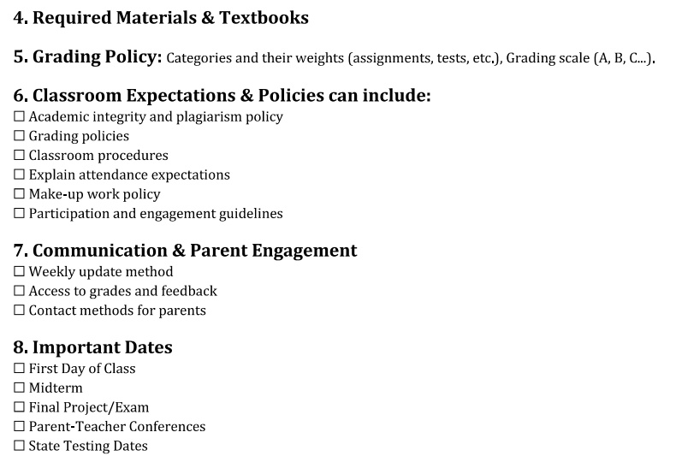
CR Anderson Middle School
7th Grade Math
CONTACT INFO
Dr. Jilyn Chandler
CRA - Room 102
jchandler@helenaschools.org
Miss Bryana Curry
CRA - Mobile Room 1
bcurry@helenaschools.org
Ms. Jessicca Wischmeier
CRA – Room 103
jwischmeier@helenaschools.org
…………………………………..……………...………..…..
Grading Policy
……………………….......
Assessments
(Weekly Quizzes and Unit Tests)
70%
Independent Work
(Worksheets and Activities)
Grading Scale
A = 90-100
B = 80-89
C = 70-79
D = 60-69
F = Below 60
………..…………...
30%
Students will be graded on assessments (weekly quizzes & end of the unit tests) and independent work (worksheets and class activities).
……………………………………………………………………………...……………..
Learning Goals & Objectives
By the end of the 7th Grade Math, students will be able to:
Master proportional reasoning and apply it across diverse real-world and culturally relevant scenarios.
Manipulate expressions, equations, and rational numbers with fluency and precision.
Analyze geometric problems, confidently calculate area, surface area, and volume, and understanding scale.
Interpret and model data, employ probability models, and make informed inferences.
Employ mathematical practices including making sense of problems, constructing arguments, modeling, reasoning quantitatively, using tools effectively, and seeking structure and patterns.
Articulate the connections between mathematics and Indigenous culture—demonstrating respect for and understanding of tribal knowledge, sovereignty, and identity as expressed through mathematical concepts.
Collaborate respectfully and thoughtfully with peers and tribal partners in constructing culturally responsive mathematical explorations.
……………………………………………………………………………...……………..
Classroom Expectations, Communication and Parent Engagement
Students are expected to stay up to date with what is being covered in class. When absent, students are expected to complete the Guided Practice (notes) and Independent Practice (worksheets) as outlined on the monthly calendar that is posted on their math teacher’s website.
Websites:
Dr. Jilyn Chandler https://staff.helenaschools.org/staff_page/jchandler/ | Miss Bryana Curry https://staff.helenaschools.org/staff_page/bcurry/ | Ms. Jessicca Wischmeier https://staff.helenaschools.org/staff_page/jwischmeier/

Slide 3
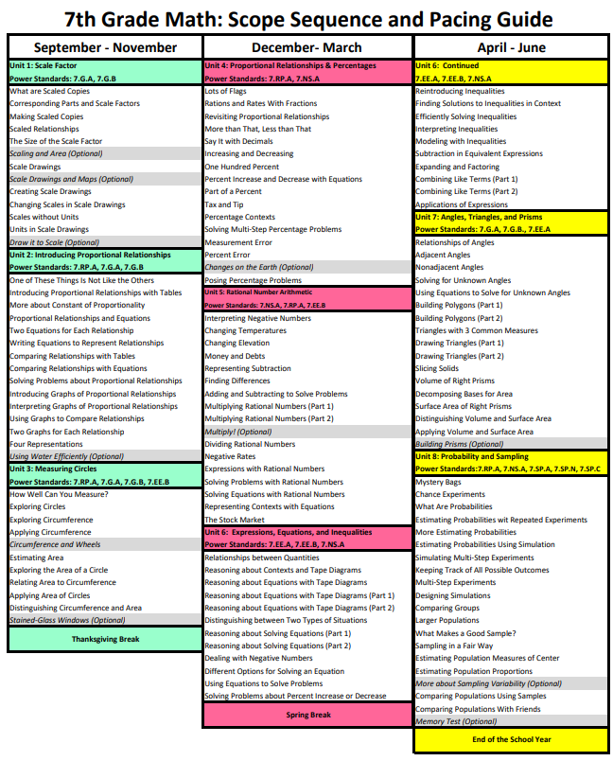

Slide 4
